Slide 1



Slide 2
Understanding Standards
National Progression Awards (NPAs) in Science
Lab reports, lab diaries
and pro formas

Slide 3
What this presentation covers
Science and Health at SCQF level 4
Science and Technology at SCQF level 4
Applied Sciences at SCQF level 5
Scientific Technologies at SCQF level 6
Laboratory Science at SCQF level 6

Slide 4
What this presentation covers
the difference between a lab report, lab diary and pro forma
key sections that should be included
ensuring pro formas are not too leading
arrangements for remediation
preparing checklists with all required criteria
necessity of marking schemes

Slide 5
Check the evidence requirements
Each of the practical units in the NPA will detail what assessed pieces of work the candidate needs to submit in the evidence requirements for the unit.
Ensure you check:
how many assessed practicals need to be completed
how many need to be written up as a full lab report
how many can be written up as a lab diary
or pro forma

Slide 6
Lab report vs. lab diary vs. pro forma
Section | Lab report | Lab diary
Date | ✓ | ✓
Title of practical | ✓ | ✓
Aim | ✓ | ✓
Background | ✓ | -
Apparatus | ✓ | -
Method | ✓ | -
Results | ✓ | ✓
Calculations | ✓ | ✓
Conclusion | ✓ | -
Evaluation | ✓ | -
Section | Lab report
Date | ✓
Title of practical | ✓
Aim | ✓
Background | ✓
Apparatus | ✓
Method | ✓
Results | ✓
Calculations | ✓
Conclusion | ✓
Evaluation | ✓
Section | Lab report | Lab diary | Pro forma
Date | ✓ | ✓ | ✓
Title of practical | ✓ | ✓ | ✓
Aim | ✓ | ✓ | ✓
Background | ✓ | - | -
Apparatus | ✓ | - | -
Method | ✓ | - | -
Results | ✓ | ✓ | ✓
Calculations | ✓ | ✓ | ✓
Conclusion | ✓ | - | -
Evaluation | ✓ | - | -
Note: These are the minimum requirements for lab diaries and
pro formas.
To build candidate skills, drawing conclusions and evaluating the experiment are encouraged.

Slide 7
Aim
A concise statement about what was trying to be achieved in the practical, for example:
To investigate the effect of substrate concentration on the rate of reaction of catalase enzyme.
To determine the Vitamin C concentration of fruit juice using titration.
To measure the wavelength of laser light using the phenomenon of diffraction.

Slide 8
Background
Should include:
the underpinning science of the experiment
any reaction equations
what specifically is being investigated in the practical

Slide 9
List of apparatus
This may be a separate list or can be subsumed in the method section of the report.
In either case, it should include:
The concentration, volume and mass of reagents used.
Relevant information about equipment, where necessary. For example, volumes of glassware, type of wire, etc.

Slide 10
Method
Must give full details of how the experiment was carried out.
It must be:
in past tense
impersonal
For example:
Hydrogen peroxide (3cm³, 6%) was added.
Not, next add hydrogen peroxide (3cm³, 6%).
Or, I added hydrogen peroxide (3cm³, 6%).

Slide 11
Results – raw data
The raw data – exactly as recorded from the experiment with no manipulations.
An appropriate number of significant figures (where relevant).
Units stated (where relevant).
In a lab report, candidates should generate appropriate table(s) to display data where relevant.
In a pro forma, tables can be provided with the
candidate required to add data.

Slide 12
Calculations
Can be all calculations or one exemplar calculation if the same calculation is repeated on each piece of data.
In general, average calculations do not have to be demonstrated.
Note: some units will require a particular complexity of calculation to be included in the unit, so practicals
which allow this will need to be included.

Slide 13
Results – graph
Often a graph will also be appropriate to display results. Where this is included, the candidate must:
Use the appropriate type of graph for the type of data recorded.
Include axis labels with units and a descriptive graph title.
Use appropriate scaling on both axes (the plotted area must take up more than half the scale on both axes).
See the Understanding Standards documentation available on the Understanding Standards website for further
guidance.

Slide 14
Discussion of results / conclusion
A conclusion is a concise statement that is linked to the aim, stating what was determined in the experiment.
For example:
Aim – To investigate the effect of substrate concentration on the rate of reaction of catalase enzyme.
Conclusion – As substrate concentration
increased, the rate of reaction of the catalase
enzyme increased.

Slide 15
Discussion of results / conclusion
In the report, prior to the conclusion, a discussion of the results section is often useful to ‘say what you see’ and show how the conclusion was drawn.
For example:
As the concentration of the substrate hydrogen peroxide increased, the volume of oxygen produced in the reaction increased thus showing an increased rate of
reaction.

Slide 16
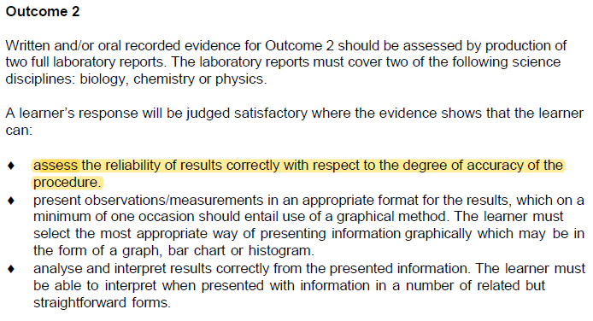
Evaluation
In this section, a candidate should comment on the reliability of the experiment – this is often required in unit evidence requirements.

Slide 17
Evaluation
This section also provides the candidate an opportunity to identify sources of error inherent in the experiment.
For example, measuring the accuracy of the equipment used, variables not controlled which could have been and how they were minimised or could be improved in a future experiment.

Slide 18

Experimental Procedures: Science
Understanding Standards documentation covering the Experimental Procedures: Science unit has been published, which includes examples that would be useful for practical units.
https://www.understandingstandards.org.uk/Home
Click ‘Login’ (top right)
Contact your SQA Coordinator for the username and password
Select ‘*HN Science’ from the subject drop-down
Select ‘Experimental Procedures: Science’
from the menu on the left-hand side

Slide 19
Pro formas – not too leading
A pro forma is a scaled-down lab report, so it should still require that the candidate must write complete sentences, in their own words.
Although pre-populated tables are appropriate, the rest of the pro forma should be section headings only, perhaps with concise guidance as to what should be included.
Formats such as ‘fill in the blanks’ to complete
a sentence, would not be appropriate.

Slide 20
Remediation vs. reassessment
Remediation is when a candidate’s work is marked and returned to them. They are then permitted to make changes in line with an assessor’s feedback in order to reach a passable standard.
Reassessment is when the candidate is required to,
for example, sit an alternative assessment paper or complete an alternative practical.
The unit descriptor will make clear what is
permitted, so read this carefully.

Slide 21
Remediation
This is usually the case when considering pieces of work such as lab reports, pro formas or lab diary entries, not summative theory assessments.
Candidates will often be permitted one opportunity to make the required changes. If the evidence is not revised to a satisfactory standard, they would need to complete an alternative practical and write-up.

Slide 22
Reassessment
If a candidate does not perform an assessed practical to the required standard, they will be given the chance to either reattempt the same practical or to undertake a different practical of similar complexity.
If a candidate does not complete a lab report, lab diary or pro forma to a satisfactory standard after remediation, they would need to complete an alternative practical and write-up.

Slide 23
Ensuring marking is consistent
Detailed marking schemes for each lab report, lab diary entry and pro forma should be prepared and internally verified.
This is to ensure that marking is consistent when more than one assessor is involved.
See the additional Understanding Standards presentation on internal verification and standardisation.

Slide 24
Recording candidate outcomes
In order to retain the evidence required for external verification, for the practical elements of units, checklists should be used for both practical and written work.
These should reflect the performance criteria and evidence requirements outlined in the unit descriptor.
Examples are provided in the Experimental Procedures: Science Understanding Standards materials and in
some Assessment Support Packs for relevant units.

Slide 25
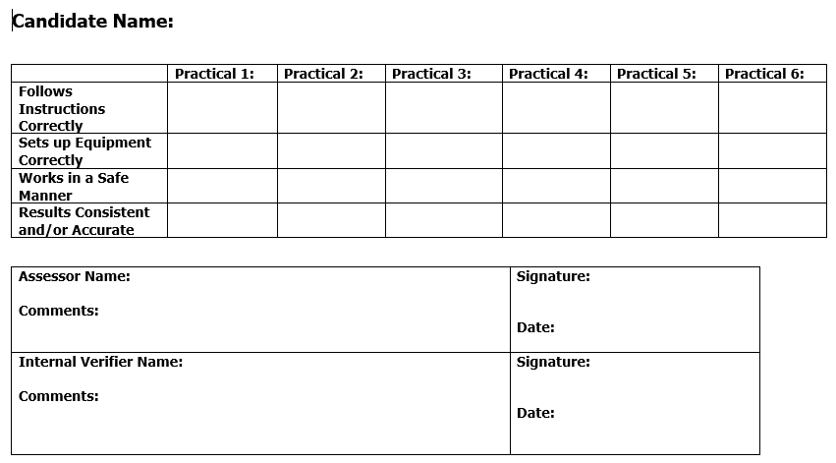
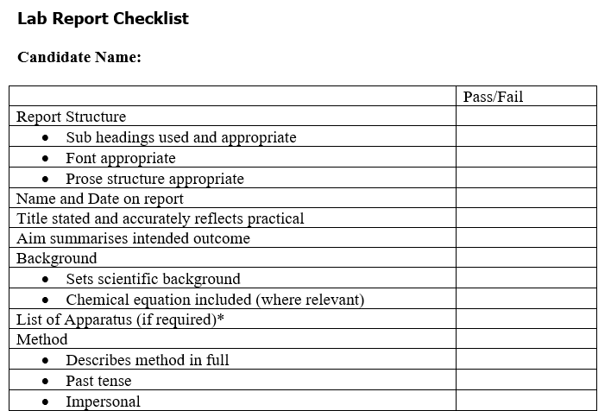
Recording candidate outcomes

Slide 26
Other audio presentations available
Evidence requirements: Interpreting what is required
Internal Verification and Standardisation
A guide to suitable practicals

Slide 27
If you need advice from SQA
Please contact qualification.development@sqa.org.uk

