Slide 1



Slide 2
Understanding Standards
National Progression Awards (NPAs) in Science
Evidence Requirements

Slide 3
National Progression Awards in Science
Science and Health at SCQF level 4
Science and Technology at SCQF level 4
Applied Sciences at SCQF level 5
Scientific Technologies at SCQF level 6
Laboratory Science at SCQF level 6

Slide 4
What this presentation covers
How to make sure candidates are meeting the
evidence requirements of the course, including:
interpreting what is required of the units
how overlap can be employed when assessing practicals
arrangements for candidate remediation
and reassessment

Slide 5

Where can the evidence requirements be found?
When you locate the details of an NPA on the SQA website, there will be a link to the group award specification.

Slide 6
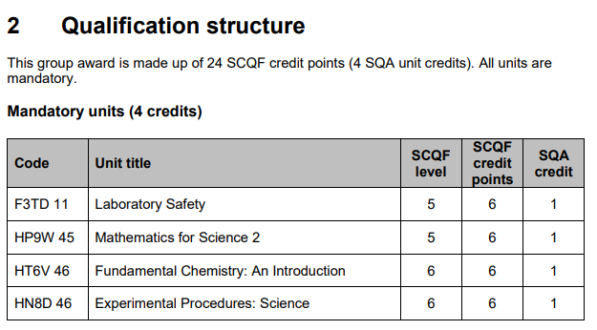
Where can the evidence
requirements be found?
Within the group award specification, a list of units will be provided.

Slide 7
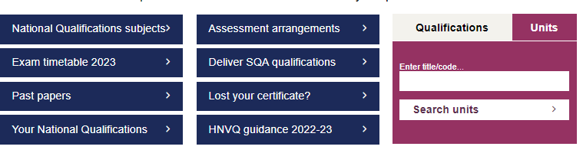
Where can the evidence requirements be found?
Once you have the unit codes, you can use the
unit search on the SQA homepage to search for each individual unit.

Slide 8
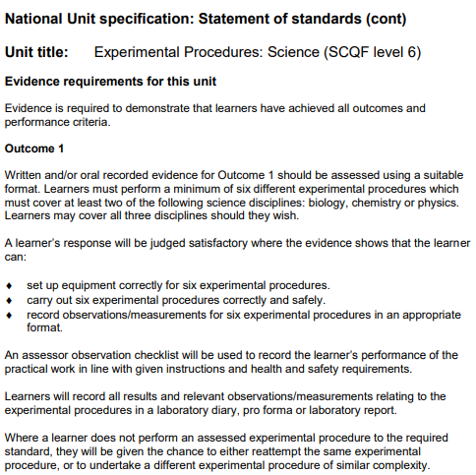
Where can the evidence requirements be found?
Within the unit descriptor document, you can find the evidence requirements for the unit.

Slide 9
NPA design
NPAs are designed to:
incorporate theory-based learning
be heavily focussed on practical elements
provide a broad range of practical experience to candidates
allow candidates to work with a mix of qualitative and quantitative data

Slide 10
NPA units
You need to make sure you are familiar with:
the evidence requirements
the approaches to assessment
These will tell you:
how many practicals need to be done
which sciences these should cover
how they should be assessed

Slide 11
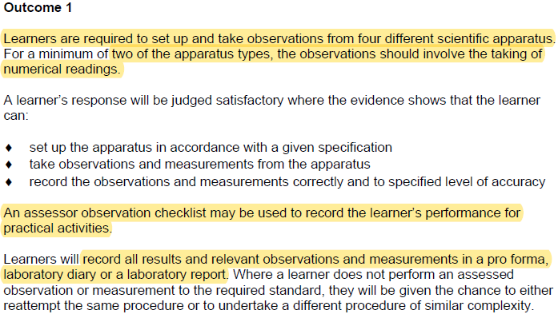
Practical units: requirements
For example, Science Practical Skills (J42F 44):

Slide 12
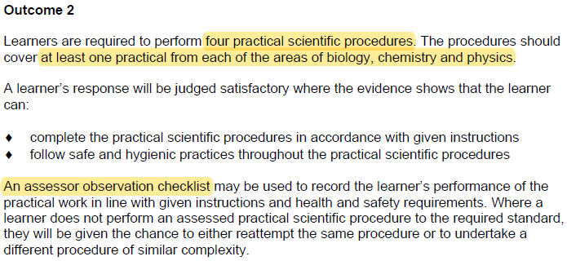
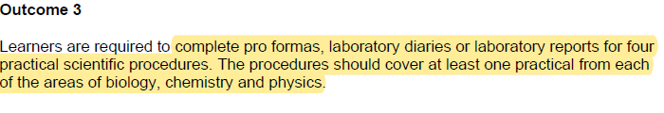
Practical units: requirements
For example, Science Practical Skills (J42F 44):

Slide 13
Double-counting of practicals
The NPAs are designed to be very practical based, so it is recommended that as many practicals as possible are carried out.
Not all of these need to be assessed – they can be used to build skills.
One assessed practical can sometimes cover:
the requirements of more than one unit
more than one outcome in a unit

Slide 14
Double-counting of practicals between units
For example, the NPA in Scientific Technologies at SCQF level 6 includes the following units which have practical requirements:
Fundamental Chemistry: An Introduction (HT6V 46)
Experimental Procedures: Science (HN8D 46)

Slide 15
Double-counting of practicals between units
Unit | Number of practicals required | Assessment method | Science(s) covered
Fundamental Chemistry | 2 | At least one lab report. Other practical reported as lab report, pro forma or lab diary entry. | Chemistry
Experimental Procedures | 6 | At least two lab reports. Other practicals reported as lab report, pro forma or lab diary entry. | Two of biology, chemistry and physics
Therefore, in meeting the requirements for
Fundamental Chemistry, part of the requirements
for Experimental Procedures would be met.

Slide 16
Double-counting of practicals within a unit
Experimental Procedures: Science (HN8D 46) unit requires that learners:
Carry out six experimental procedures which cover two of biology, chemistry and physics (outcome 1).
Record observations and measurements for all six in a laboratory diary, pro forma or laboratory report (outcome 1).
Complete two full laboratory reports covering two of biology, chemistry and physics (outcome 2).
Therefore, if a learner completed a lab report and pro forma
for both chemistry and biology plus two pro formas for
physics, (accompanied by passed observation checklists)
they would have met the evidence requirements.

Slide 17
Double-counting of practicals between units
It is not always possible to double-count practicals.
For example, the NPA in Science and Health at SCQF level 4 includes the following units which have practical requirements:
⬥ Nature's Chemistry (H21J 74)
⬥ Science: Human Health (H268 74)

Slide 18
What needs to be included in a lab report, lab diary or pro forma?
Please see the additional Understanding Standards audio presentation on this topic available on the HN section of the Understanding Standards website.

Slide 19

Experimental Procedures: Science
Understanding Standards documentation covering the Experimental Procedures: Science unit has been published.
https://www.understandingstandards.org.uk/Home
click ‘Login’ (top right)
contact your SQA Coordinator for the username and password
select ‘*HN Science’ from the subject drop-down
select ‘Experimental Procedures: Science’
from the menu on the left-hand side

Slide 20
Arrangements for remediation and reassessment
When a candidate doesn’t meet the required standards on the first attempt, you must refer closely to the unit descriptor to see how this should be addressed.
Requirements will be different depending on the unit and its nature (theory or practical).
Remediation may be appropriate in some cases, but reassessment may be necessary for others.

Slide 21
Remediation vs. reassessment
Remediation is when a candidate’s work is marked and returned to them. They are then permitted to make changes in line with an assessor’s feedback in order to reach a passable standard.
Reassessment is when the candidate is required to, for example, sit an alternative assessment paper or complete an alternative practical.
The unit descriptor will make clear what is
permitted so read this carefully.

Slide 22
Remediation
This is usually the case when considering pieces of work such as lab reports, pro formas or lab diary entries,
not summative theory assessments.
Candidates will often be permitted one opportunity to make the required changes. If the evidence is not revised to a satisfactory standard, they would need to complete an alternative practical and write-up.
Oral remediation is not permitted.

Slide 23
Reassessment
If a candidate does not attain the required pass mark in an assessment, they will need to resit the unit using an alternative assessment paper under the same conditions.
If a candidate does not perform an assessed practical to the required standard, they will be given the chance to either reattempt the same practical or to undertake a different practical of similar complexity.

Slide 24
Other audio presentations available
Requirements of lab reports, lab diaries and pro formas
Internal Verification and Standardisation
A guide to suitable practicals

Slide 25
If you need advice from SQA
Please contact qualification.development@sqa.org.uk

