Slide 1



Slide 2
Climate Change and Sustainability
National 3 and National 4
An overview of the National Progression Award (NPA)

Slide 3
Aims of the session
To provide teachers, lecturers and assessors with:
information about National Progression Awards (NPAs)
details on how to access information for the Climate Change and Sustainability NPA
details on how to request approval to present the NPA
detailed information on Climate Change at National 3 and National 4 and Sustainability at National 3 and National 4
an opportunity to ask questions and clarify

Slide 4
National Progression Awards
NPAs are group awards
NPAs are aimed at assessing a defined set of skills and knowledge in specialist vocational areas
NPAs are awarded at SCQF Levels 2-6
NPAs can be delivered by schools/colleges individually or in partnership between schools, colleges and employers

Slide 5

Accessing information about the Climate Change and Sustainability NPA
click ‘qualifications’ and choose ‘NCs and NPAs’
choose ‘browse NC and NPA Subjects’
choose ‘Social Sciences/Social Subjects’

Slide 6
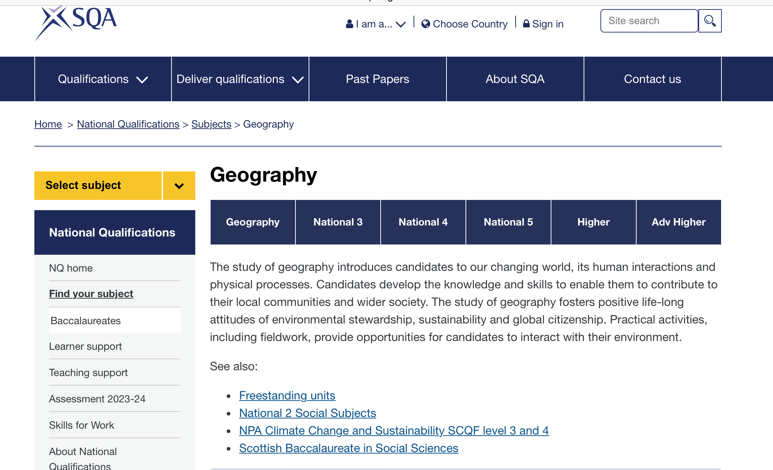
Accessing information about the Climate Change and Sustainability NPA – Geography home page

Slide 7
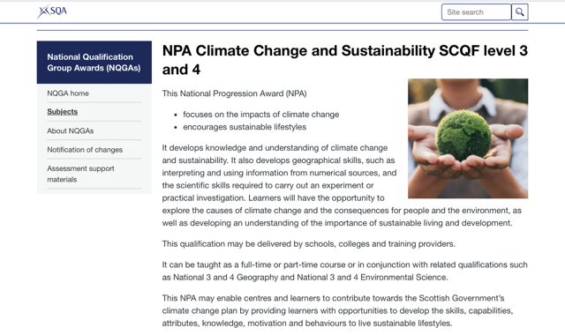
Accessing information about the Climate Change and Sustainability NPA

Slide 8
NPA approval
Centres must apply for qualification approval from SQA to offer an NPA.
All centres have a Regional Manager who will support the approval process.
Ask your SQA Coordinator for the contact details of your Regional Manager.
Approval is a simple process and must be obtained before starting to teach an NPA.

Slide 9
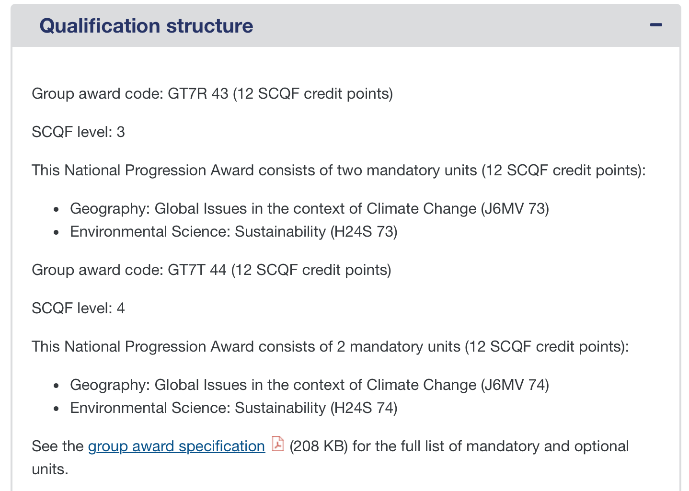
NPA structure
Please note the unit codes for the Global Issues in the context of Climate Change are different from the National 3 and National 4 codes for the Geography Course:
National 3 is J6MV 73
National 4 is J6MV 74
Use these codes for presenting for both the NPA and for National 3/National 4 Geography

Slide 10
Global Issue in the context of Climate Change
The Unit Specifications can be found using the following links:
Unit specification: Geography: Global Issues in the Context of Climate Change (National 3) (sqa.org.uk)
Unit specification: Geography: Global Issues in the Context of Climate Change (National 4) (sqa.org.uk)
Unit Assessment Support Packs (UASPs) can be found in the NQ Geography section of the SQA Secure site (secure.sqa.org.uk)

Slide 11
Global Issue in the context of Climate Change
– Making Assessment Judgments
The UASPs at National 3 and National 4 contain a set of questions.
Marks are not used.
Each assessment standard is judged individually.
The ‘Making Assessment Judgments’ column in the judging evidence tables in the UASPs, indicate the minimum standard required to pass each assessment standard.
As long a candidate meets the minimum standard required, they have passed that assessment standard.
The assessment for the unit could be centre devised and take the form of, for example, a poster, PowerPoint presentation etc.

Slide 12
Global Issue in the context of Climate Change
– Outcome 1 assessment standards
National 3 – Outcome 1
Use numerical or graphical information in the context of climate change by:
1.1 extracting geographical information from a numerical or graphical source
1.2 interpreting a limited range of geographical information from a numerical or graphical source to reach a basic conclusion
National 4 – Outcome 1
Use a limited range of numerical and graphical information in the context of climate change by:
1.1 interpreting relevant numerical and graphical information from two sources
1.2 evaluating numerical and graphical information to draw a straightforward conclusion based upon evidence

Slide 13
Global Issue in the context of Climate Change
– Outcome 2 assessment standards
National 3 – Outcome 2
Draw on basic knowledge and understanding of climate change by:
2.1 briefly describing key features of climate change
2.2 briefly describing causes of climate change
2.3 briefly describing effects of climate change
National 4 – Outcome 2
Draw on straightforward knowledge and understanding of climate change by:
2.1 describing key features of climate change
2.2 briefly explaining the causes or effects of climate change
2.3 briefly explaining the strategies adopted in response to climate change

Slide 14
Climate Change – Making Assessment Judgements
National 3 Outcome 1
Assessment Standard | Making Assessment Judgements
1.1 Extracting geographical information from a numerical or graphical source | Candidate is able to extract at least one relevant, factual point. The emissions from cars is increasing.
1.2 Interpreting a limited range of geographical information from a numerical or graphical source to reach a basic conclusion | Candidate is able to interpret at least one relevant, factual point from the source. Temperature increase may be due to an increase of carbon dioxide.

Slide 15
Climate Change – Making Assessment Judgements
National 3 Outcome 2
Assessment Standard | Making Assessment Judgements
2.1 Briefly describing key features of a global geographical issue. | Candidate is able to make at least two simple, obvious, relevant, factual descriptions Climate change affects the land and the sea areas. Climate change is happening all over the world
2.2 Briefly describing causes of a global geographical issue | Candidate is able to make simple, obvious, relevant and factual descriptions of at least two causes of a global geographical issue with minimal development, or one description of a single cause, with basic development. Cutting down trees. More methane in the atmosphere (2 causes) Cutting down trees and burning them releases CO₂ (basic development)

Slide 16
Climate Change – Making Assessment Judgements
National 3 Outcome 2 (continued)
Assessment Standard | Making Assessment Judgements
2.3 Briefly describing effects of a global geographical issue | Candidate is able make simple, obvious, relevant and factual descriptions of at least two effects of a global geographical issue with minimal development, or one description of a single effect, with basic development. More flooding near the sea. Longer growing seasons in some places (2 effects) More flooding in low lying areas, like Bangladesh (basic development)

Slide 17
Climate Change – Making Assessment Judgements
National 4 Outcome 1
Assessment Standard | Making Assessment Judgements
1.1 interpreting relevant numerical and graphical information from two sources | Candidate is able to use the numerical and graphical information to interpret at least two characteristics or features from the sources provided. Temperature change has increased from 0.7°F in 1900 to 2.0°F in 2010 Of the greenhouse gases caused by human activity, 54.7% is CO₂
1.2 evaluating numerical and graphical information to draw a straightforward conclusion based upon evidence | Candidate uses evidence to draw a conclusion from numerical or graphical information. Conclusions should be supported by relevant and accurate use of evidence drawn from the source(s). Temperature change goes up and down over time but CO₂ always increases .

Slide 18
Climate Change – Making Assessment Judgements
National 4 Outcome 2
Assessment Standard | Making Assessment Judgements
2.1 describing key features of climate change | Candidate is able to describe two key characteristics or features of climate change. Recently, the change is happening more quickly. Climate change is happening in many parts of the world, for example, the Sahara.
2.2 briefly explaining the causes or effects of climate change | Candidate is able to give at least two explanations that make the issue plain or clear. CAUSES - Greenhouse gases trap the radiation from the sun, increasing temperatures. The industrial revolution caused more greenhouse gases to be produced, such as CO_{2.} EFFECTS - Polar bears may lose their homes as Arctic ice melts. There may be more heatwaves causing people to die.

Slide 19
Climate Change – Making Assessment Judgements
National 4 Outcome 2
Assessment Standard | Making Assessment Judgements
2.3 briefly explaining the strategies adopted in response to climate change | Candidate is able to explain two strategies that deal with climate change. Using renewable sources to make electricity avoids putting CO₂ in the atmosphere. Walking and cycling reduce the amount of petrol used.

Slide 20
Sustainability
The Unit Specifications can be found using the following links:
Unit Specification: Environmental Science: Sustainability (National 3) (sqa.org.uk)
Unit Specification: Environmental Science: Sustainability (National 4) (sqa.org.uk)
Unit Assessment Support Packs (UASPs) can be found in the NQ Environmental Science section of the SQA Secure site (secure.sqa.org.uk).

Slide 21
National 3 Sustainability
The National 3 unit covers the key areas of:
processes which may contribute to climate change
the possible impact of atmospheric change on the survival of living things
the causes and possible consequences of an environmental issue, and ways to manage the impact (of the environmental issue)
The unit could be tackled through major themes such as transport, deforestation, industry, agriculture, and depletion of non-renewable resources.

Slide 22
National 4 Sustainability
The National 4 unit covers the key areas of:
the sustainability of key natural resources and possible implications for human activity
the interaction between humans and the environment and the impact of human activity on an area
the role of agriculture in the production of food and raw material and its environmental impacts and sustainability
society’s energy needs and the impact of developments in transport infrastructure in a selected area
development of sustainable systems.

Slide 23
Sustainability – Outcome 1 Assessment Standards
National 3 – Outcome 1
Apply skills of scientific inquiry and draw on knowledge and understanding of the key areas of this Unit to carry out an experiment/practical investigation by:
1.1 Following given procedures safely
1.2 Making and recording observations/measurements correctly
1.3 Presenting results in an appropriate format
1.4 Drawing valid conclusions
1.5 Evaluating experimental procedures
National 4 – Outcome 1
As National 3 Outcome 1, but with an additional assessment standard:
1.1 Planning an experiment/practical investigation

Slide 24
Sustainability – Outcome 2 Assessment Standards
Outcome 2 has the same assessment standards for both National 3 and National 4 however, the UASPs are different.
Outcome 2
Draw on knowledge and understanding of the key areas of this Unit and apply scientific skills by:
2.1 Making accurate statements
2.2 Solving problems

Slide 25
Sustainability – Making Assessment Judgements
Outcome 1
Candidates complete an experiment or practical investigation.
Marks are not used.
Each assessment standard is judged individually.
Candidates must pass at least four out of the five assessment standards at National 3 and five out of the six assessment standards at National 4.
Outcome 2
The UASPs at National 3 and National 4 contain a set of questions that cover both assessment standard 2.1 and assessment standard 2.2.
Marks are used.
Candidates must achieve at least 50% of the available marks to
pass the Outcome.

Slide 26
Sustainability – Making Assessment Judgements
National 3 Outcome 1
Assessment Standard | Making Assessment Judgements
1.1 Following given procedures safely | The learner must be observed to follow procedures safely.
1.2 Making and recording observations/measurements correctly | Observations/measurements must be recorded correctly. Assessors may give support with tables/headings/units, as appropriate
1.3 Presenting results in an appropriate format | One format from: table, line graph, bar graph, scatter graph or other appropriate format. Assessors may give support with format, headings, units as appropriate.

Slide 27
Sustainability – Making Assessment Judgements
National 3 Outcome 1 (continued)
Assessment Standard | Making Assessment Judgements
1.4 Drawing valid conclusions | The conclusion should relate to the aim of the experiment/practical investigation and be supported by the data. If results are inconclusive but the candidate refers to evidence and the aim to say that no conclusion can be drawn, this would be a valid and sufficient response.
1.5 Evaluating experimental procedures | The candidate should suggest one improvement to the experiment/practical investigation.

Slide 28
Sustainability – Outcome 1 practical investigation topics National 3
Suggested experiments/practical investigations
Various suggestions in the Sustainability UASP Packages 1 and 2 (updated version available on the SQA secure site from 2024/25) and Environmental Science Course Specification. investigate eg number/volume of waste types placed in school litter bins during break investigate air quality eg effect of vehicle emissions on lichens on trees or tar spot fungus on sycamores investigate freshwater quality eg clarity, pH, presence/absence of aquatic invertebrates/indicator species investigate whether CO₂ concentration can affect temperature

Slide 29
Sustainability – Making Assessment Judgements
National 4 Outcome 1
Assessment Standard | Making Assessment Judgements
1.1 Planning an experiment/practical investigation | Plan should include: an aim a variable to be kept constant what will be measured/observed the equipment/materials to be used the method, including safety considerations The plan must be clear enough for another person to follow and at an appropriate level.

Slide 30
Sustainability – Making Assessment Judgements
National 4 Outcome 1
Assessment Standard | Making Assessment Judgements
1.2 Following procedures safely | The learner must be observed to follow procedures safely.
1.3 Making and recording observations/ measurements correctly | Observations/measurements taken must be recorded correctly. The raw data should be collated in a relevant form eg table.
1.4 Presenting results in an appropriate format | At least one format from: line graph, bar graph, scatter graph or other appropriate format. Candidates should use SI units and standard abbreviations. Graphs on graph paper.

Slide 31
Sustainability – Making Assessment Judgements
National 4 Outcome 1
Assessment Standard | Making Assessment Judgements
1.5 Drawing valid conclusions | Conclusions must relate to the aim of the experiment/ practical investigation and be supported by the data. If results are inconclusive but candidate refers to evidence and the aim to say that no conclusion can be drawn, this would be a valid and sufficient response.
1.6 Evaluating experimental procedures | Evaluation should suggest one possible improvement for the experiment/practical investigation.

Slide 32
Sustainability – Practical Investigation Topics National 4
Suggested experiments/practical investigations
Various suggestions in the Sustainability UASP Packages 1 and 2 (updated version available on the SQA secure site from 2024/25) and Environmental Science Course Specification. The suggested activities in the UASPs mirror those for National 3. This unit also lends itself to investigating renewable energy generation eg through use of model wind turbines or mini HEP.

Slide 33
Additional support for the Climate Change and Sustainability NPA
Contact joan.highton@sqa.org.uk if you have any generic questions about the award or specific questions about the following units:
Geography: Global Issues in the context of Climate Change (J6MV 73)
Geography: Global Issues in the context of Climate Change (J6MV 74)
Contact donna.clark@sqa.org.uk if you have any specific questions about the following units:
Environmental Science: Sustainability (H24S 73)
Environmental Science: Sustainability (H24S 74)

