Slide 1

National 5 Candidate 4 – Without a Second Glance Composition

Slide 2
Annotations for a composition
Identification
Development
Inconsistencies

Slide 3
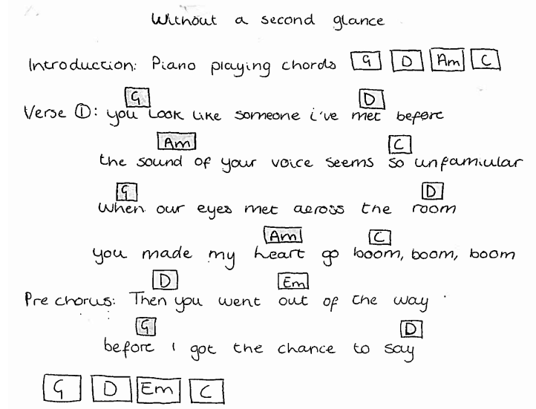

Slide 7
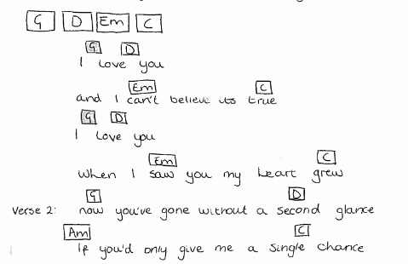

Slide 8
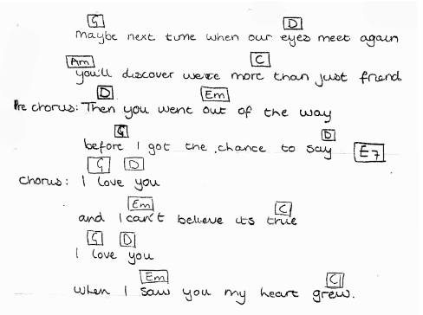

Slide 11
Candidate 4 – Without a Second Glance – 13 marks
15-17 mark range
A very good composition demonstrating a range of musical ideas which have been developed with some imagination – appropriate to the candidate’s chosen style. The selection and use of elements shows creativity.
12-14 mark range
A good composition demonstrating a range of musical ideas which have been developed competently – appropriate to the candidate’s chosen style. The selection and use of elements shows some creativity.
10-11 mark range
A composition demonstrating musical ideas which have been developed
satisfactorily – appropriate to the candidate’s chosen style. The
selection and use of elements may be simplistic and
straightforward.

Slide 12
Further examples
Still Not Over You (performance plan song) – 18 marks (National 5 Music Assignment Commentary, October 2017)
Home (performance plan song) – 10 marks (National 5 Music Assignment – Candidate Evidence, May 2020)

