Slide 1

National 5 Candidate 3 – Volvo

Slide 2
Annotations for a composition
Identification
Development
Inconsistencies

Slide 6
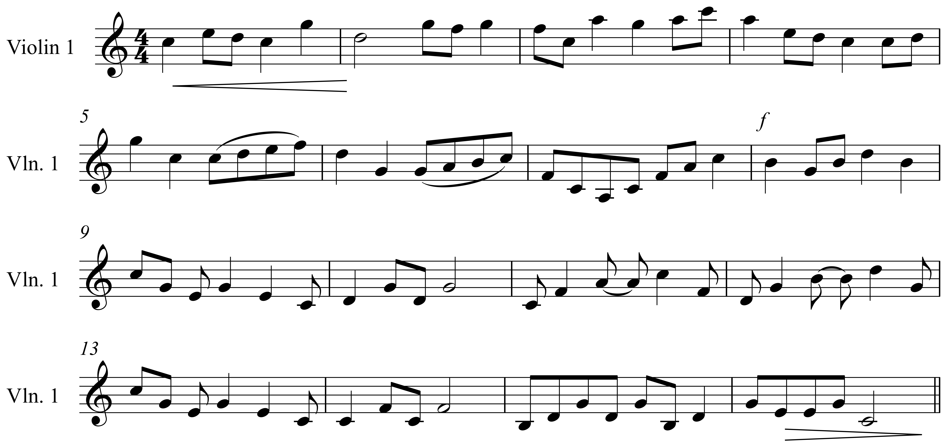

Slide 7
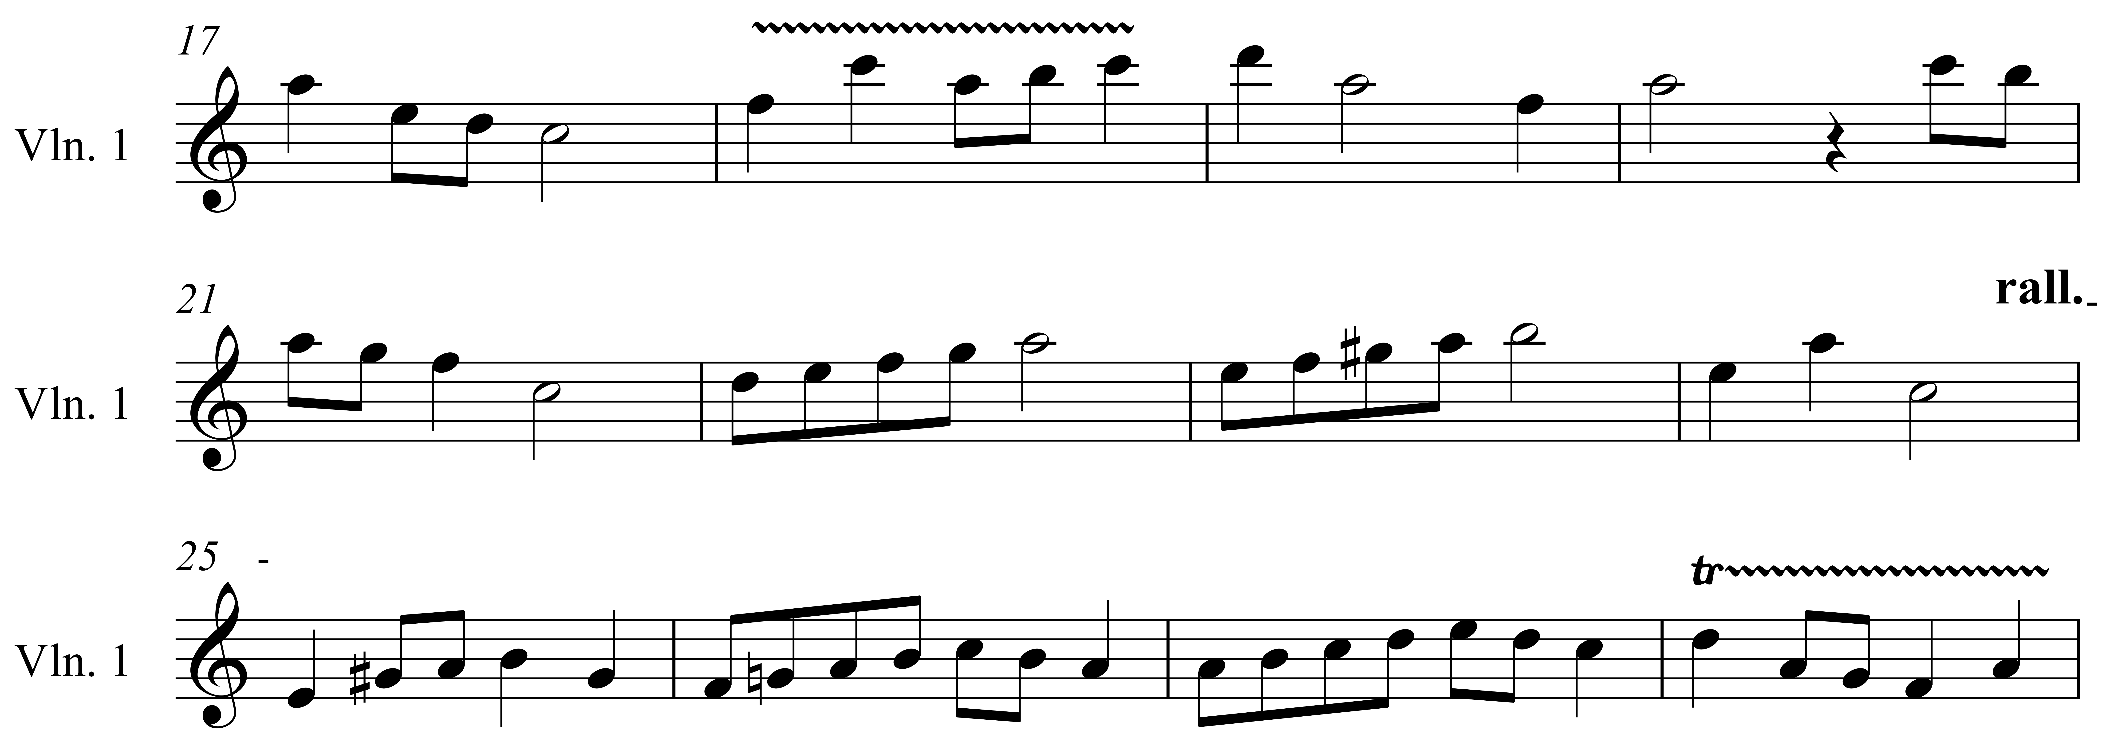

Slide 8
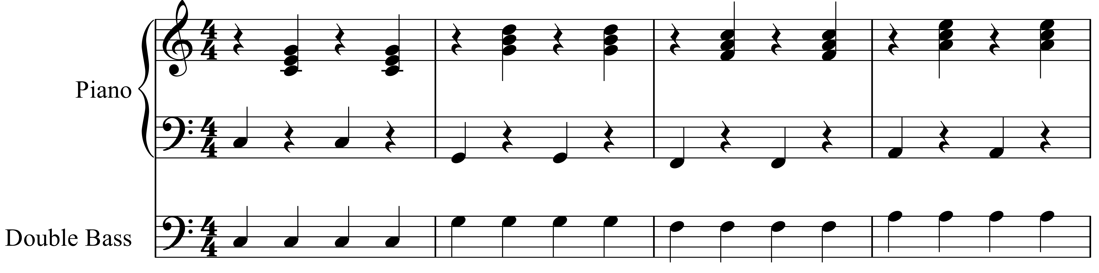

Slide 10
Candidate 3 – Volvo – 6 marks
7-9 mark range
A composition demonstrating musical ideas which have been developed inconsistently to the candidate’s chosen style. The selection and use of elements is not always appropriate.
4-6 mark range
A composition demonstrating limited musical ideas with little development appropriate to the candidate’s chosen style. The selection and use of elements is poor.
1-3 mark range
A composition which shows a very limited understanding of musical ideas with no development appropriate to the candidate’s chosen style. The selection and use of elements is very poor.

Slide 11
What advice could you give to candidates?
Advise the candidate to listen carefully to their composition.
Ask the candidate ‘do they hear anything that doesn’t sound right?’
What might you advise the candidate to prioritise to improve the composition?

Slide 13
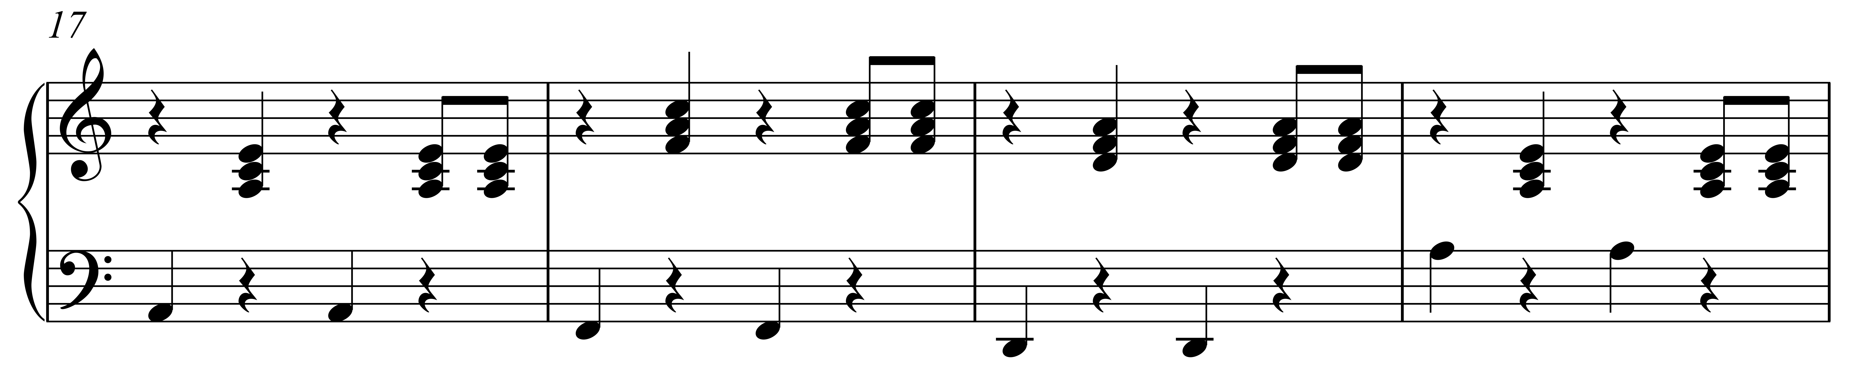
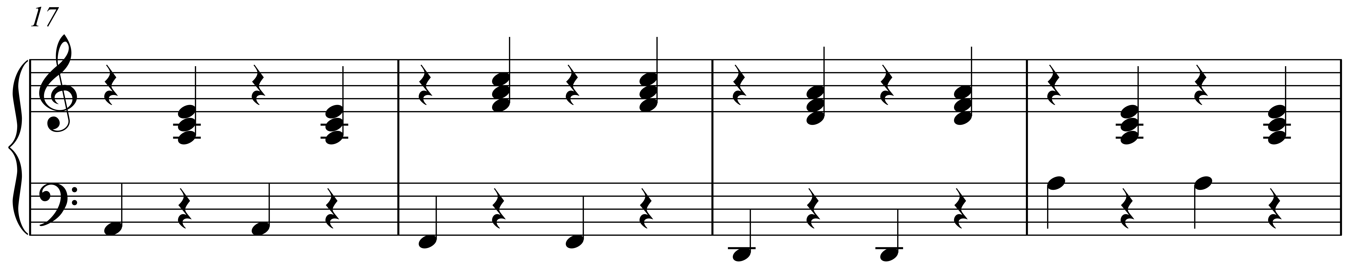

Slide 14
How could the candidate vary the rhythm?

Slide 15
How could the candidate vary the rhythm?
Where might this varied rhythm be introduced?

Slide 16
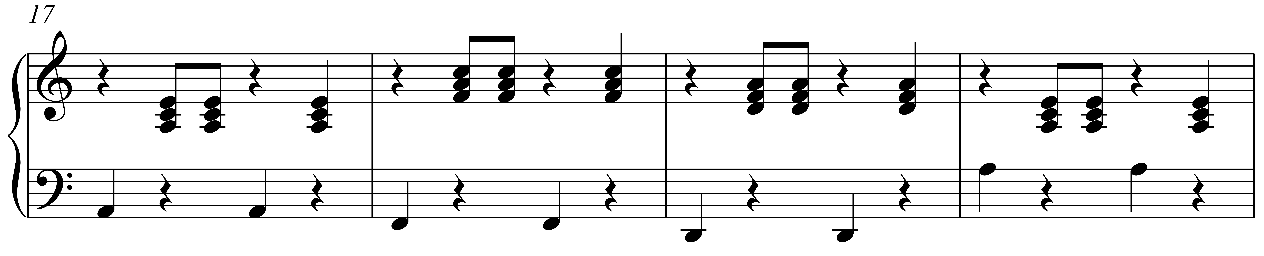

Slide 17
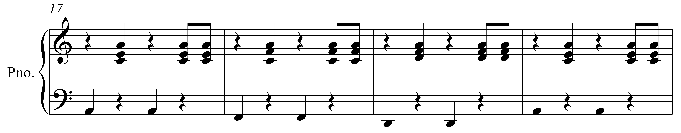

Slide 18
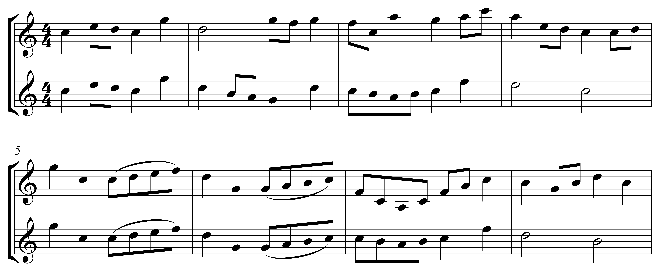
Original
melody
Amended
melody
Original
melody
Amended
melody

Slide 19
Original
melody
Amended
melody
Original
melody
Amended
melody

Slide 20
Original
melody
Amended
melody
Original
melody
Amended
melody

Slide 21
Original
melody
Amended
melody
Original
melody
Amended
melody

Slide 22
Further examples
Classical Morning (piano) – 19 marks (National 5 Music Assignment Commentary, June 2017)
Tango (keyboard) – 15 marks (National 5 Music Assignment Commentary, June 2017)

