Slide 1

National 5 Candidate 2 – Sad Song

Slide 2
Annotations for a composition
Identification
Development
Inconsistencies

Slide 3
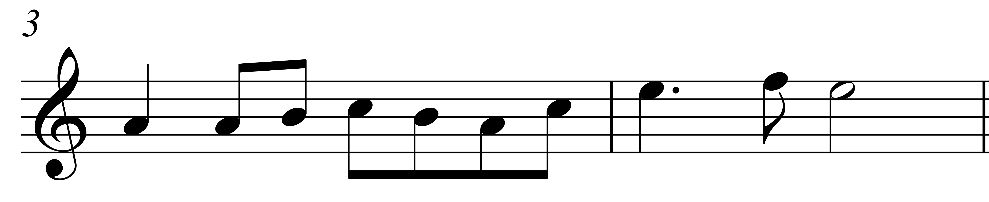

Slide 4
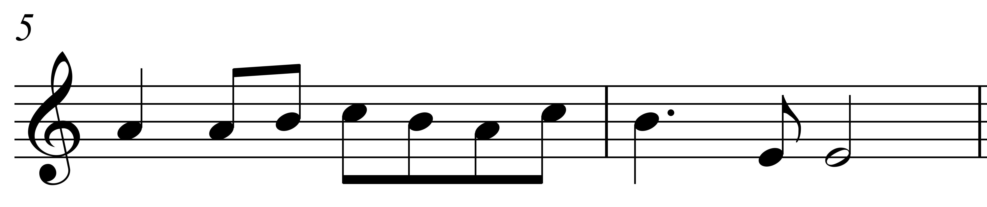

Slide 5
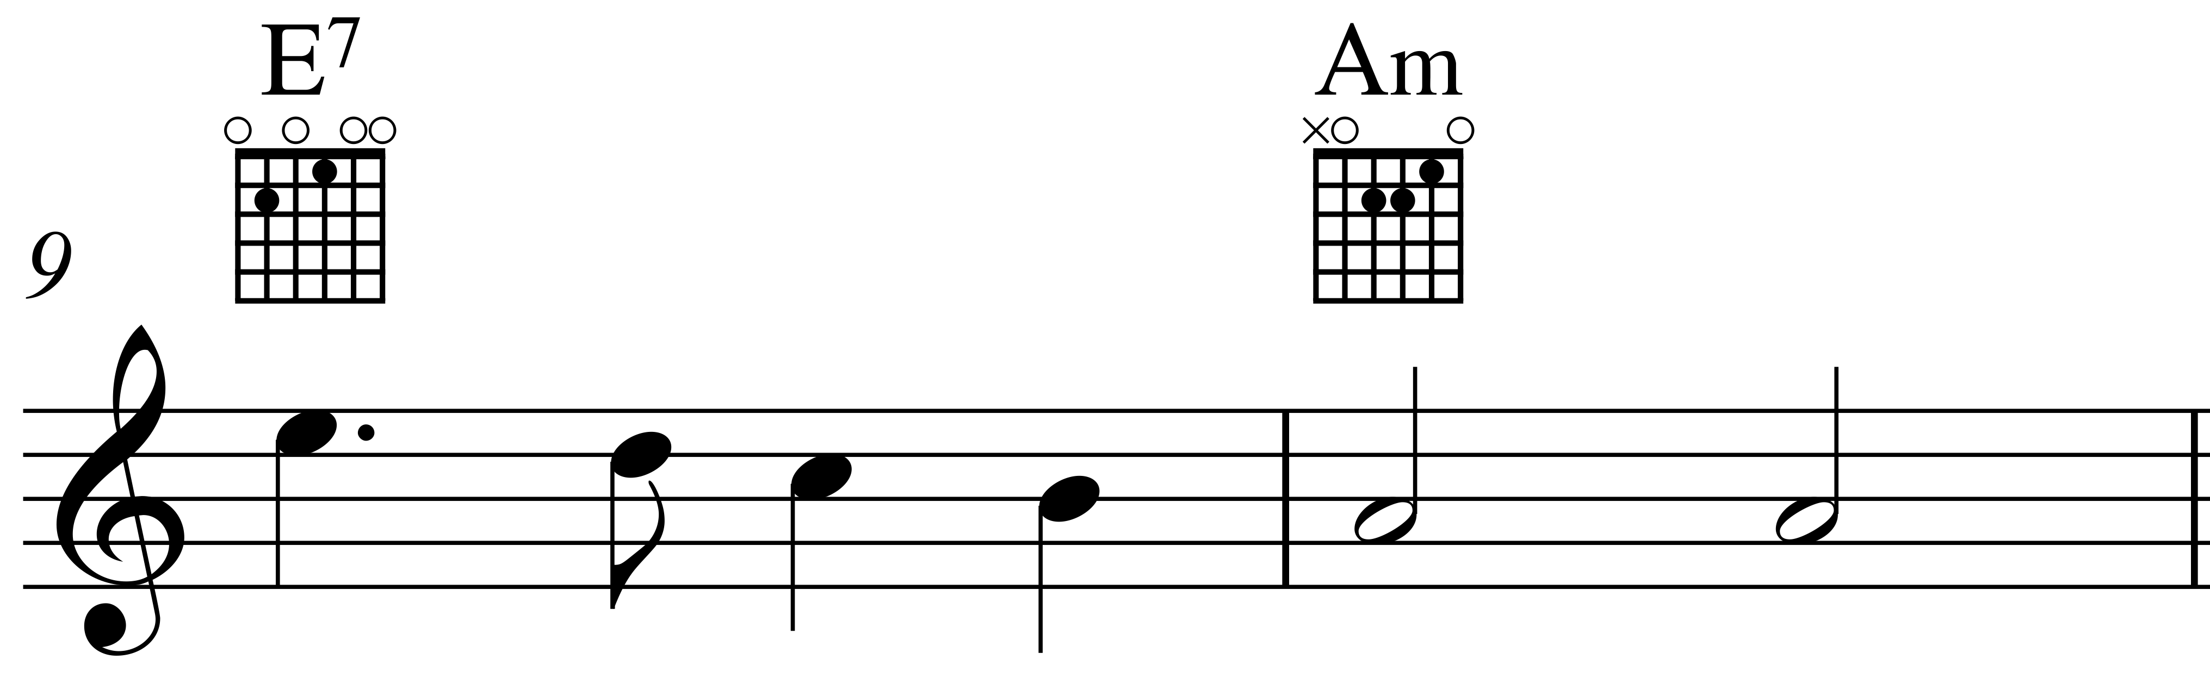

Slide 6
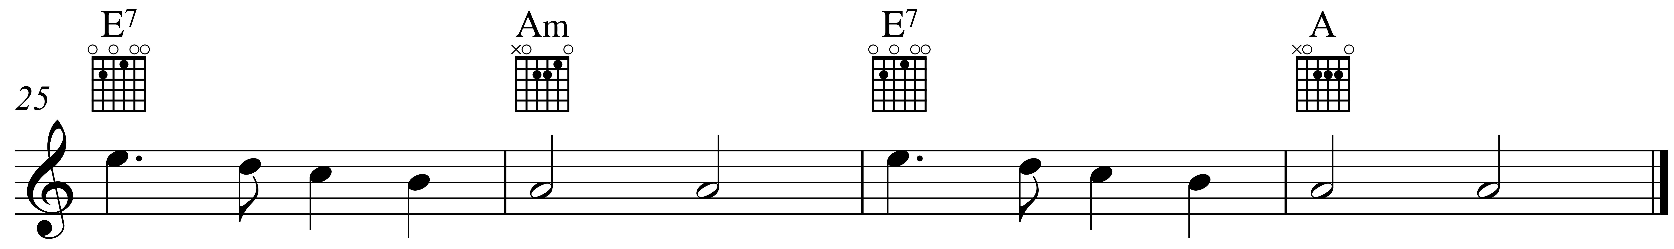

Slide 7
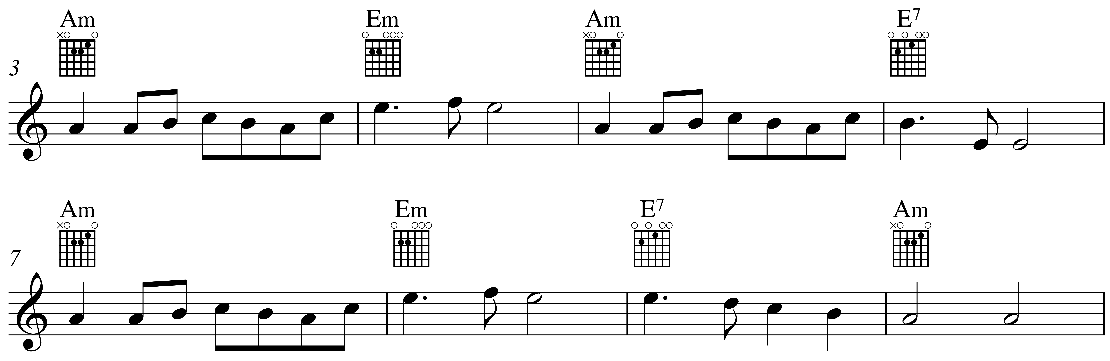

Slide 8
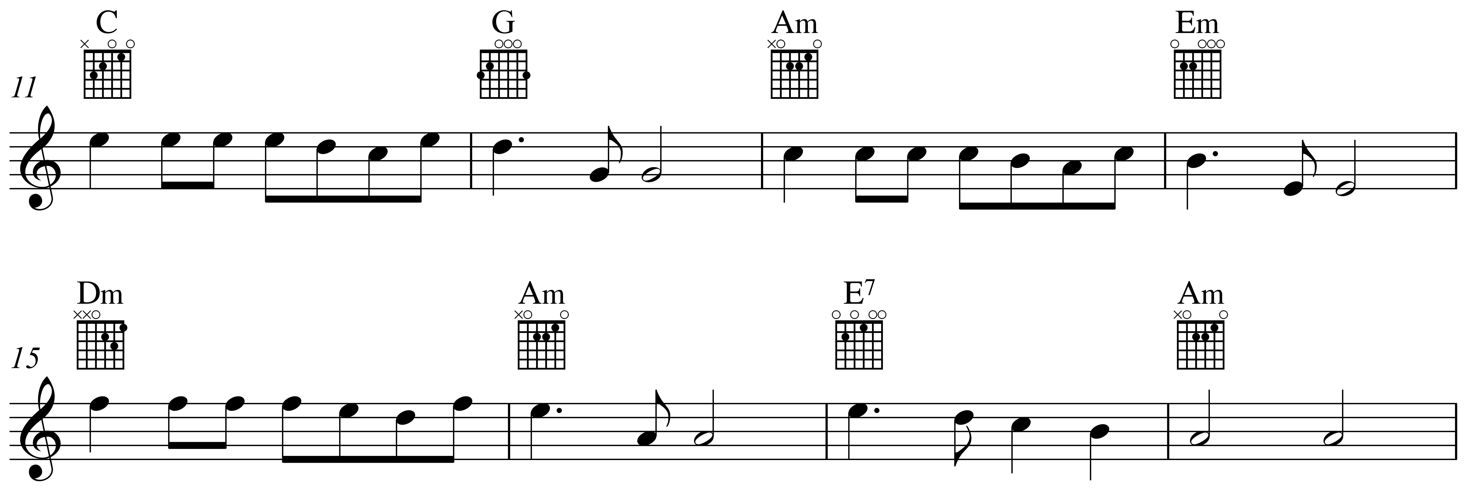

Slide 11
Candidate 2 – Sad Song – 15 marks
18-20 mark range
An excellent composition demonstrating a range of musical ideas which have been developed imaginatively and convincingly – appropriate to the candidate’s chosen style. The selection and use of elements is highly creative and effective.
15-17 mark range
A very good composition demonstrating a range of musical ideas which have been developed with some imagination – appropriate to the candidate’s chosen style. The selection and use of elements shows creativity.
12-14 mark range
A good composition demonstrating a range of musical ideas which have been developed competently – appropriate to the candidate’s chosen style. The selection and use of elements shows some creativity.

Slide 12
Further examples
Untitled (keyboard) – 14 marks (National 5 Music Assignment Commentary, October 2017)
Composition (clarinet, clarinet) – 13 marks (National 5 Music Assignment Commentary, June 2017)

Slide 13
Candidate 2 – Sad Song composing reviews
Review 1 – candidate’s original review
Review 2 – alternative review for comparison

Slide 14
Composing review
The composing review must, with reference to compositional methods used, include:
the main decisions made
the exploration and development of musical ideas
strengths and/or areas for improvement

Slide 15
Sad Song – composing review 1
I decided to write a piece for guitars.
I decided to use the chords 1, 5 in A minor.
I found a strum pattern I liked.
I used Am and Em first but then thought about using a major chord so chose E7.
When I had the chords for the first 8 bars I experimented with a melody.
I got the first bar quite quickly and then decided to use it a few times but each time to answer with a different idea.
When I had my melody I got my friend to play it while I strummed the chords. It sounded good and I decided to add a middle section.
I know that C is related to Am so I began with the chords 1, 5 in C and then went back to Am and Em. That sounded good and so I
experimented with a tune for these chords.

Slide 16
Composing review 1 (cont’d)
I found a good idea for C-G and then used it again as a sequence.
I hadn’t used chord 4 in Am yet so I tried it out and liked it.
I used the idea from my sequence to get a tune for Dm and Am and then finished off the middle section the same way I finished the first section.
I decided to repeat the first section to make my composition ABA.
I wanted to make a change but didn’t know what to do.
Then I decided to try out major chords again and it sounded really good, so I finished in the major.
I added an introduction, using the end of each section.
I think my piece sounds lovely. The minor chords make it sad and I really like the sequence.
Finishing off in the major is a surprise which is nice.
I have used a lot of repetition, but I like it.

Slide 17
Composing review 1 (cont’d)
I decided to write a piece for guitars.
I decided to use the chords 1, 5 in A minor.
I found a strum pattern I liked.
I used Am and Em first but then thought about using a major chord so chose E7.
When I had the chords for the first 8 bars I experimented with a melody.
I got the first bar quite quickly and then decided to use it a few times but each time to answer with a different idea.
When I had my melody I got my friend to play it while I strummed the chords. It sounded good and I decided to add a middle section.
I know that C is related to Am so I began with the chords 1, 5 in C
and then went back to Am and Em. That sounded good and so I experimented with a tune for these chords.

Slide 18
Composing review 1 (cont’d)
I found a good idea for C-G and then used it again as a sequence.
I hadn’t used chord 4 in Am yet so I tried it out and liked it.
I used the idea from my sequence to get a tune for Dm and Am and then finished off the middle section the same way I finished the first section.
I decided to repeat the first section to make my composition ABA.
I wanted to make a change but didn’t know what to do.
Then I decided to try out major chords again and it sounded really good, so I finished in the major.
I added an introduction, using the end of each section.
I think my piece sounds lovely. The minor chords make it sad and I really like the sequence.
Finishing off in the major is a surprise which is nice.
I have used a lot of repetition, but I like it.

Slide 19
Composing review 1 (cont’d)
I decided to write a piece for guitars.
I decided to use the chords 1, 5 in A minor.
I found a strum pattern I liked.
I used Am and Em first but then thought about using a major chord so chose E7.
When I had the chords for the first 8 bars I experimented with a melody.
I got the first bar quite quickly and then decided to use it a few times but each time to answer with a different idea.
When I had my melody I got my friend to play it while I strummed the chords. It sounded good and I decided to add a middle section.
I know that C is related to Am so I began with the chords 1, 5 in C
and then went back to Am and Em. That sounded good and so I experimented with a tune for these chords.

Slide 20
Composing review 1 (cont’d)
I found a good idea for C-G and then used it again as a sequence.
I hadn’t used chord 4 in Am yet so I tried it out and liked it.
I used the idea from my sequence to get a tune for Dm and Am and then finished off the middle section the same way I finished the first section.
I decided to repeat the first section to make my composition ABA.
I wanted to make a change but didn’t know what to do.
Then I decided to try out major chords again and it sounded really good, so I finished in the major.
I added an introduction, using the end of each section.
I think my piece sounds lovely. The minor chords make it sad and I really like the sequence.
Finishing off in the major is a surprise which is nice.
I have used a lot of repetition, but I like it.

Slide 21
Composing review 1 – 9 marks
The composing review contains:
9-10 mark range
a detailed account of the main decisions made
a detailed explanation of the exploration and development of musical ideas
clear details of strengths and/or areas for improvement
7-8 mark range
a fairly detailed account of the main decisions made
a relevant explanation of the exploration and development of musical ideas
identification of strengths and/or areas for improvement

Slide 22
Sad Song – composing review 2
I decided to write a piece for guitars.
I decided to use the chords 1, 5 in A minor.
I found a strum pattern I liked.
I used Am and Em first but then thought about using a minor chord so chose E7.
I got the first bar quite quickly and then decided to use it a few times but each time to answer with a different idea.
When I had my melody I got my friend to play it while I strummed the chords. It sounded good and I decided to write a middle section.
I began with the chords 1, 5 in C in the middle section and then went back to Am and Em. It sounded good.

Slide 23
Composing review 2 (cont’d)
I found a good idea for C-G and then used it again as a sequence.
I finished off the middle section the same way I had finished the first section.
I decided to repeat the first section to make my composition ABA.
I added an introduction using the end of each section.
I think my piece sounds lovely.
Finishing off in the major is nice.
I have used a lot of repetition, but I like it.

Slide 24
Composing review 2 (cont’d)
I decided to write a piece for guitars.
I decided to use the chords 1, 5 in A minor.
I found a strum pattern I liked.
I used Am and Em first but then thought about using a minor chord so chose E7.
I got the first bar quite quickly and then decided to use it a few times but each time to answer with a different idea.
When I had my melody I got my friend to play it while I strummed the chords. It sounded good and I decided to write a middle section.
I began with the chords 1, 5 in C in the middle section and then went back to Am and Em. It sounded good.

Slide 25
Composing review 2 (cont’d)
I found a good idea for C-G and then used it again as a sequence.
I finished off the middle section the same way I had finished the first section.
I decided to repeat the first section to make my composition ABA.
I added an introduction using the end of each section.
I think my piece sounds lovely.
Finishing off in major is nice.
I have used a lot of repetition, but I like it.

Slide 26
Composing review 2 (cont’d)
I decided to write a piece for guitars
I decided to use the chords 1, 5 in A minor
I found a strum pattern I liked.
I used Am and Em first but then thought about using a minor chord so chose E7.
I got the first bar quite quickly and then decided to use it a few times but each time to answer with a different idea.
When I had my melody I got my friend to play it while I strummed the chords. It sounded good and I decided to write a middle section.
I began with the chords 1, 5 in C in the middle section and then went back to Am and Em. It sounded good.

Slide 27
Composing review 2 (cont’d)
I found a good idea for C-G and then used it again as a sequence.
I finished off the middle section the same way I had finished the first section.
I decided to repeat the first section to make my composition ABA.
I added an introduction using the end of each section.
I think my piece sounds lovely.
Finishing off in the major is nice.
I have used a lot of repetition, but I like it.

Slide 28
Composing review 2 – 5 marks
The composing review contains:
5-6 mark range
a satisfactory account of the main decisions made
sufficient explanation of the exploration and development of musical ideas
a satisfactory identification of strengths and/or areas for improvement
3-4 mark range
a limited account of the main decisions made
limited explanation of the exploration and development of musical ideas
limited identification of strengths and/or areas for improvement

