Slide 1

National 5 Candidate 1 – Waltz

Slide 2
Candidate 1 – Waltz – 10 marks
12-14 mark range
A good composition demonstrating a range of musical ideas which have been developed competently – appropriate to the candidate’s chosen style. The selection and use of elements shows some creativity.
10-11 mark range
A composition demonstrating musical ideas which have been developed satisfactorily – appropriate to the candidate’s chosen style. The selection and use of elements may be simplistic and straightforward.
7-9 mark range
A composition demonstrating musical ideas which have been developed inconsistently to the candidate’s chosen style. The selection and use of elements is not always appropriate.

Slide 3
Annotations for a composition
Identification
Development
Inconsistencies

Slide 4
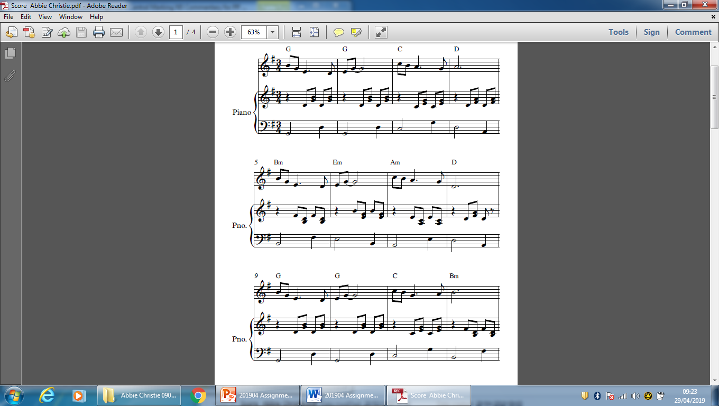

Slide 7
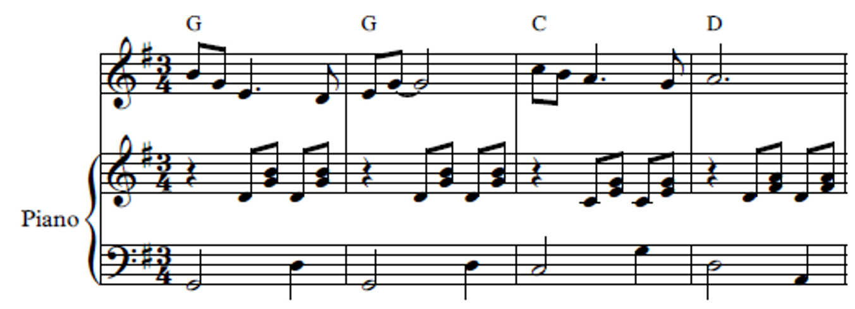

Slide 8
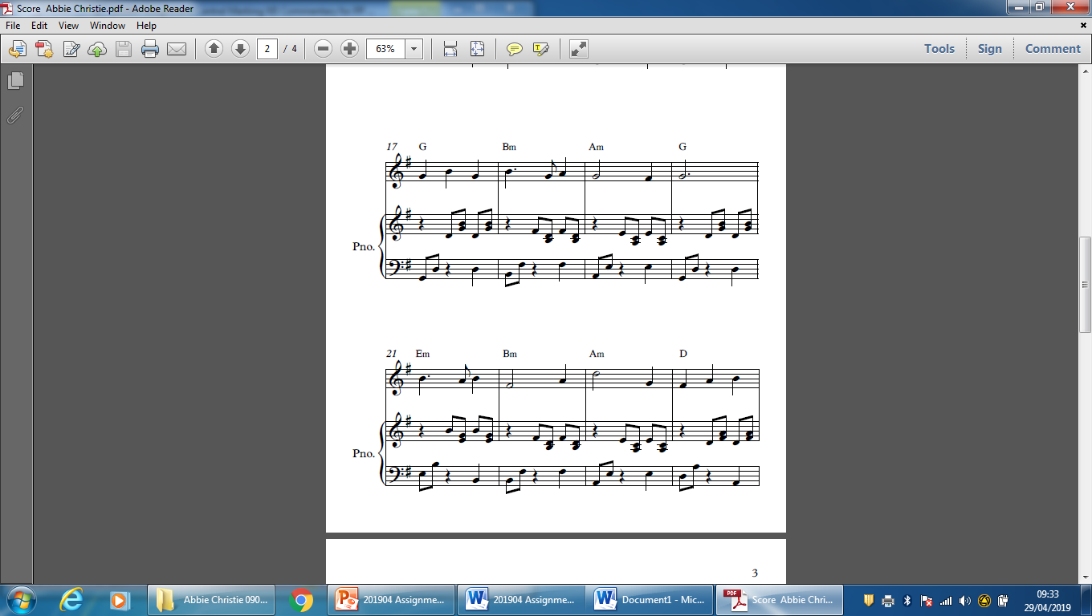

Slide 10
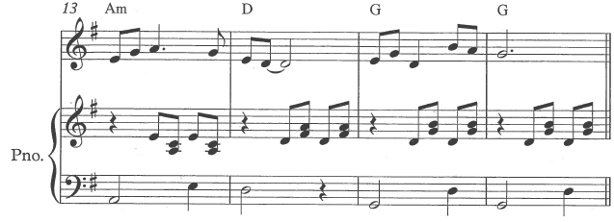
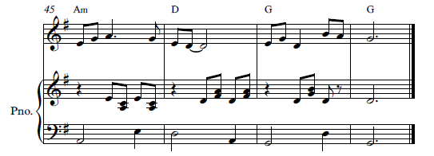
“..I made minimal changes to the bass line..”

Slide 12
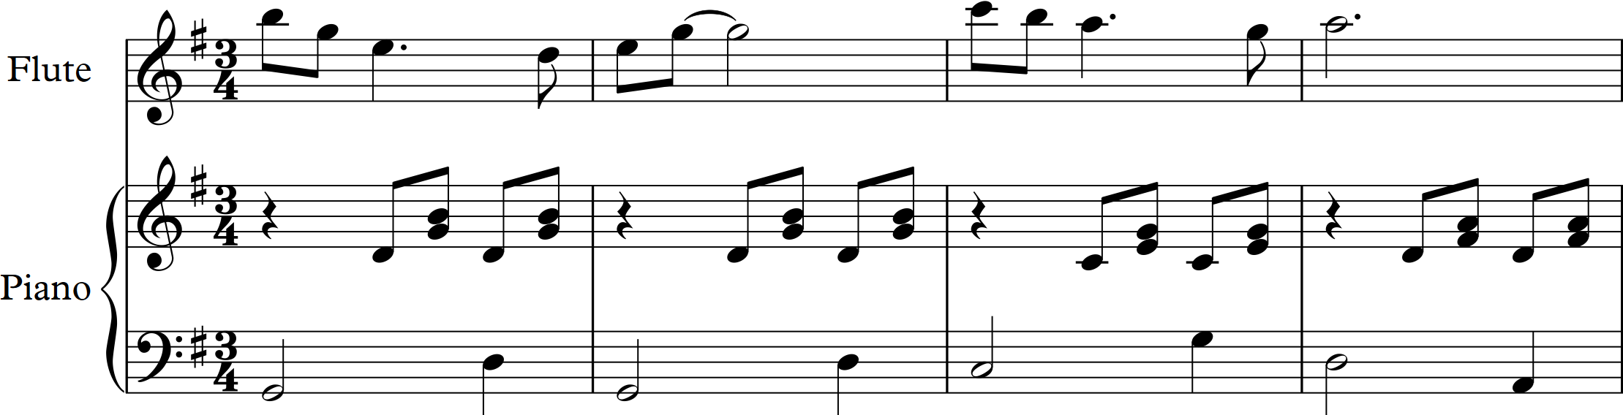
Melody transposed up an octave

Slide 13
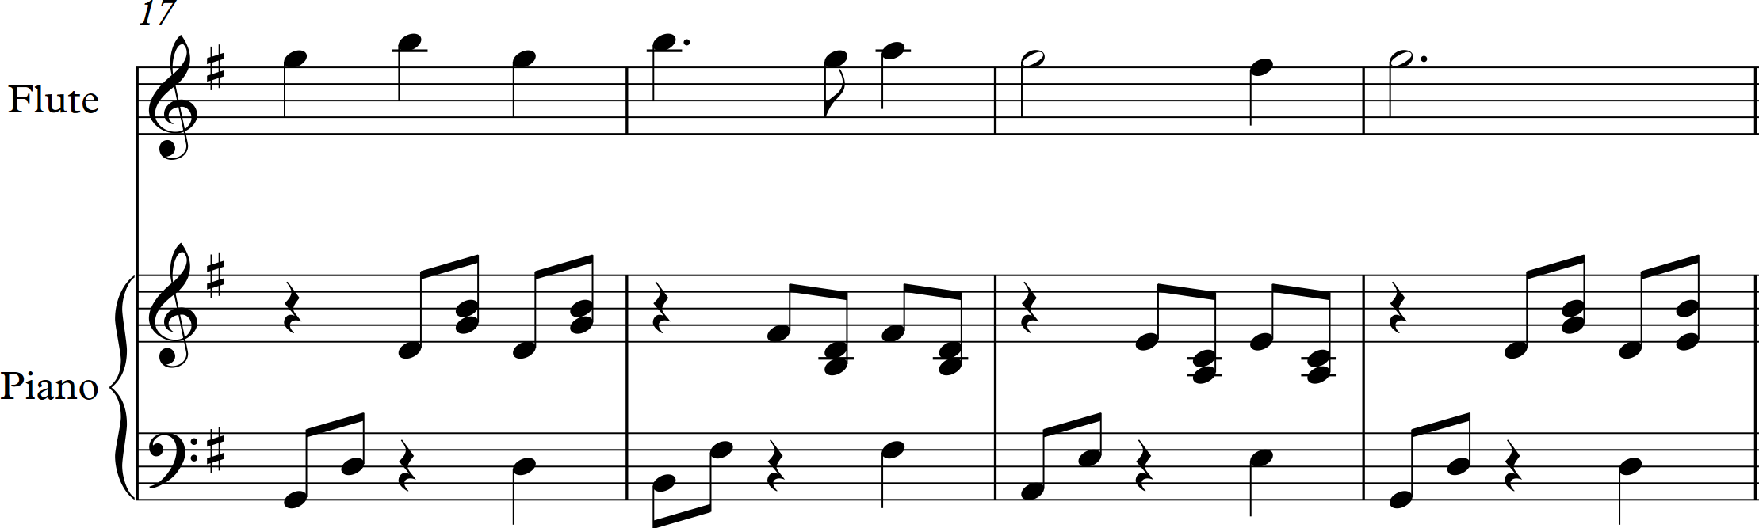
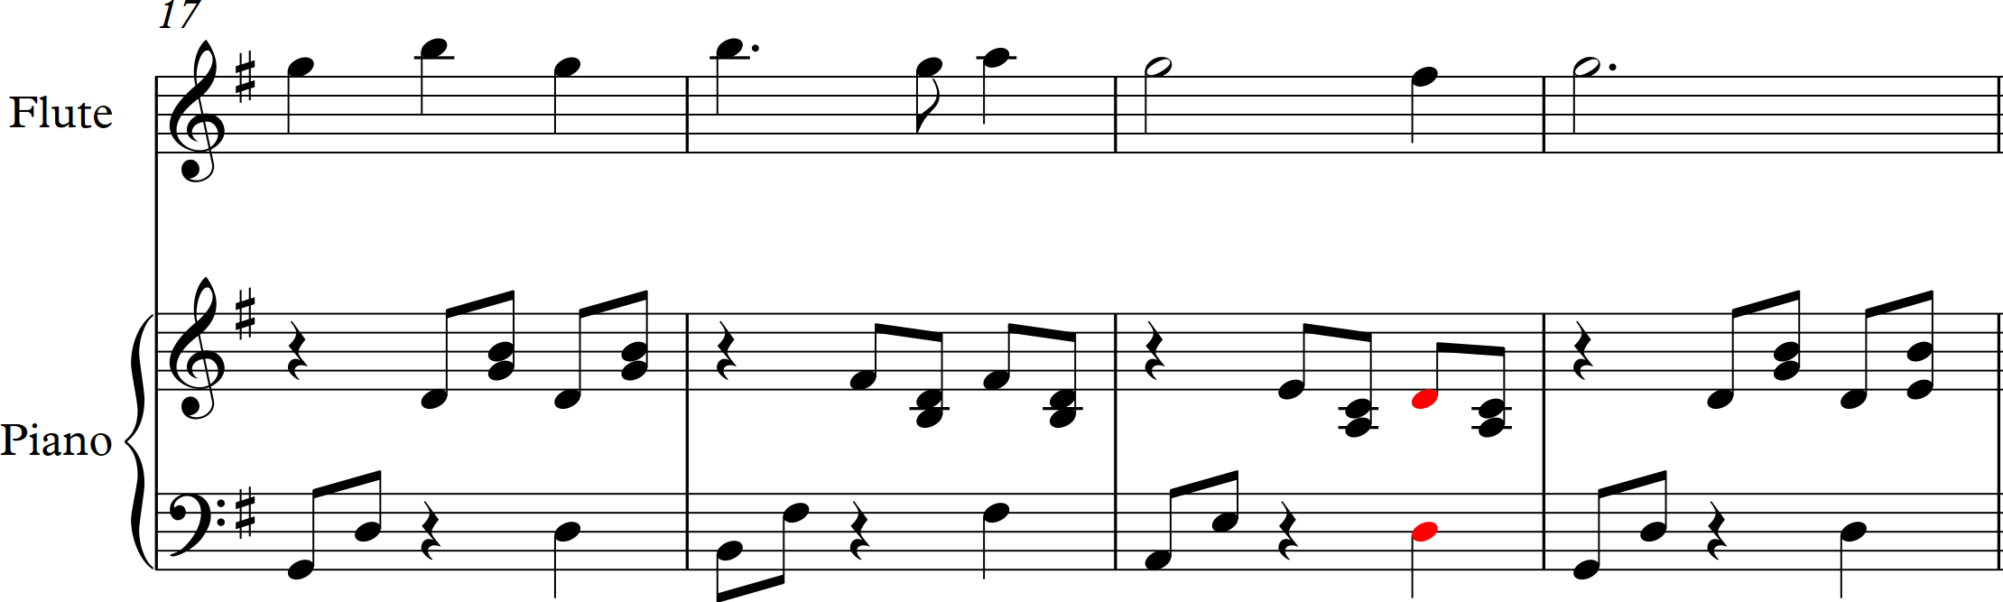
Original version
Amended harmony

Slide 14
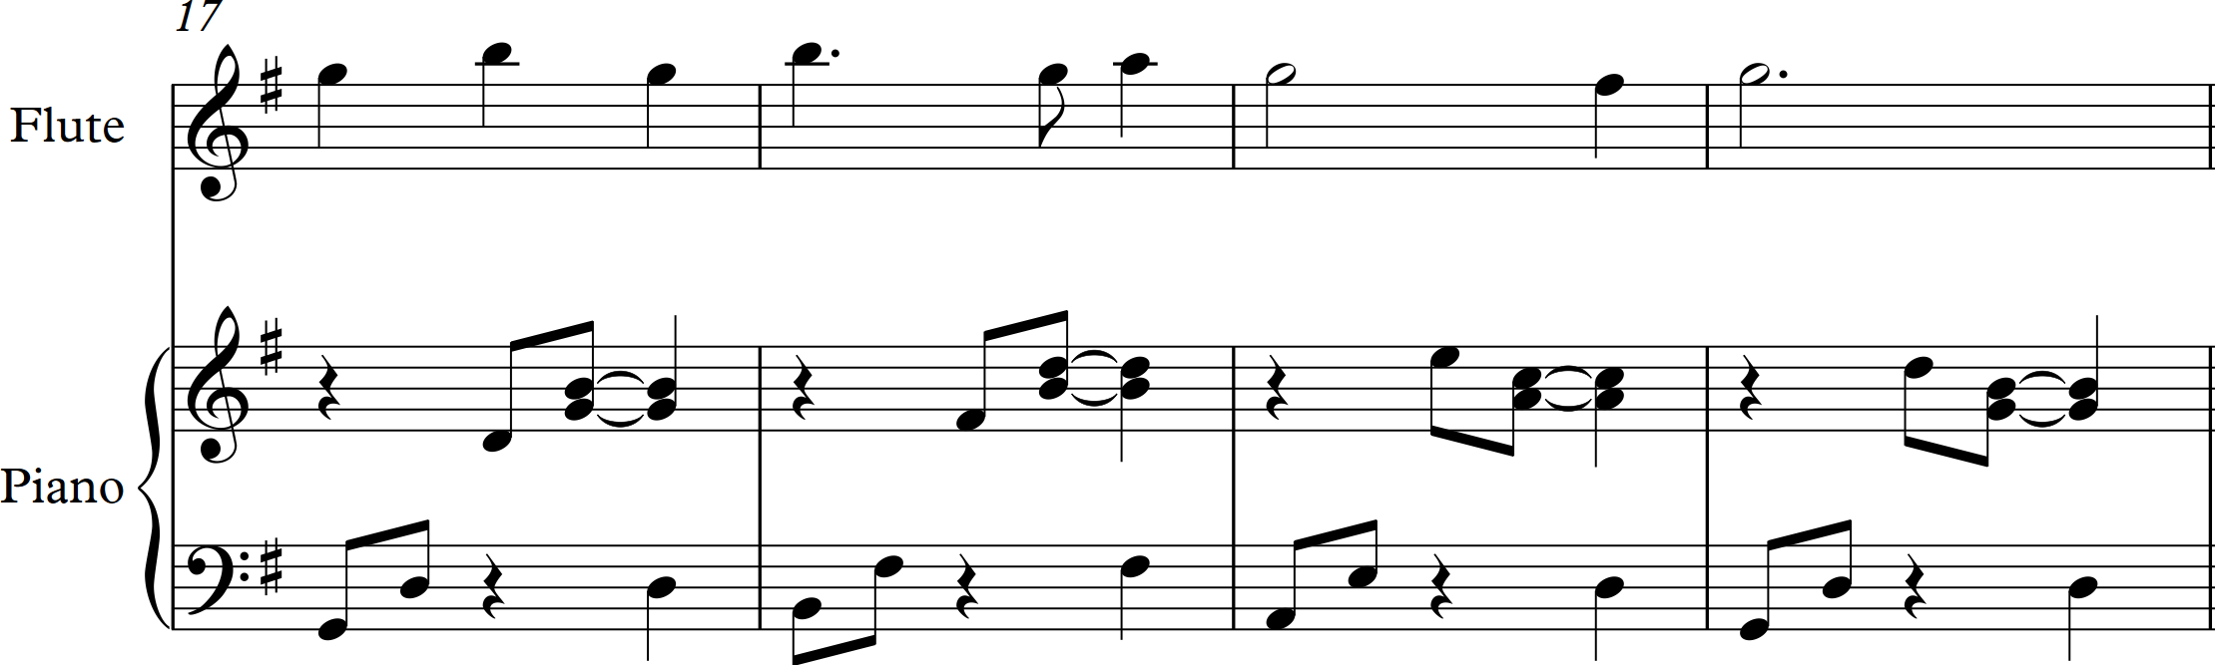
Different right-hand rhythms

Slide 15
Further examples
Song Without Words (clarinet, piano) – 20 marks (National 5 Music Assignment, October 2017)
Untitled (keyboard) – 16 marks (National 5 Music Assignment, November 2018)

