Slide 1

Higher Candidate 4 – Cast Adrift

Slide 2
Annotations for a composition
Identification
Development
Inconsistencies

Slide 3
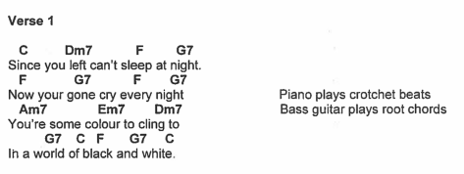

Slide 4
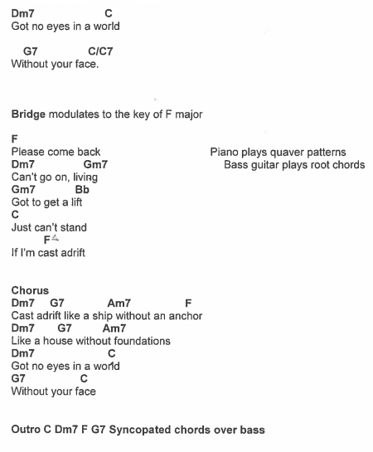

Slide 6
Structure
Intro
Verse 1
Chorus
Verse 2
Chorus
Bridge
Chorus
Outro

Slide 7
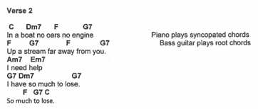

Slide 8


Slide 9
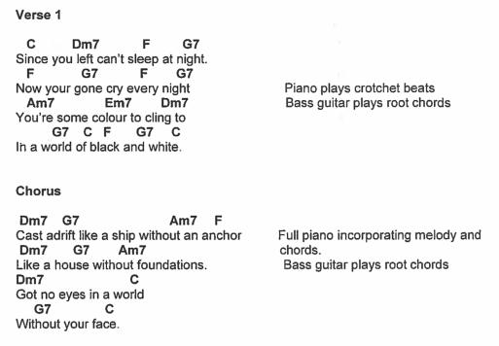

Slide 10
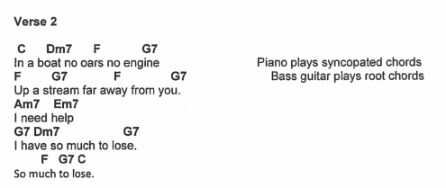

Slide 11
Candidate 4 – Cast Adrift – 11 marks
12-14 mark range
A good composition demonstrating a range of musical ideas which have been developed competently – appropriate to the candidate’s chosen style. The selection and use of elements shows some creativity.
10-11 mark range
A composition demonstrating musical ideas which have been developed satisfactorily – appropriate to the candidate’s chosen style. The selection and use of elements may be simplistic and straightforward.
7-9 mark range
A composition demonstrating musical ideas which have been developed inconsistently to the candidate’s chosen style. The selection and use of elements is not always appropriate.

Slide 12
Further examples
Sleep Tight (voice and guitar) – 16 marks (Higher Music Assignment Commentary, June 2018)
Beside You (voice, guitar, piano, drum kit) – 15 marks (Higher Music Assignment Commentary, October 2018)

