Slide 1

Higher Candidate 3 – Piece for Flute, Guitar and Piano

Slide 2
Candidate 3 – Piece for flute, guitar and piano – 7 marks
10-11 mark range
A composition demonstrating musical ideas which have been developed satisfactorily – appropriate to the candidate’s chosen style. The selection and use of elements may be simplistic and straightforward.
7-9 mark range
A composition demonstrating musical ideas which have been developed inconsistently to the candidate’s chosen style. The selection and use of elements is not always appropriate.
4-6 mark range
A composition demonstrating limited musical ideas with little development appropriate to the candidate’s chosen style. The selection and use of elements is poor.

Slide 3
Annotations for a composition
Identification
Development
Inconsistencies

Slide 4
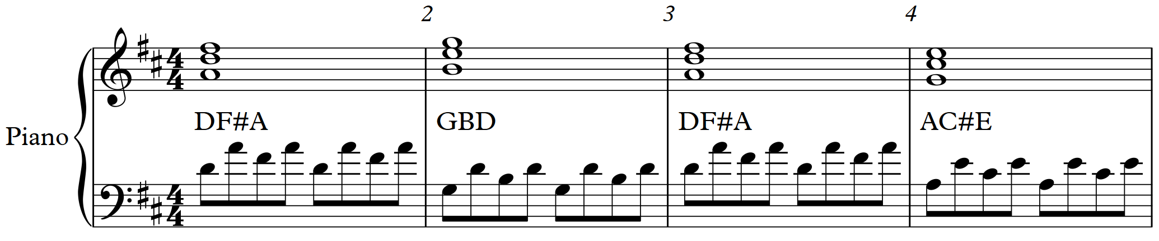

Slide 6
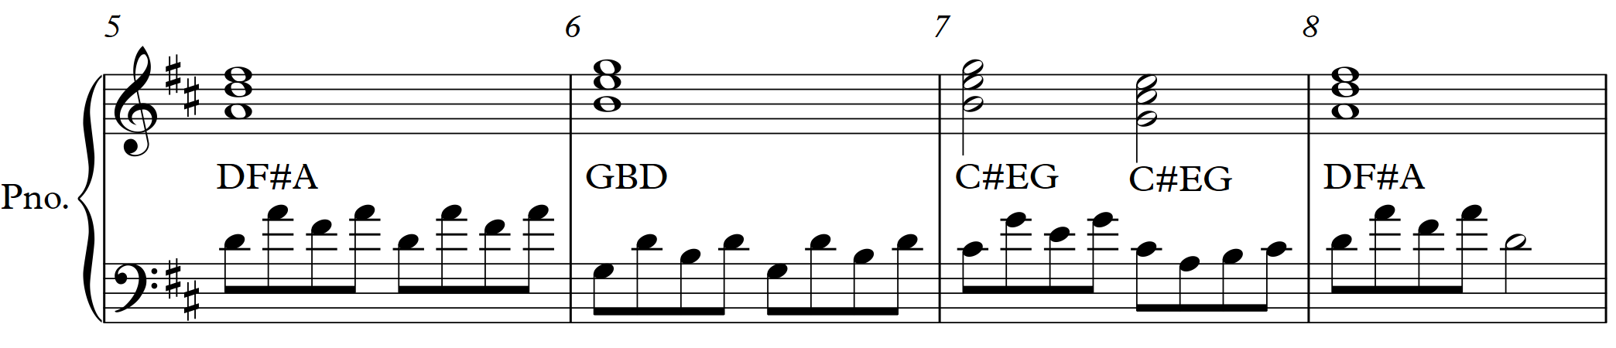

Slide 9
D | G | D | A7 | D | G | C#º A7 | D
D | G | D | A7 | D | G | C#º A7 | D
D | G | D | A7 | D | G | C#º A7 | D

Slide 10
D | G | D | A7 | D | G | C#º A7 | D
D | G | D | A7 | D | G | C#º A7 | D
Bm | Em | Bm | F#m | Bm | Em | A | Bm
D | G | D | A7 | D | G | C#º A7 | D

Slide 12
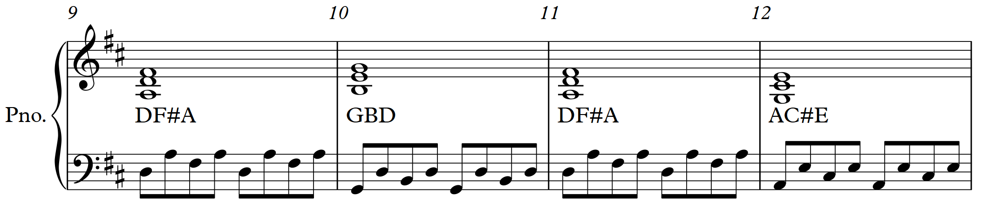

Slide 13
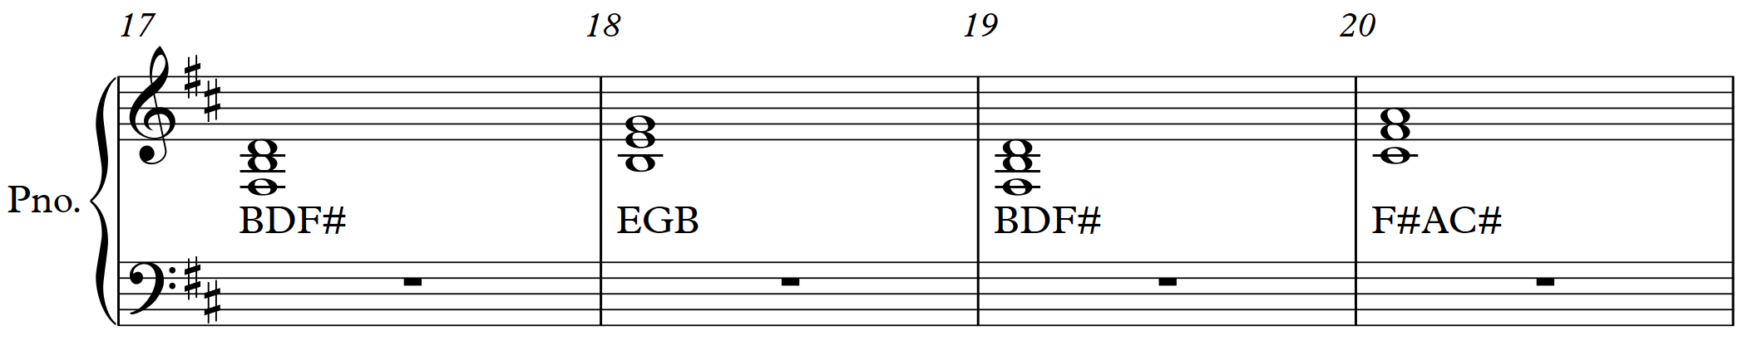
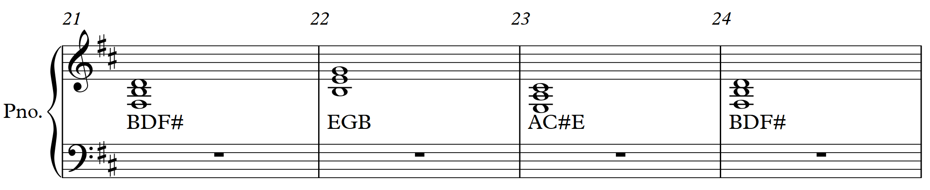

Slide 14
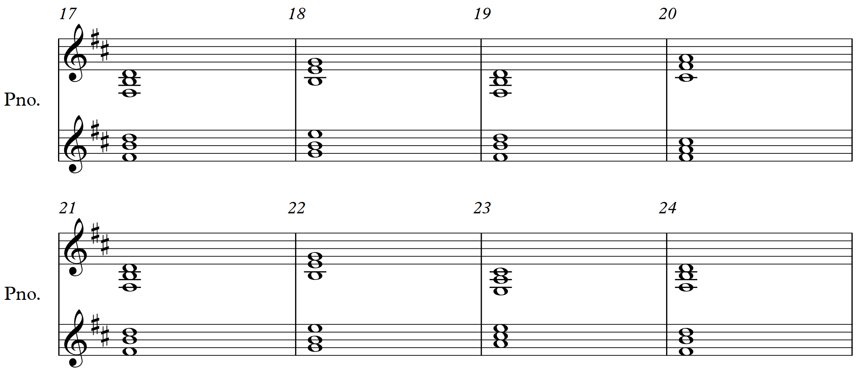
Original
chords
New chord
positions
Original
chords
New chord
positions

Slide 15
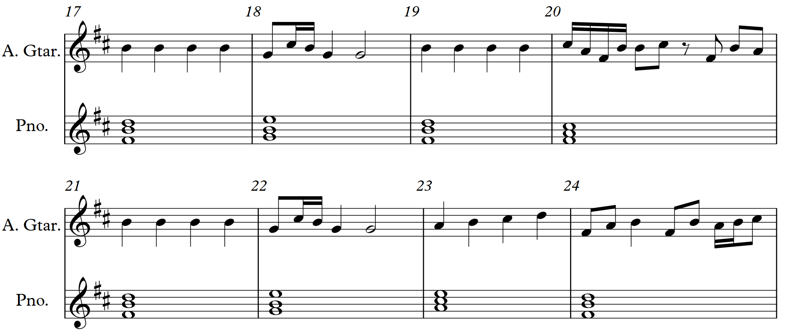

Slide 16
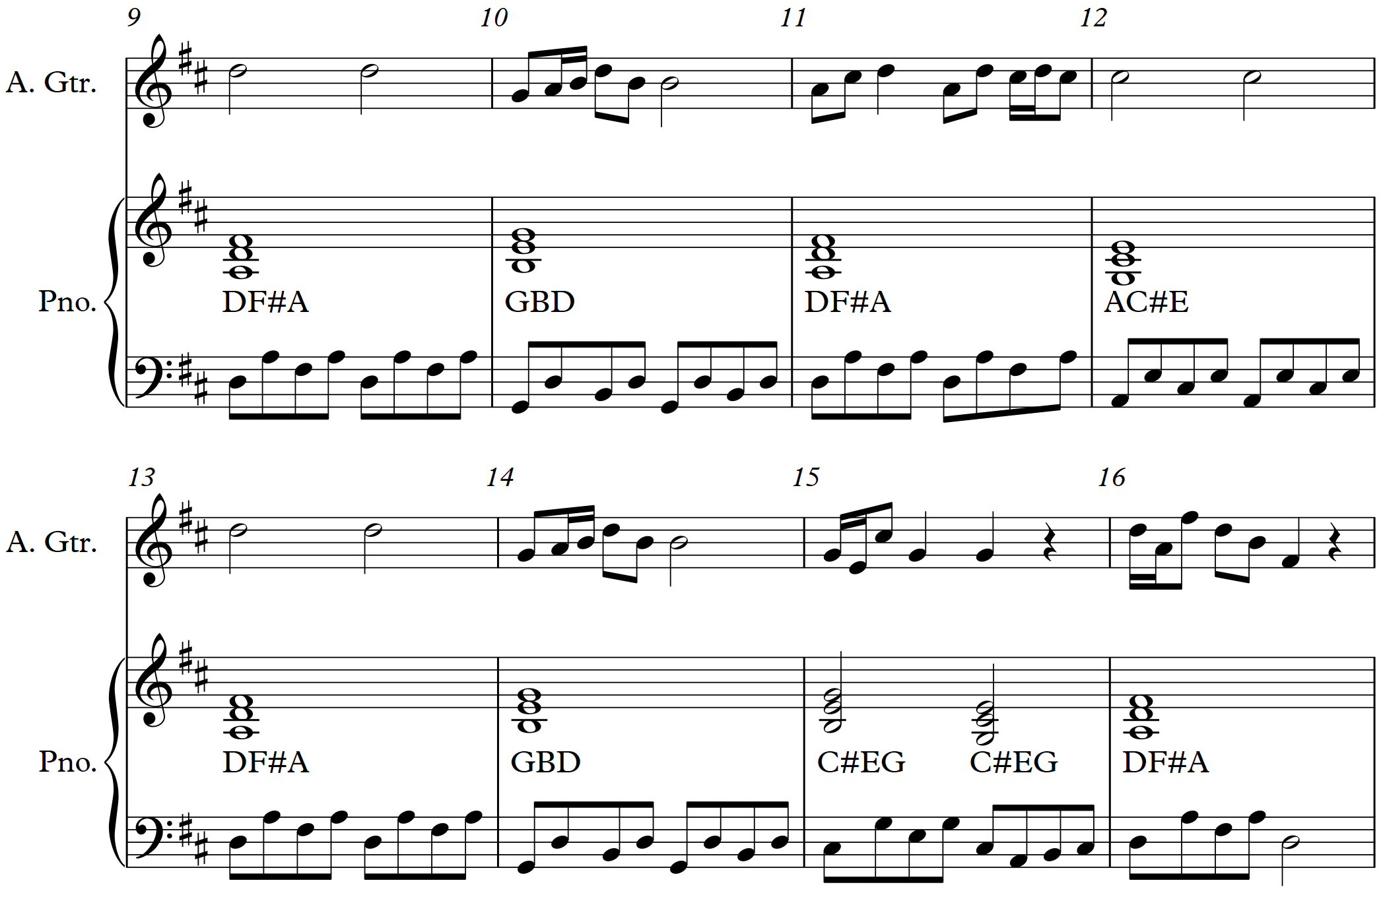

Slide 18
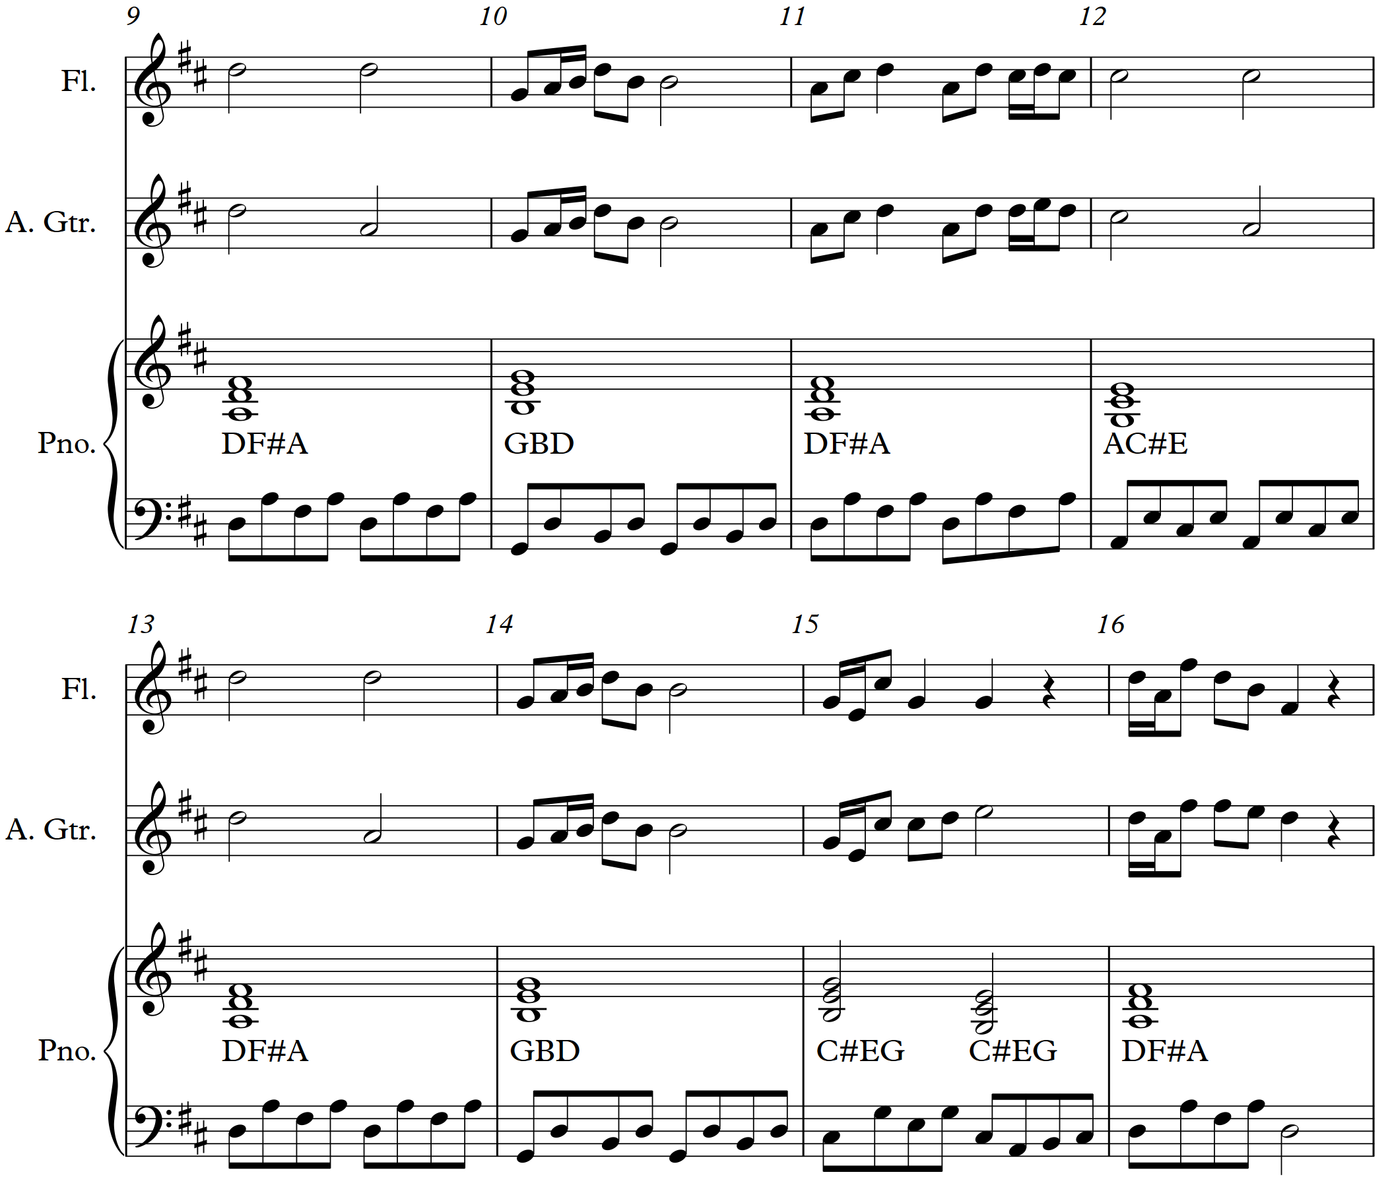
Original melody
Altered melody
Original melody
Altered melody

Slide 19
Original melody
Altered melody
Original melody
Altered melody

Slide 20
Original melody
Altered melody
Original melody
Altered melody

Slide 21
Original melody
Altered melody
Original melody
Altered melody

Slide 22
Original melody
Altered melody
Original melody
Altered melody

Slide 23
Original melody
Altered melody
Original melody
Altered melody

Slide 24
Original melody
Altered melody
Original melody
Altered melody

Slide 25
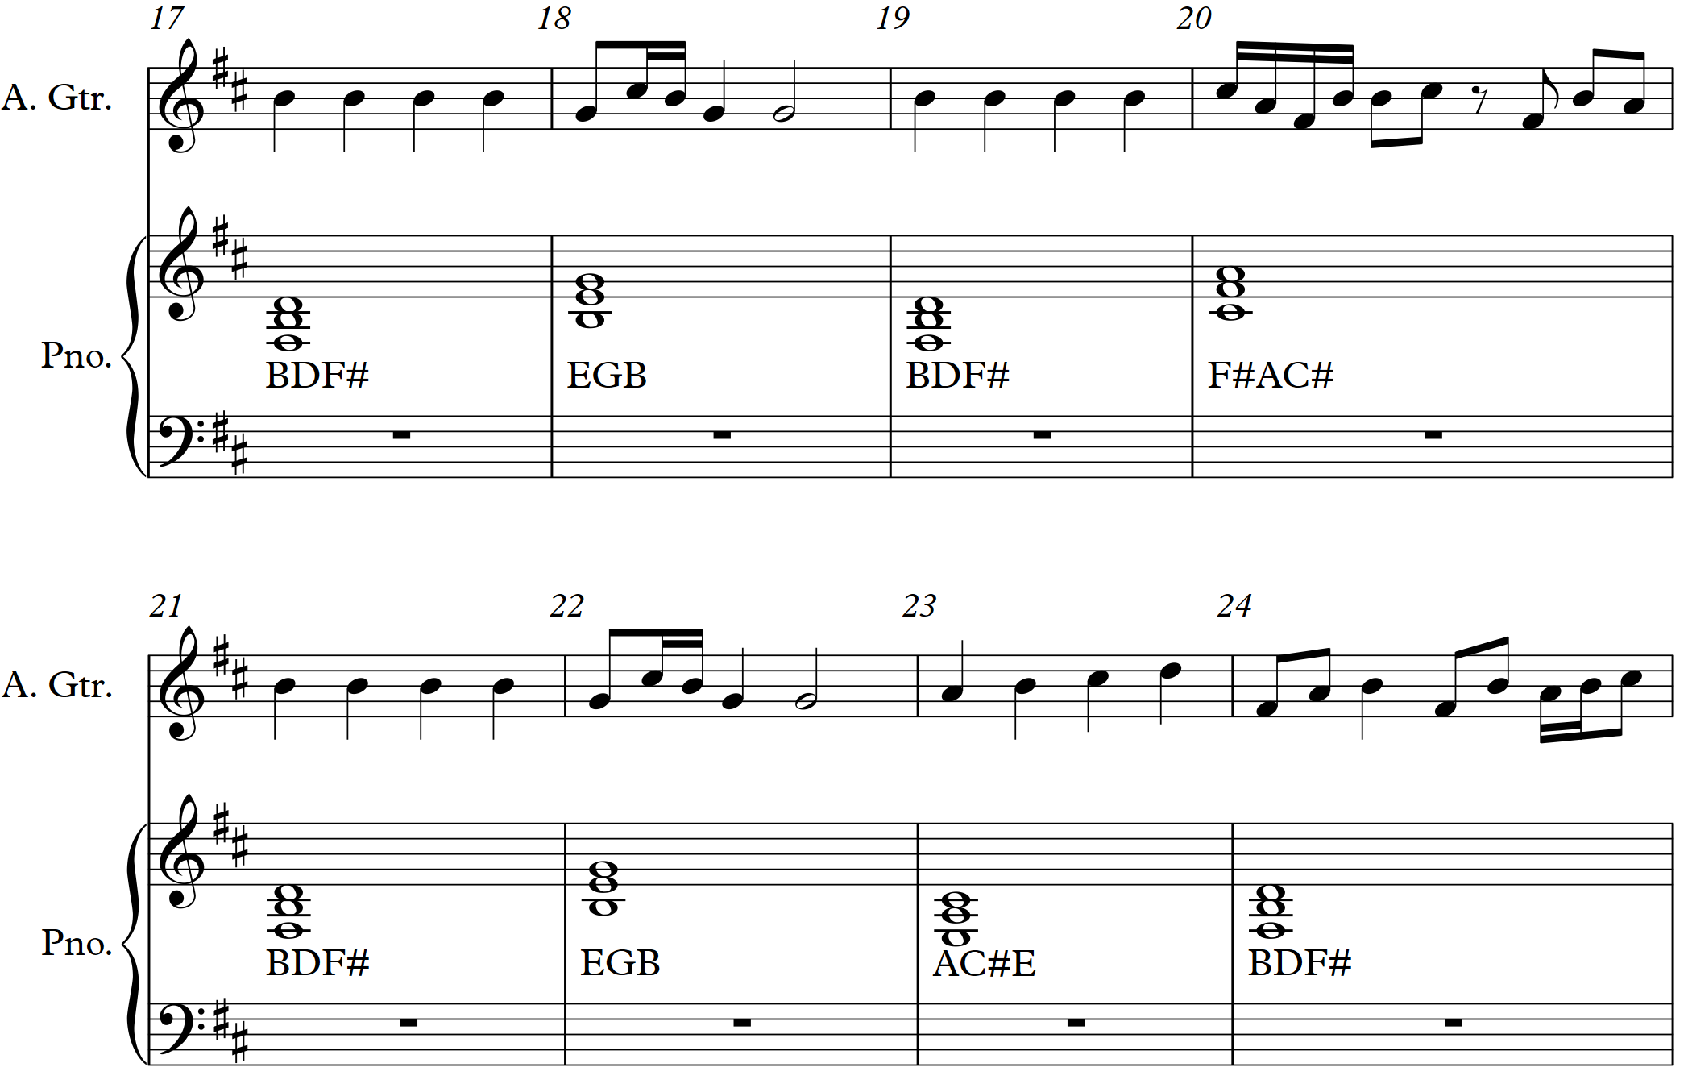

Slide 27
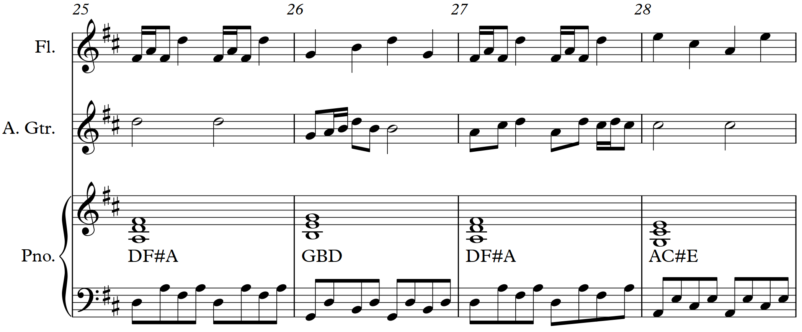

Slide 29
Further examples
The Flowing Teviot (oboe, clarinet and piano) .– 18 marks (Higher Music Assignment Commentary, October 2018)
As I Like It (cornet and piano) – 20 marks (Higher Music Assignment Commentary, June 2018)

