Slide 1

Higher Candidate 1 – Piece for Piano and Cello

Slide 2
Candidate 1 – Piece for piano and cello – 10 marks
12-14 mark range
A good composition demonstrating a range of musical ideas which have been developed competently – appropriate to the candidate’s chosen style. The selection and use of elements shows some creativity.
10-11 mark range
A composition demonstrating musical ideas which have been developed satisfactorily – appropriate to the candidate’s chosen style. The selection and use of elements may be simplistic and straightforward.
7-9 mark range
A composition demonstrating musical ideas which have been developed inconsistently to the candidate’s chosen style. The selection and use of elements is not always appropriate.

Slide 3
Annotations for a composition
Identification
Development
Inconsistencies

Slide 4
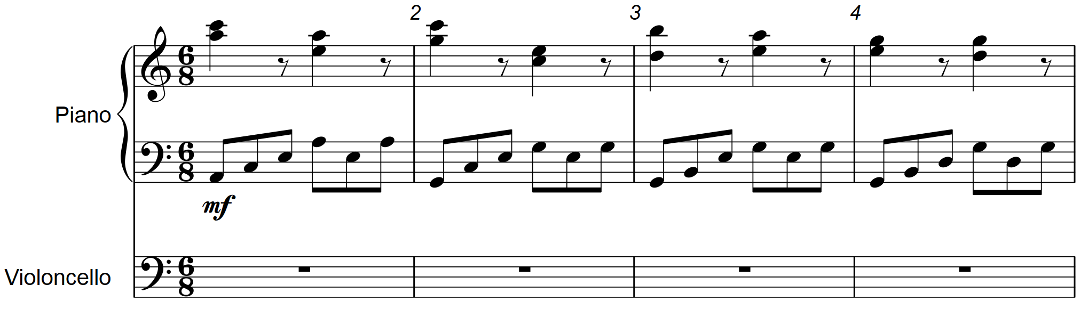

Slide 7
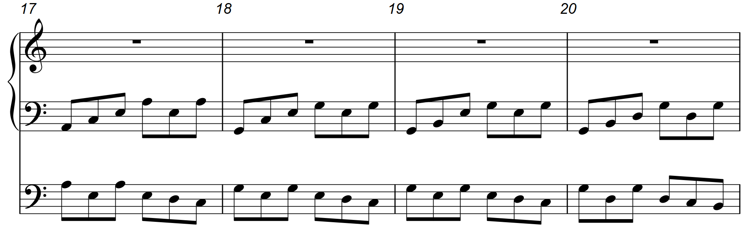

Slide 9
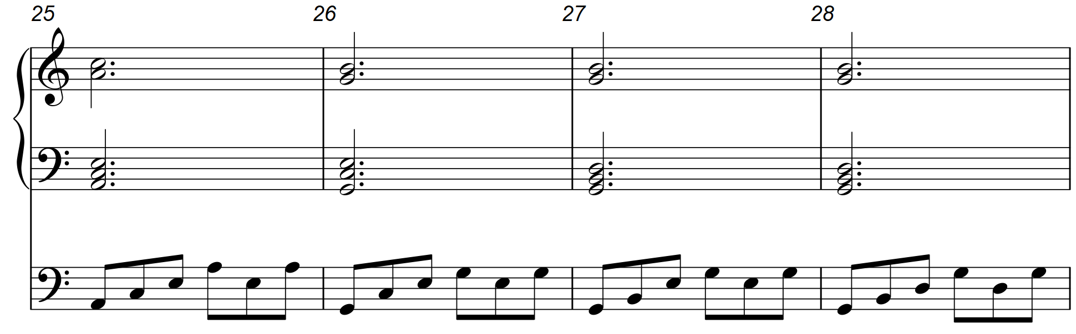

Slide 10
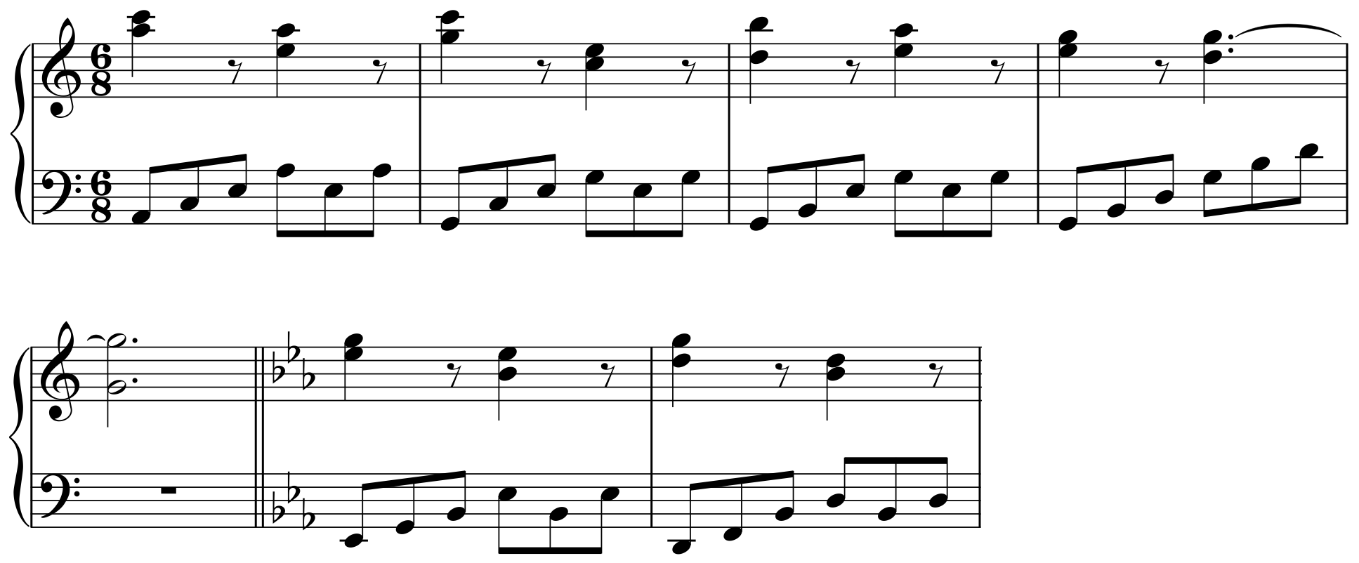
Developing the harmony by adding a pivot note

Slide 11
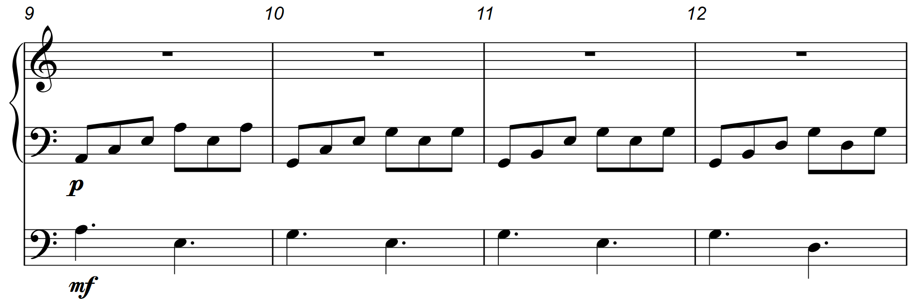
Piano
Cello

Slide 12
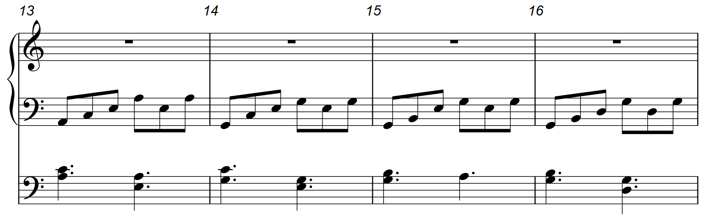
Piano
Cello
Piano
Cello

Slide 13
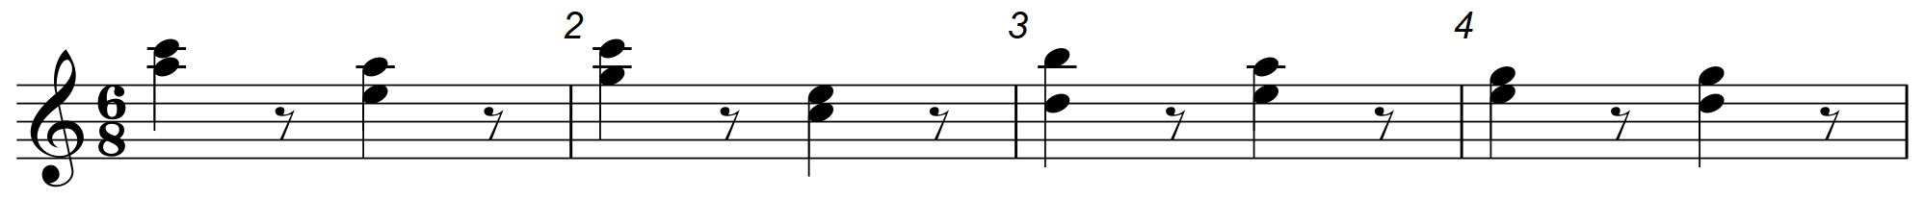
Piano
RH

Slide 14
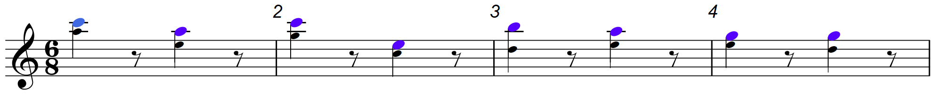
Piano
RH
Piano
RH

Slide 15
Piano
RH
Cello

Slide 16
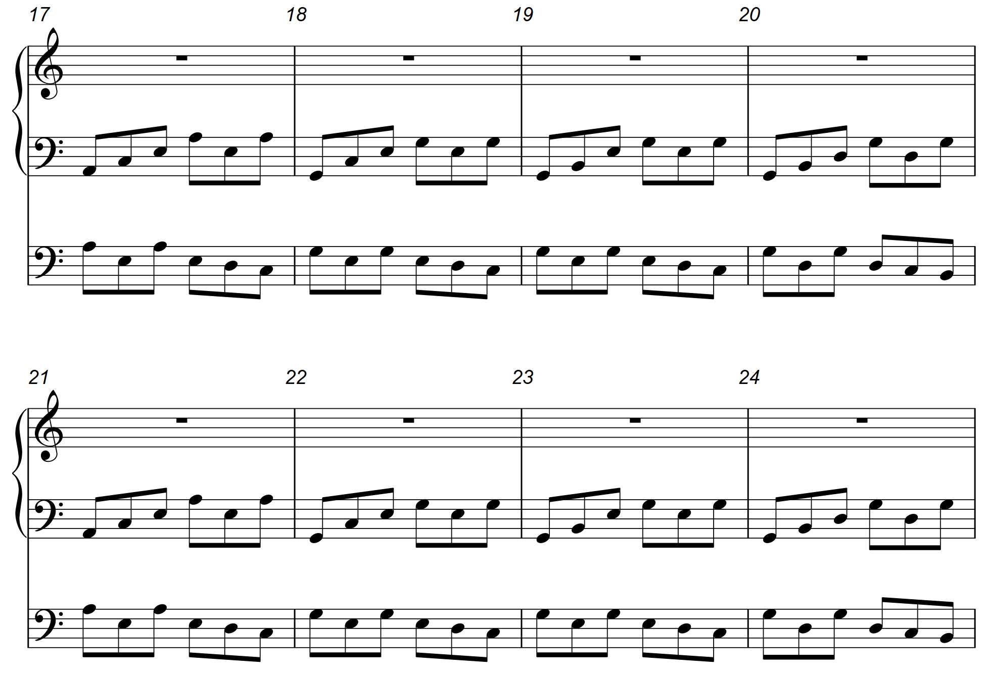
Piano
Cello
Piano
Cello

Slide 17
Piano
Cello
Piano
Cello

Slide 18
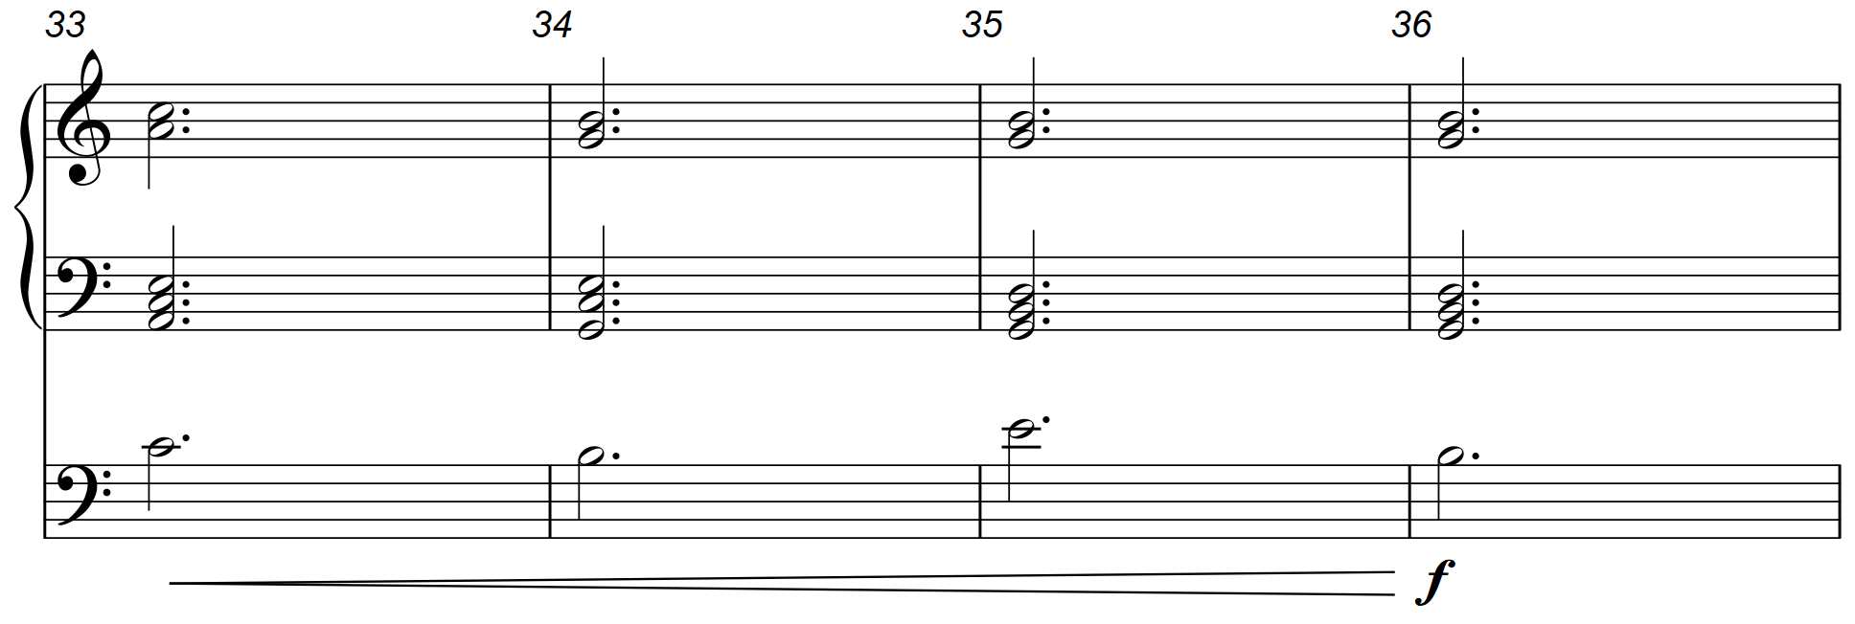
Piano
Cello

Slide 19
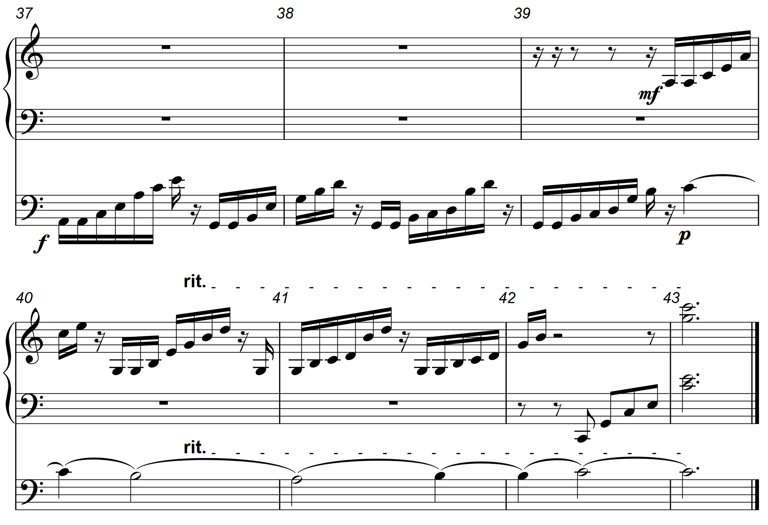
Piano
Cello
Piano
Cello

Slide 20
Piano
Cello
Piano
Cello

Slide 21
What advice could you give to candidates?
Ask the candidate ‘what could you do to develop the melody?’

Slide 22
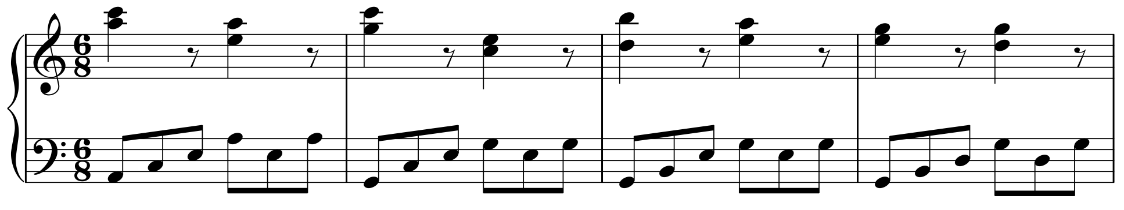
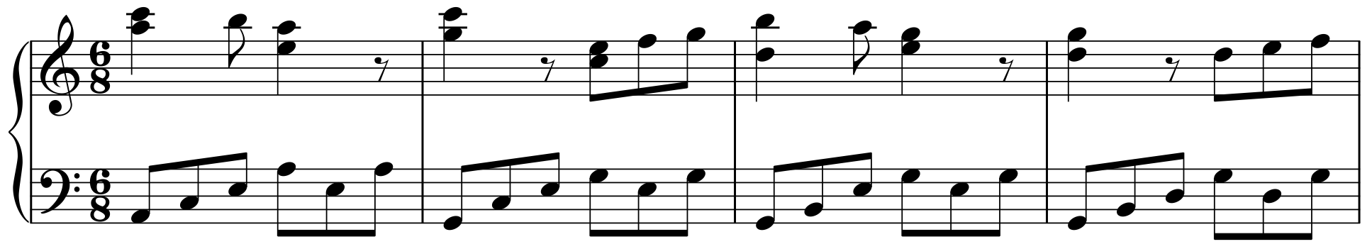
Original ‘melody’
Developing the melody – adding passing notes

Slide 23
Original ‘melody’
Developing the melody – additional quavers for rhythmic interest

Slide 24
Original ‘melody’
Developing the melody – notes amended to fit with harmony

Slide 25
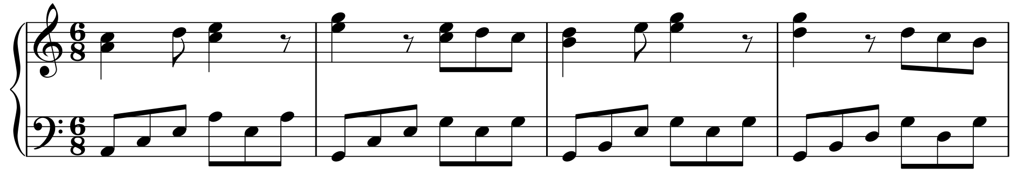
Developing the melody – inverting the shape

Slide 26
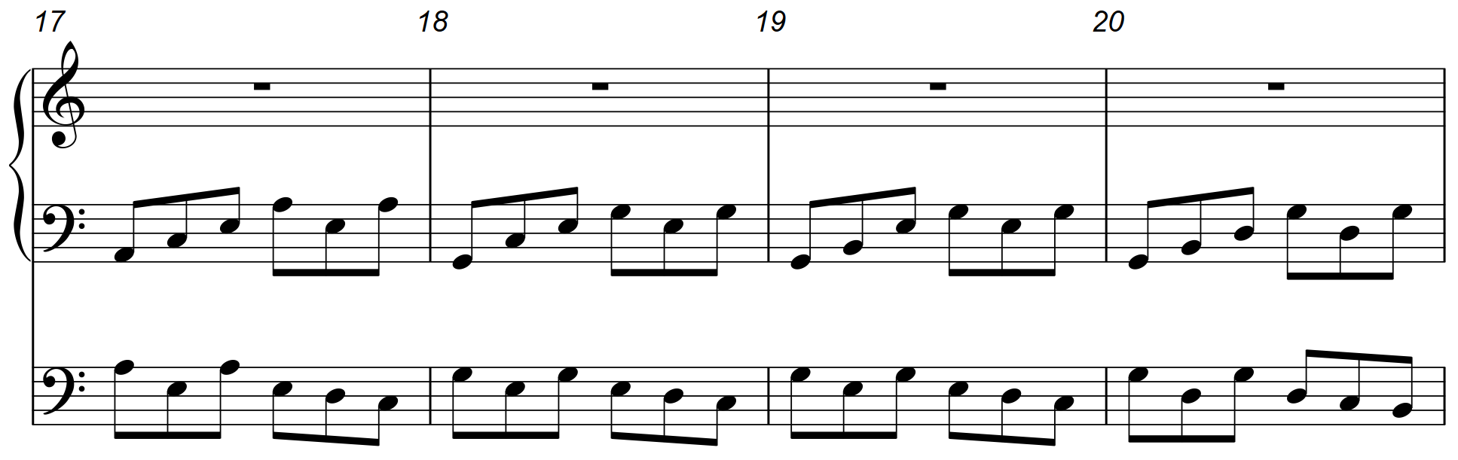
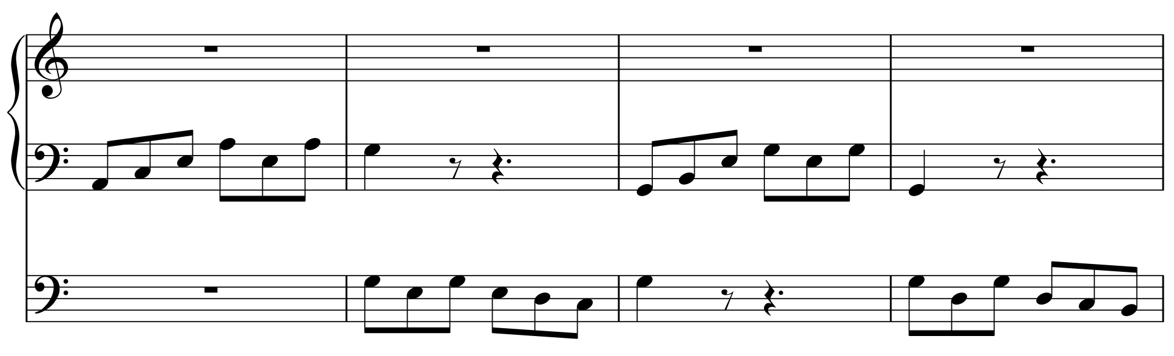
Piano
Cello
‘Dovetailing’ the instruments – notice how the parts overlap
Piano
Cello

Slide 27
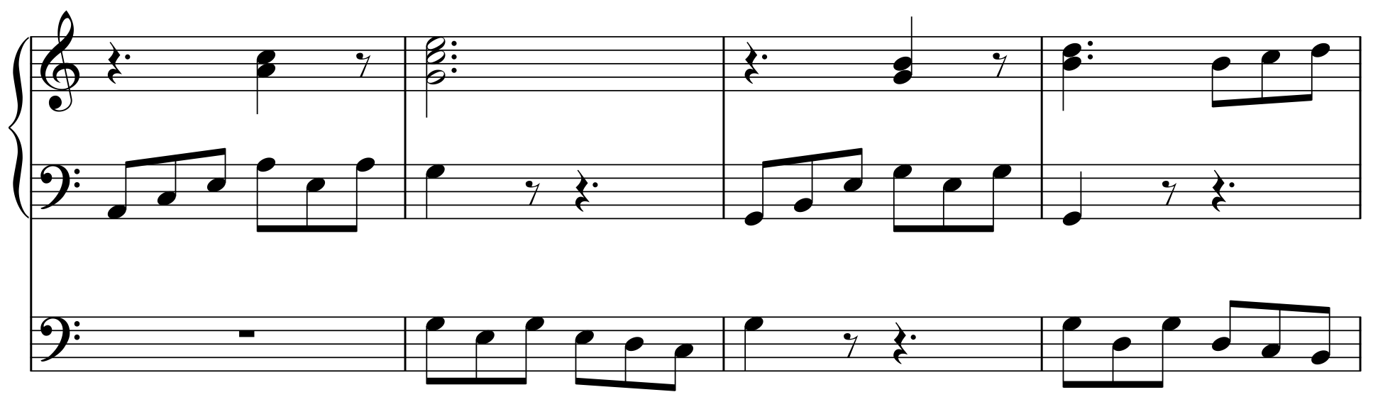
Piano
Cello
Right hand piano part added from notes of the underlying chords, leaving space for other instruments to be heard.
Piano
Cello

Slide 28
Further examples
Copy Cat Rag (marimba and piano) – 17 marks (Higher Music Assignment Commentary, October 2018)
Siciliana (flute and harp) – 17 marks (Higher Music Assignment Commentary, October 2018)

