Slide 1

Advanced Higher Candidate 9 – Shaiman: I Know Where I’ve Been (Hairspray)
Analysis

Slide 2
Analysis requirement
You must identify key features within your chosen piece by referring to at least five of the elements below:
style
melody
harmony
rhythm and tempo
texture
structure and/or form
timbre and dynamics

Slide 3
Bars:
1-4 | 5-12 | 13-21* | 22-29 | 30-37 | 38-45 | 46-53 | 54-60
Intro | Verse 1 | Verse 2 | Middle 8 | Verse 3 | Middle 8 | Verse 4 | Coda
G major | G major modulating to E minor before descending to D7sus4 and back to G in bar 12. | G major. Same chord pattern as v.1, but stays in E minor after modulation | E minor, modulating back to G major during bar 34. | G major with same chord sequence as other verses until bar 41, C/D chord is used to lead back to G major instead of E minor | Am7 chord goes straight to E minor for partial repeat of middle 8 chord sequence. Bar 50 moves from B chord to D and then up a semitone to E♭ (chord V in new key) to modulate to A♭ major. | A♭ major | A♭ major

Slide 4
‘Worth noting from the table above is that the song follows a regular 8 bar structure throughout, but at the end of verse 2 an extra bar* is added. This allows for a short saxophone and rhythm guitar interjection and, perhaps also by delaying the start of the middle 8 gives it more emphasis.’

Slide 5
‘The music crescendos as they sing about the struggle to overcome.
Unison is used in the backing vocals (“I know it, I know it”) to emphasise their determination to win and also by all voices and instruments in the 3rd last bar’.

Slide 6
‘The backing vocals are used very effectively. Often in gospel songs they sing most of the time but here they start by softly humming in unison in the first Middle 8. Before that, in bar 13 a lone soprano, when Motormouth sings ‘There’s a cry’, provides a high, drawn-out pedal, imitating a cry.’

Slide 7
‘In verse 3 as well as humming in harmony, the backing vocals echo the soloist’s word “dream”, before singing more loudly the melody with words in three-part harmony in the second Middle 8.
This subtle use of vocals builds up the texture and tension.’

Slide 8
‘The drum kit is sensitively used with a closed hi-hat tap on beats 2 and 4, highlighting the rhythm guitar part.
The saxophone also provides interjections at the ends of phrases, in a call and response fashion as befits the gospel style. This economical use of instruments allows the voice to come through even though the singer is singing softly.’

Slide 9
‘In one of the biggest climaxes of the song, the music modulates from G major to Ab major. While this happens, underneath the word “take” the drum kit plays a fill using all twelve quavers of the bar, followed by the piano (R.H) playing the same rhythm in octaves, accenting the modulation. Time code ref: 3.05-3.12

Slide 10
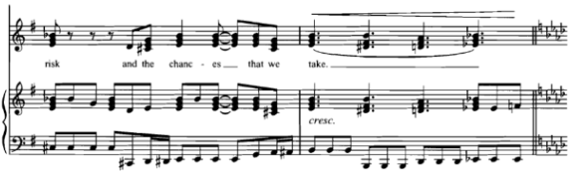
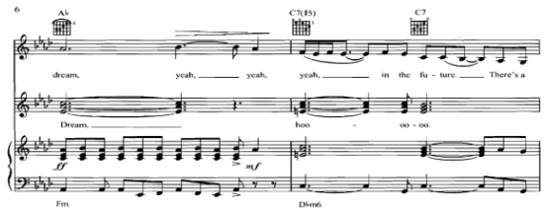
Time code ref: 3.05-3.12

Slide 11
‘I Know Where I’ve Been’ is a song from the 2007 film Hairspray. Hairspray is set in Baltimore in 1962, six years before the Civil Rights Movement was passed in 1968. This song is sung by Motormouth Maybelle during a peaceful protest march and is about the struggles of her and her children’s past and their hopes for the future.’

Slide 12
Candidate 9 – Shaiman – 5 marks
5 marks
The candidate demonstrates a perceptive understanding of the chosen piece by giving a detailed identification of key features of the music, backed up with detailed reference to the audio and, where appropriate, a score or guide to the music.
4 marks
The candidate demonstrates a secure understanding of the chosen piece by giving a fairly detailed identification of key features of the music, backed up with fairly detailed reference to the audio and, where appropriate, a score or guide to the music.
3 marks
The candidate demonstrates a satisfactory understanding of the chosen piece by giving a satisfactory identification of key features of the music, backed up with satisfactory reference to the audio and, where appropriate, a score or guide to the music.

Slide 13
Further example of analyses
Queen: Killer Queen – 5 marks (AH Music Assignment – candidate evidence, August 2019)
Mozart: Piano Sonata No 16 in C major – 4 marks (AH Music Assignment – candidate evidence, August 2019)
Debussy: Prélude à l’après-midi d’un faune – 1 mark (AH Music Assignment – candidate evidence, August 2019)

