Slide 1

Advanced Higher Candidate 8 – Beethoven: Symphony No 5, 1st Movement Analysis

Slide 2
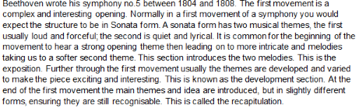

Slide 3
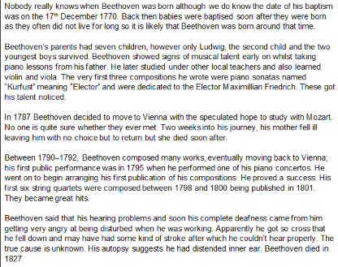

Slide 4
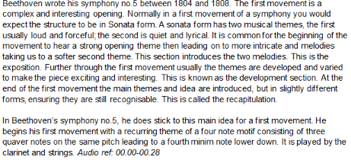

Slide 5
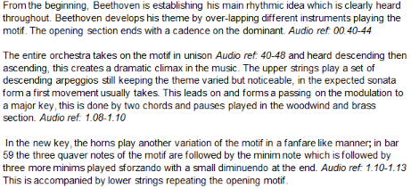

Slide 6
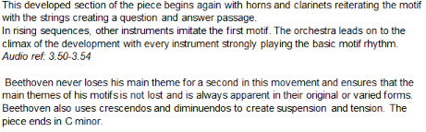

Slide 10


Slide 11
Analysis requirement
You must identify key features within your chosen piece by referring to at least five of the elements below:
style
melody
harmony
rhythm and tempo
texture
structure and/or form
timbre and dynamics

Slide 12
Candidate 8 – Beethoven– 1 mark
3 marks
The candidate demonstrates a satisfactory understanding of the chosen piece by giving a satisfactory identification of key features of the music, backed up with satisfactory reference to the audio and, where appropriate, a score or guide to the music.
2 marks
The candidate demonstrates a limited understanding of the chosen piece by giving a limited identification of key features of the music, backed up with limited reference to the audio and, where appropriate, a score or guide to the music.
1 mark
The candidate demonstrates little or no understanding of the chosen piece. There is little or no identification of key features of the music, backed up with little, inaccurate, or no reference to the audio nor, where appropriate, a score or guide to the music.

