Slide 1

Advanced Higher Candidate 7 – Pleyel: Violin Duo No. 6, Allegro
Analysis

Slide 2
Analysis requirement
You must identify key features within your chosen piece by referring to at least five of the elements below:
style
melody
harmony
rhythm and tempo
texture
structure and/or form
timbre and dynamics

Slide 3
A question to ask about an analysis
To what extent has the candidate demonstrated a perceptive understanding by identifying key features of the music, backed up with reference to the audio and score?

Slide 4
‘The final section starting at bar 138 has theme 1 back in E minor like the opening but this time after only 7 bars, theme 3 returns also in the key of E minor.’

Slide 5
‘In bars 1-6 violin 1 starts with theme 1 in E minor.’
‘At bar 13 violin 1 has theme 2 in G major.’
‘… where the tempo changes to ‘Tempo di menuetto’ … the key signature changes to E major.

Slide 6
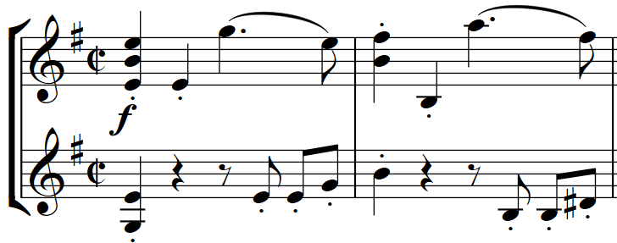
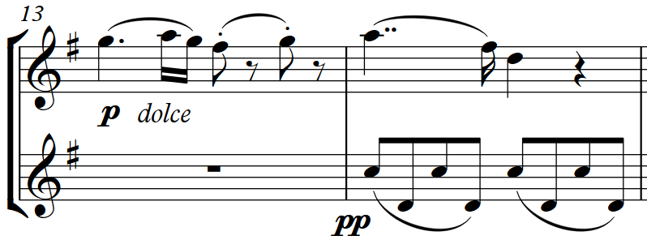
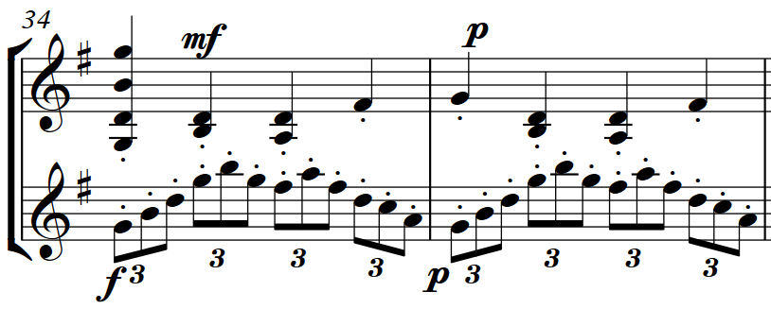
Theme 1
Theme 2
Theme 3

Slide 7
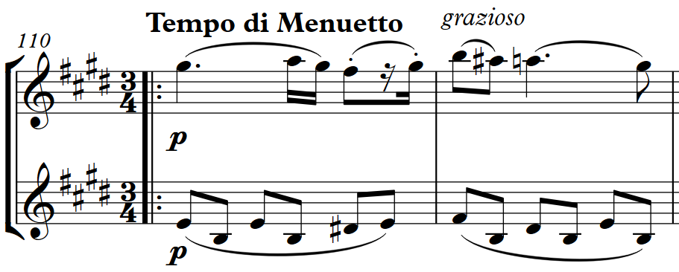
‘In bar 110 the violin 1 melody is similar to theme 2.’
Theme 2
Bar 110

Slide 8
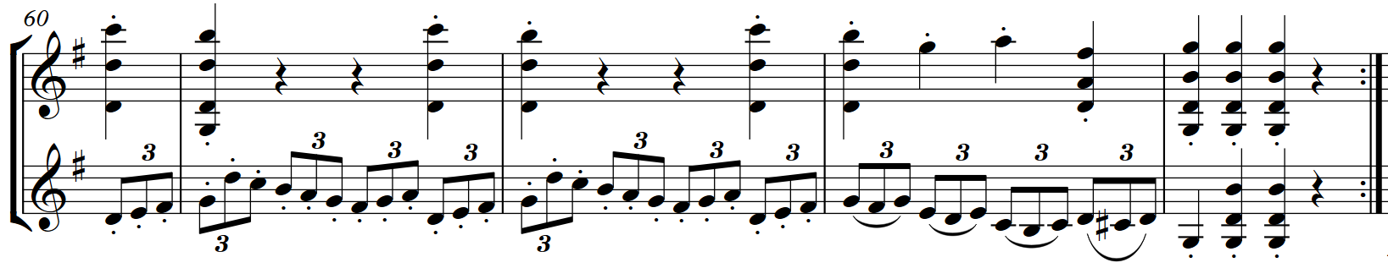
‘Both violins have chords.’

Slide 9
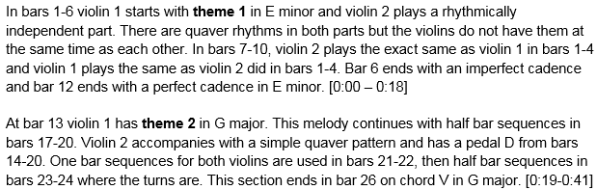

Slide 10
How could a candidate write about the key features?
Write in chronological order.
Focus on one element initially.

Slide 11
Candidate 7 – Pleyel – 3 marks
4 marks
The candidate demonstrates a secure understanding of the chosen piece by giving a fairly detailed identification of key features of the music, backed up with fairly detailed reference to the audio and, where appropriate, a score or guide to the music.
3 marks
The candidate demonstrates a satisfactory understanding of the chosen piece by giving a satisfactory identification of key features of the music, backed up with satisfactory reference to the audio and, where appropriate, a score or guide to the music.
2 marks
The candidate demonstrates a limited understanding of the chosen piece by giving a limited identification of key features of the music, backed up with limited reference to the audio and, where appropriate, a score or guide to the music.

