Slide 1

Advanced Higher Candidate 6 – Spanish Eyes arrangement

Slide 2
Questions to ask about an arrangement
What is the candidate’s creative input?
What has worked well?

Slide 3
Annotations for a composition or arrangement
Identification
Development
Inconsistencies

Slide 4
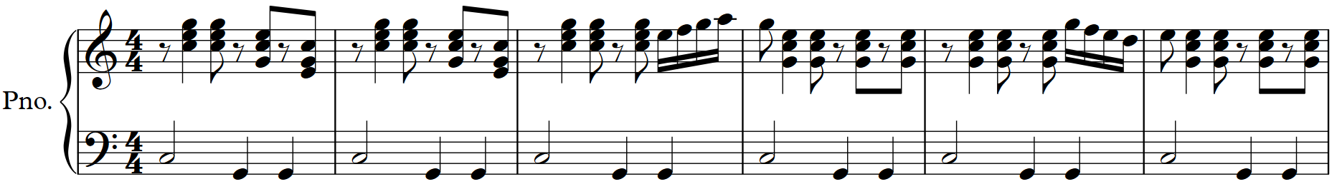
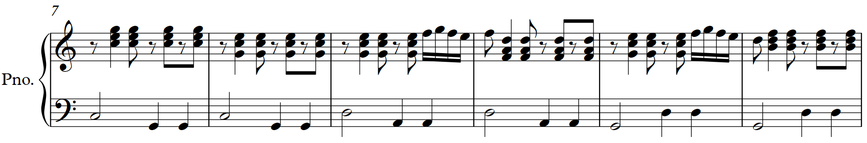
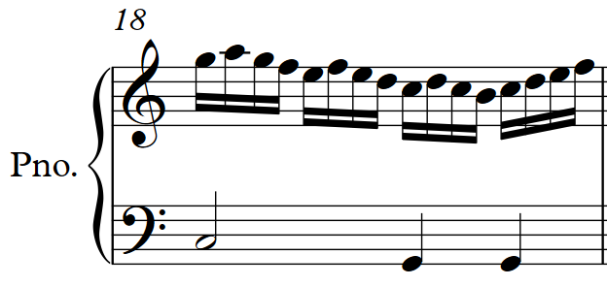

Slide 8
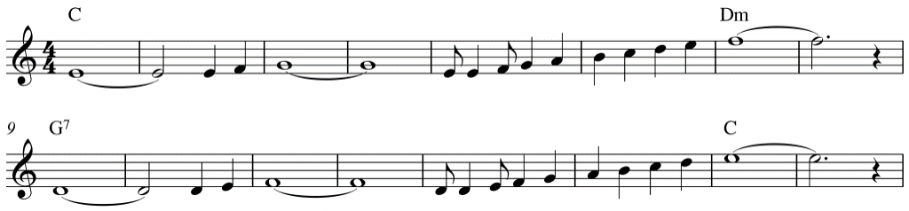
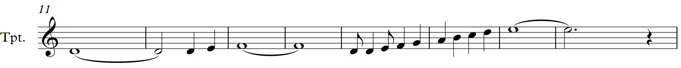
Source
material

Slide 9
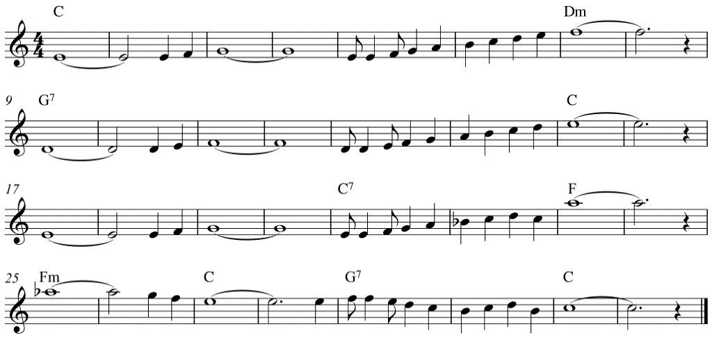
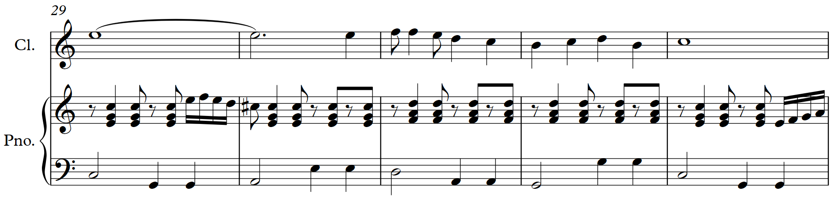
Source
material

Slide 10
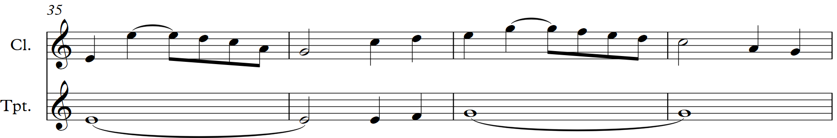
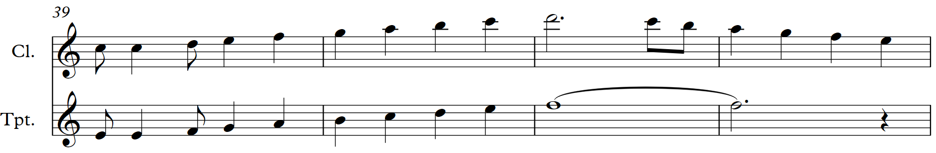

Slide 13
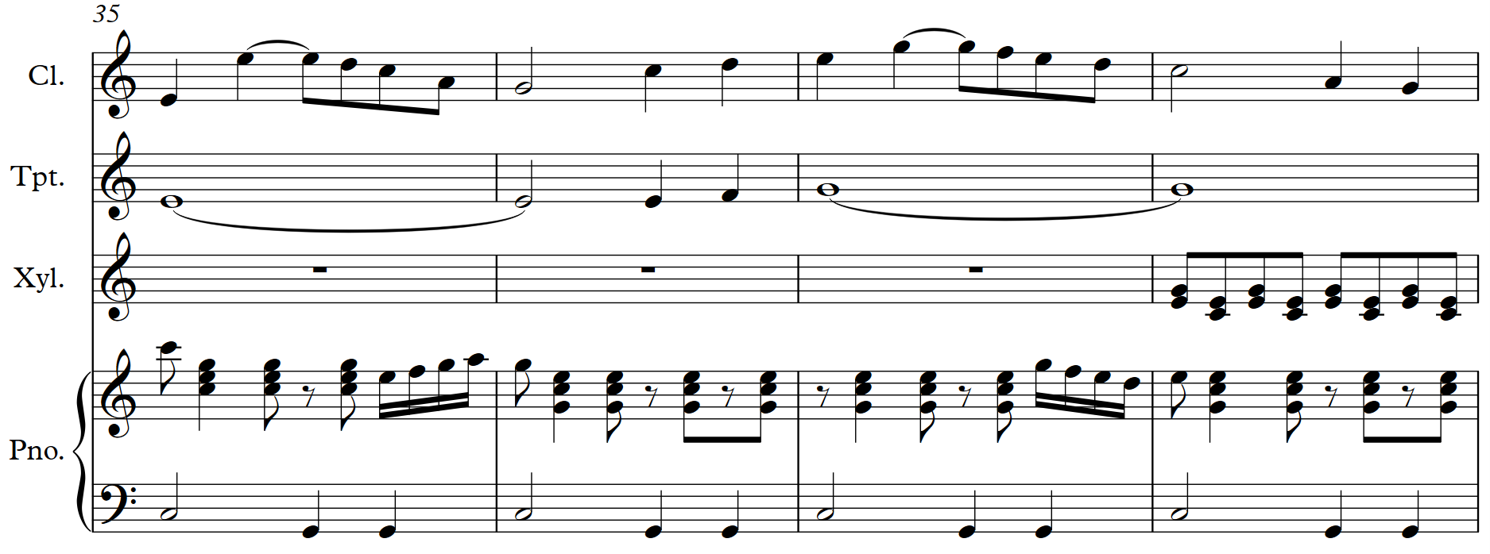
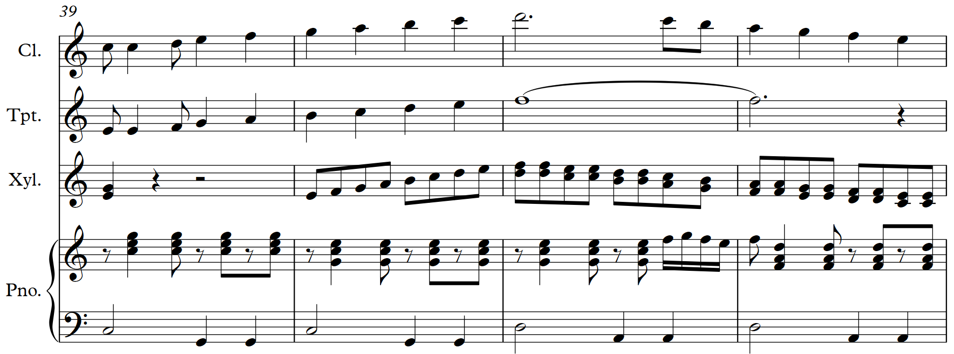

Slide 14
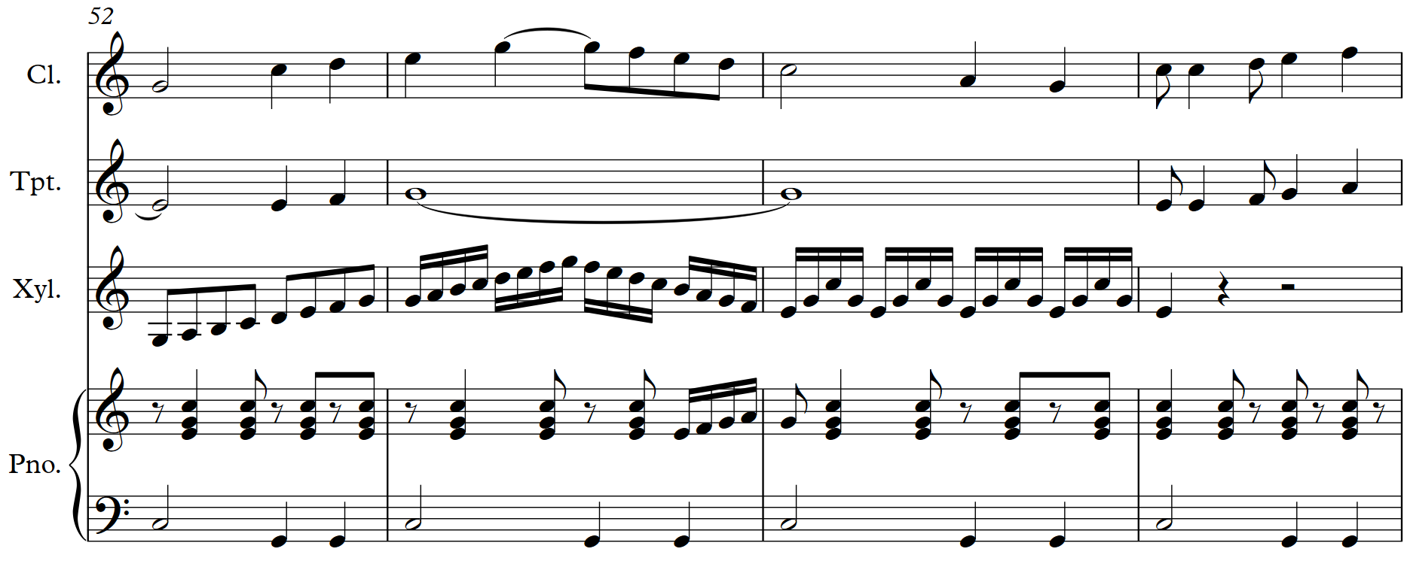

Slide 15
Questions to ask about an arrangement
What is the candidate’s creative input?
What has worked well?
The creative input which works well is limited to an effective countermelody; most of the other additions, once introduced, lack development.

Slide 16
Candidate 6 – Spanish Eyes – 4 marks
5-6 mark range
A satisfactory arrangement that uses compositional methods to show some development of aspects of the original piece. The arrangement employs instrumental forces and combinations in a straightforward way.
3-4 mark range
A simplistic arrangement that uses compositional methods to show limited development of aspects of the original piece. Instrumental forces and combinations are not always appropriate.
1-2 mark range
A poor arrangement that shows very limited development of aspects of the original piece. Instrumental forces and combinations are inappropriate.

Slide 17
Further example of an arrangement
Be Still For The Presence Of The Lord (flutes, clarinets, trumpet, cello, soprano, alto, piano) – arrangement mark of 9, review mark of 5 (AH Music Assignment – candidate evidence, August 2019)

