Slide 1

Advanced Higher
Candidate 5 – Puff, the Magic Dragon arrangement

Slide 2
Annotations for a composition or arrangement
Identification
Development
Inconsistencies

Slide 3
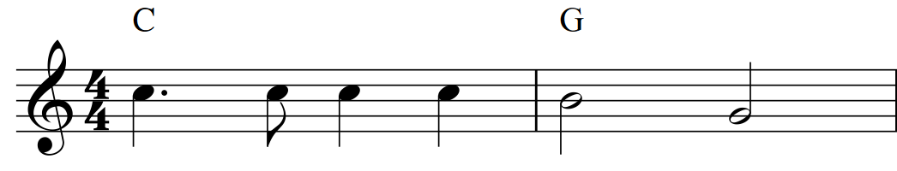
Original
melody

Slide 4
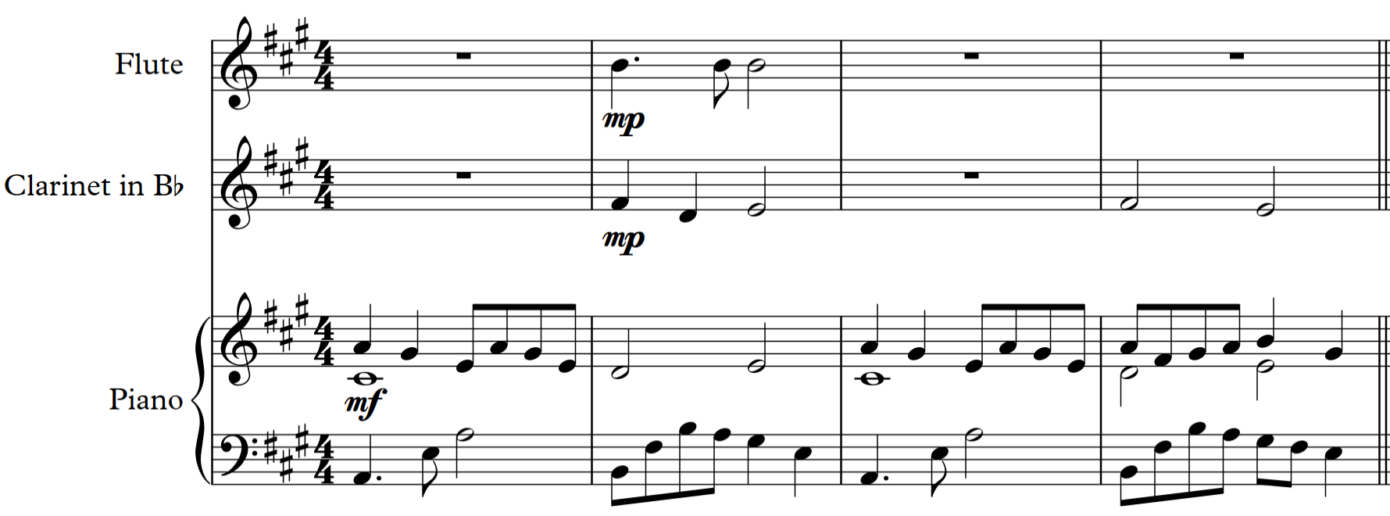
Original
melody

Slide 5
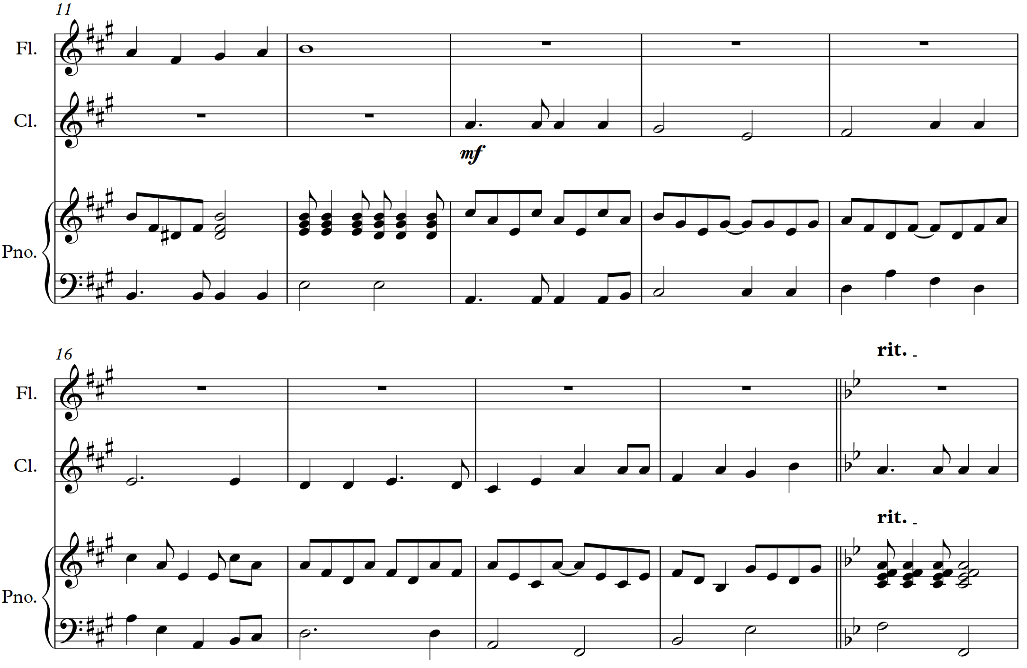

Slide 6
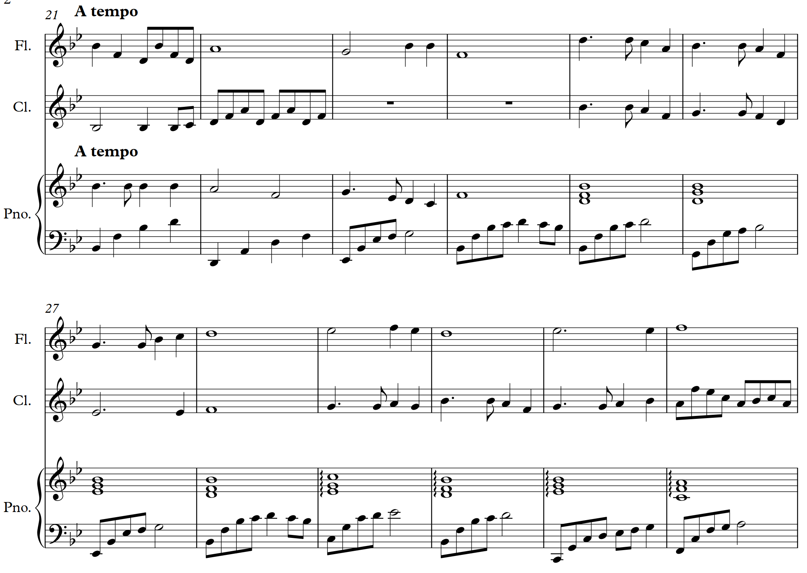
New chord progression

Slide 7
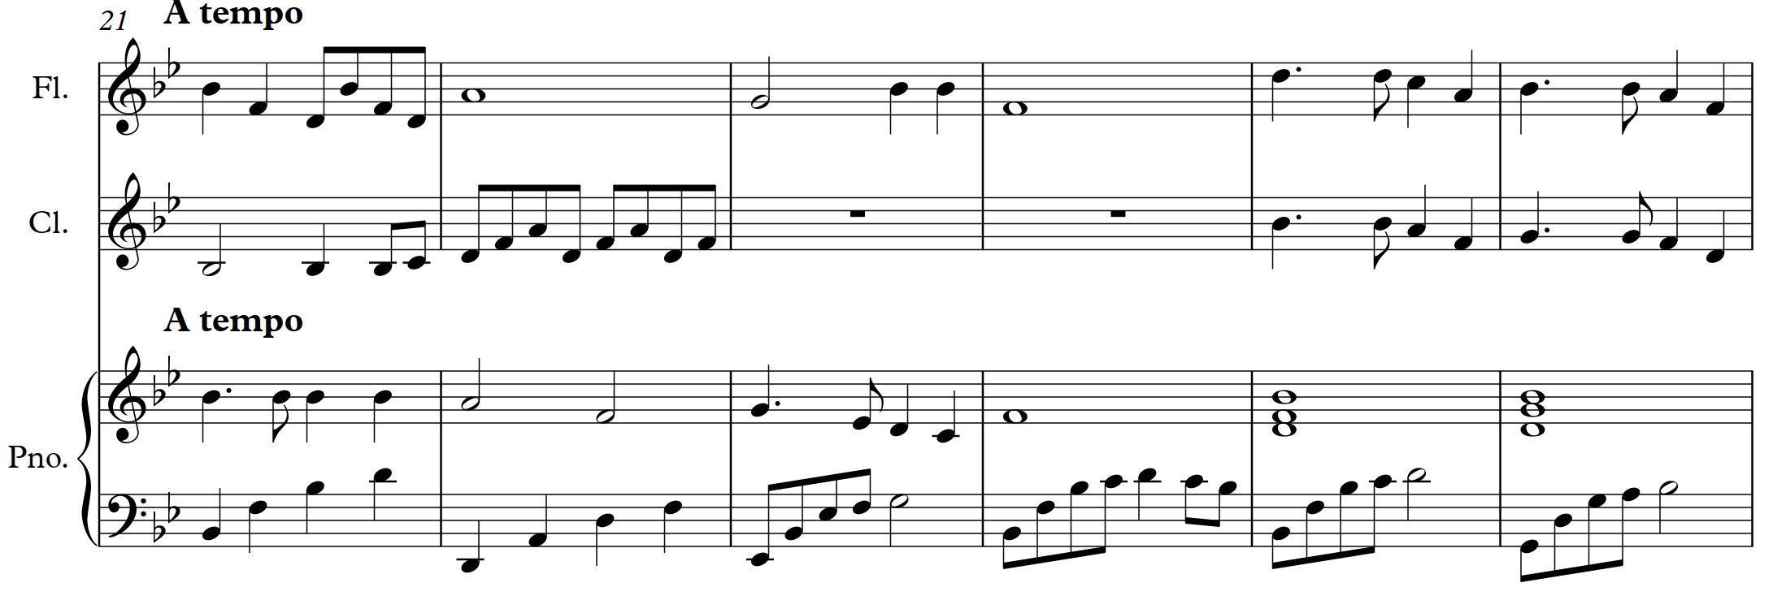
Original
melody

Slide 8
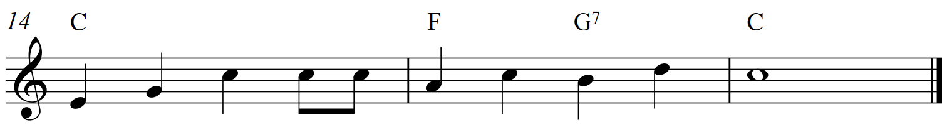
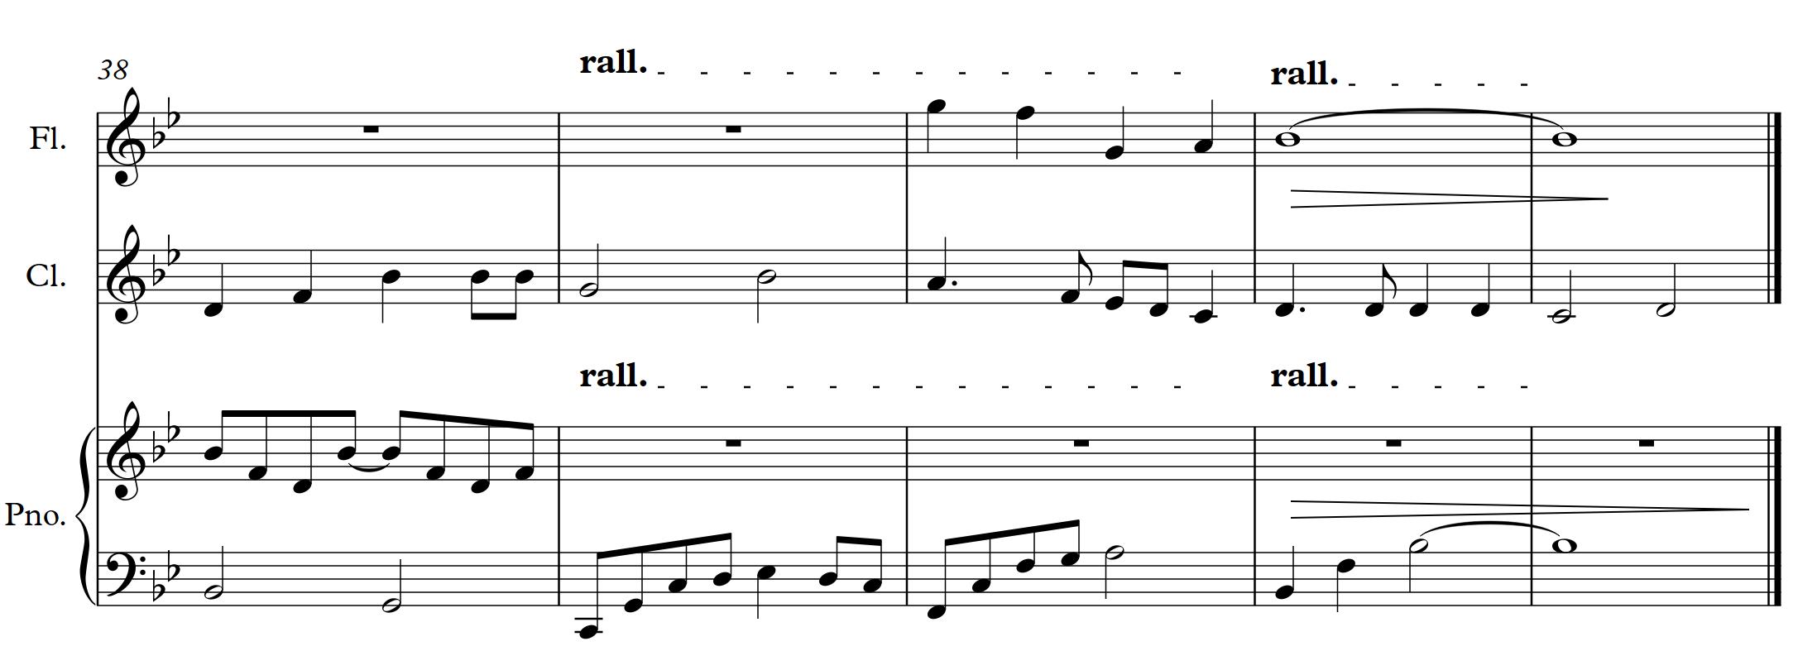
Original
melody

Slide 9
Original
melody

Slide 10
Original
melody

Slide 11
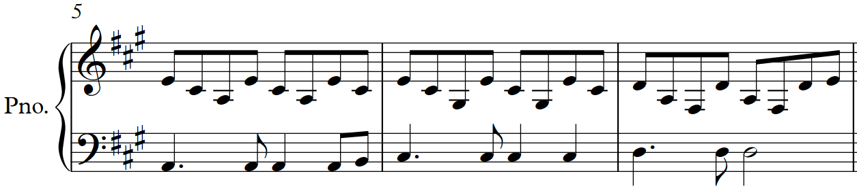
3
3
2
3
3
2
3
3
2

Slide 12
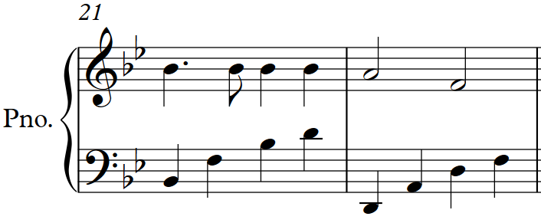
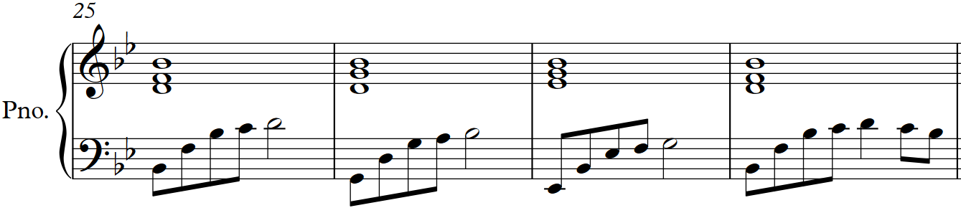
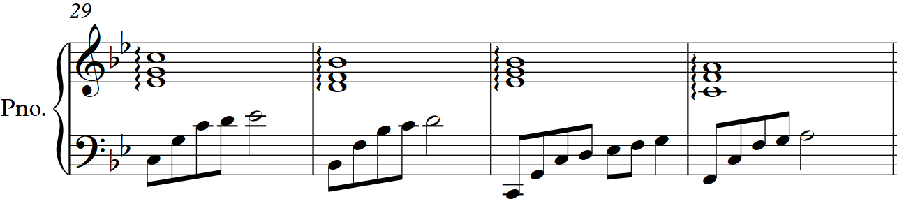

Slide 13
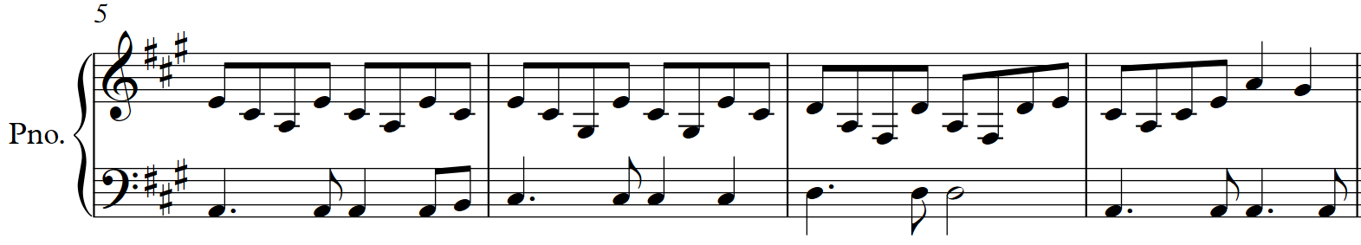
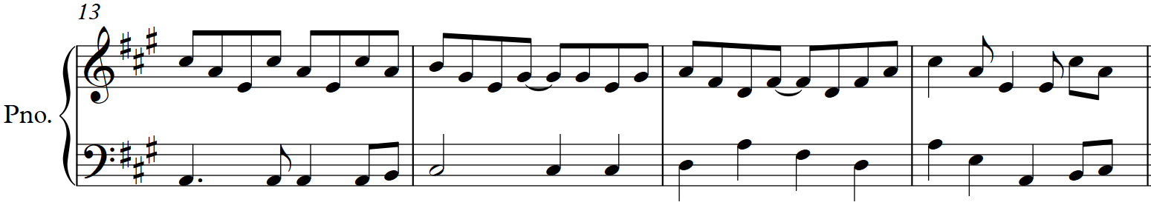

Slide 14
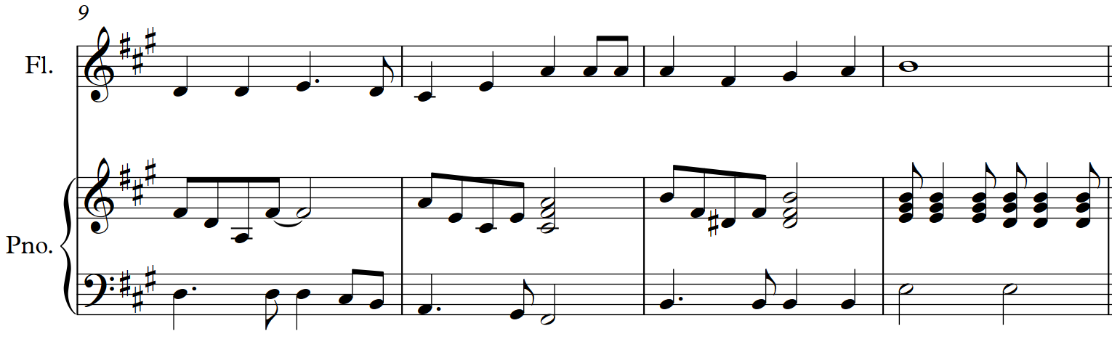
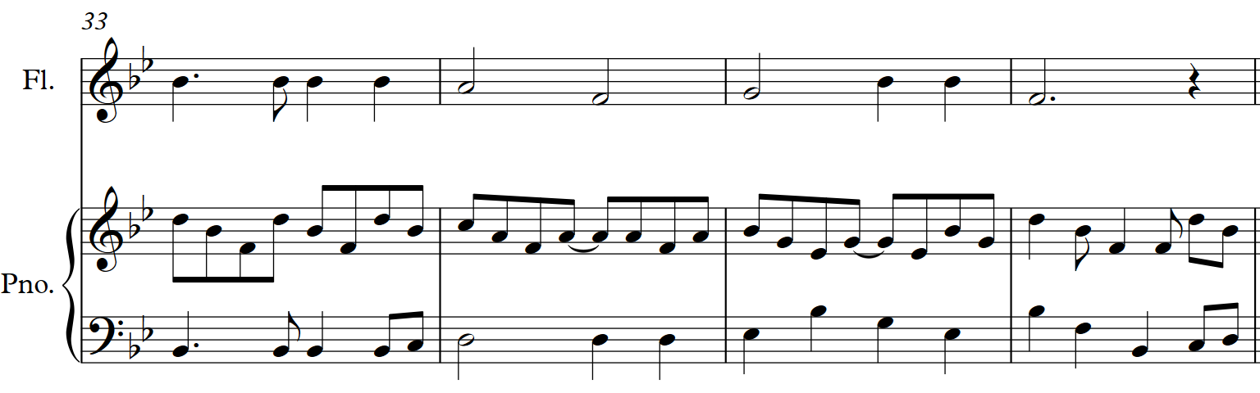
Flute
Flute

Slide 15
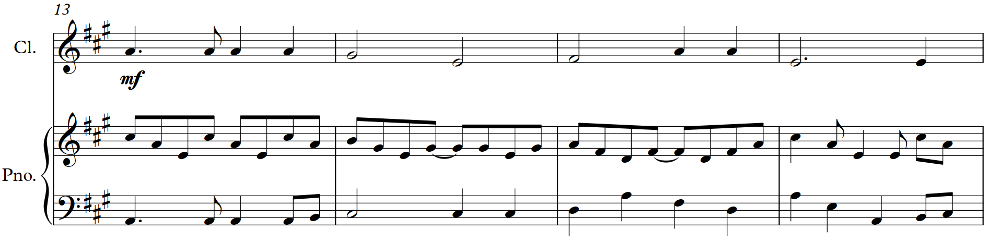
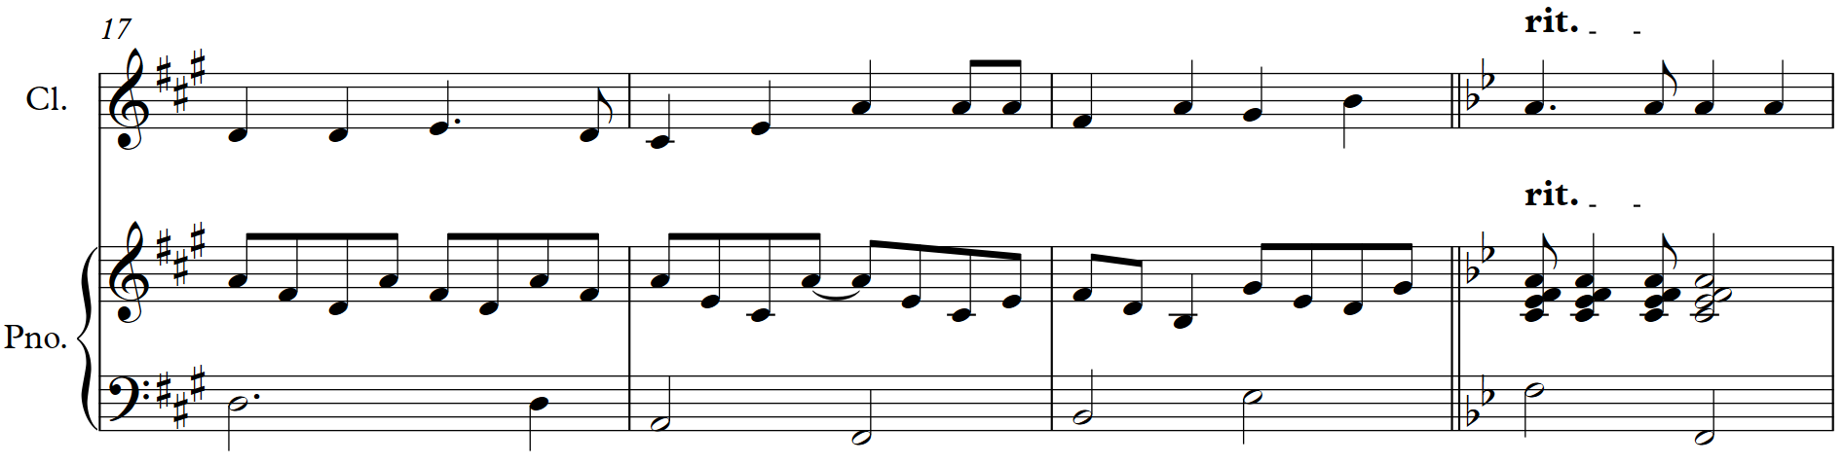
Clarinet
Clarinet

Slide 16
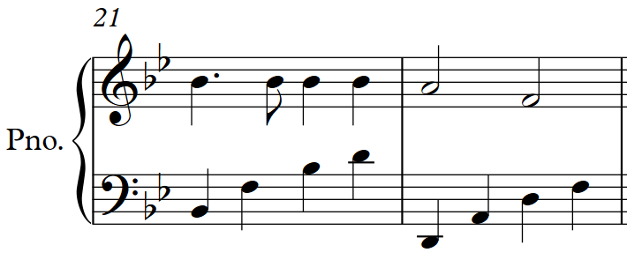
Flute
Clarinet
Piano

Slide 17
‘The first line shows the original chords and
underneath the chords I used.’
I | V | IV | I | V7 | I | II7 | V
I | iii | IV | I | IV | I vi | II7 | V V7
I | V | IV | I | V7 | I | IV V7 | I
I | iii7 | IV | I | IV | I vi | ii V7 | I

Slide 18
Candidate 5 – Puff, the Magic Dragon – 7 marks
9-10 mark range
An excellent arrangement that uses a range of compositional methods to develop aspects of the original piece imaginatively and convincingly. The arrangement skilfully and effectively employs varied instrumental forces and combinations, shows originality, and is highly creative.
7-8 mark range
A good arrangement that uses a range of compositional methods to develop aspects of the original piece with some imagination. The arrangement successfully employs varied instrumental forces and combinations, shows some originality, and is creative.
5-6 mark range
A satisfactory arrangement that uses compositional methods to show some development of aspects of the original piece. The arrangement employs instrumental forces and combinations in a straightforward way.

