Slide 1

Advanced Higher Candidate 3 – Twilight Terror 2 composition

Slide 2
Annotations for a composition or arrangement
Identification
Development
Inconsistencies

Slide 3
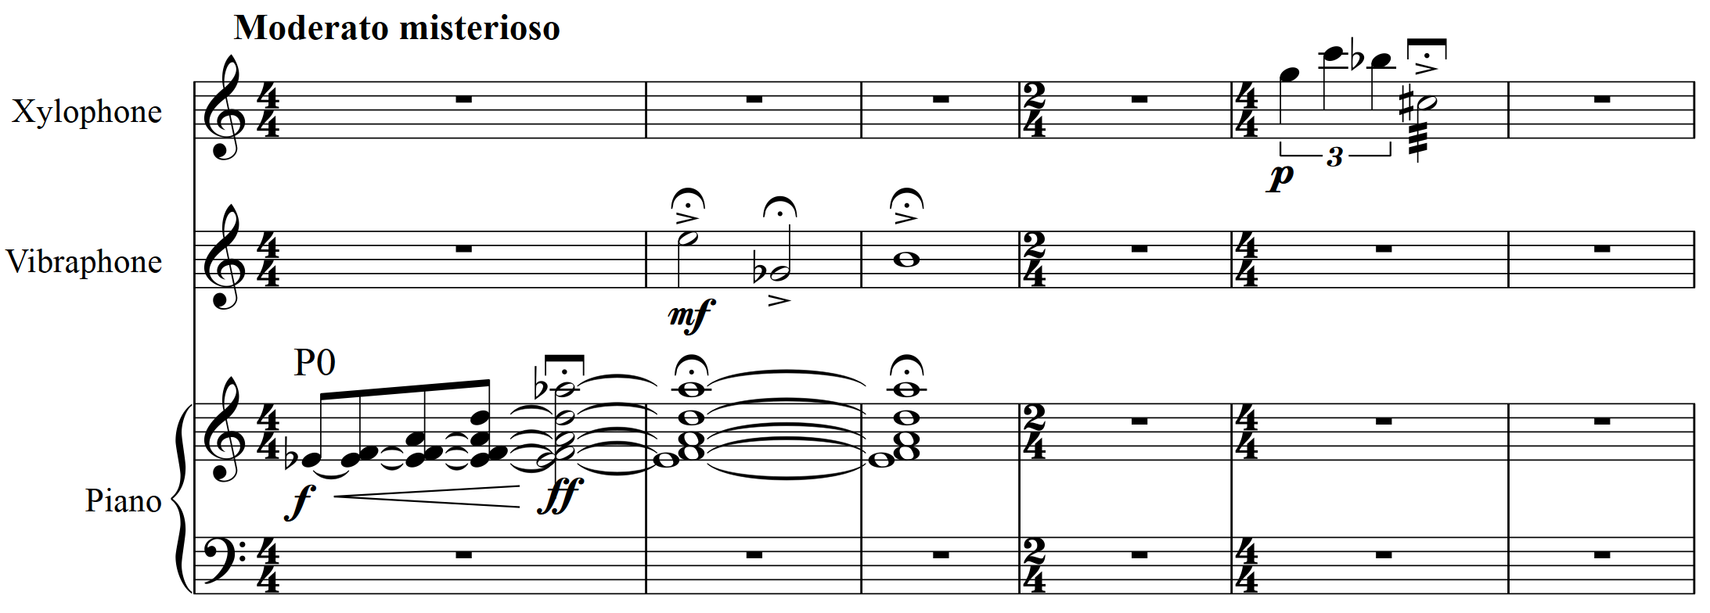
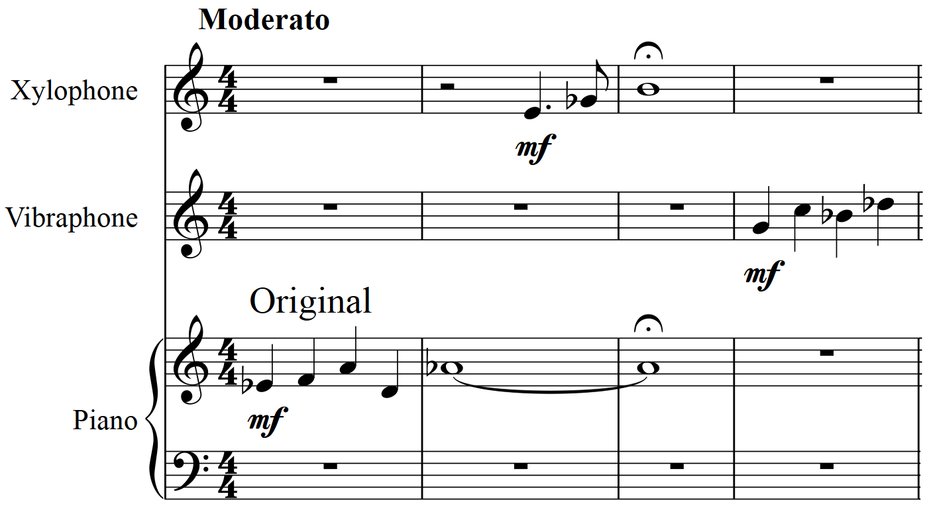
Twilight
Terror
version 1
Twilight
Terror
version 2
‘ a spooky night-time scene’

Slide 4
Twilight
Terror
version 1
Twilight
Terror
version 2
‘ a spooky night-time scene’

Slide 5
Twilight
Terror
version 1
Twilight
Terror
version 2
‘ a spooky night-time scene’

Slide 6
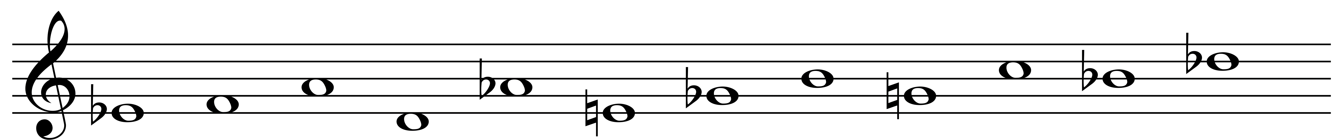
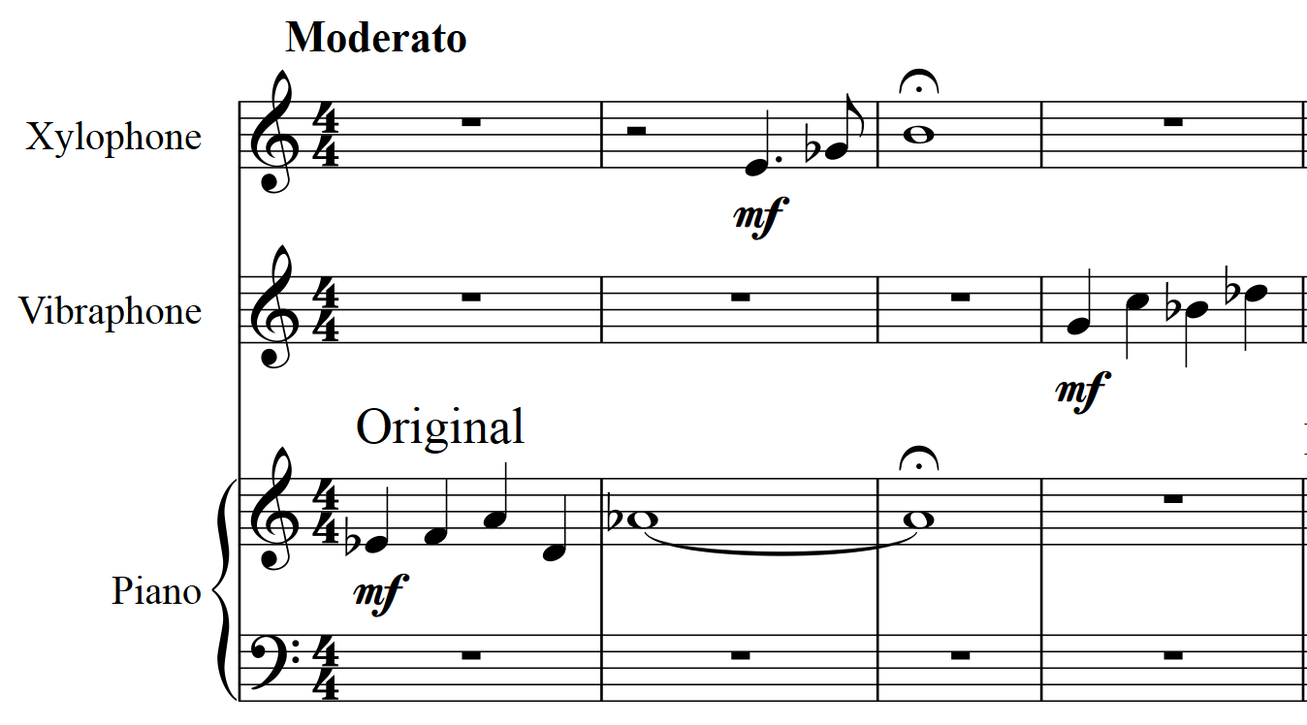
Original

Slide 7
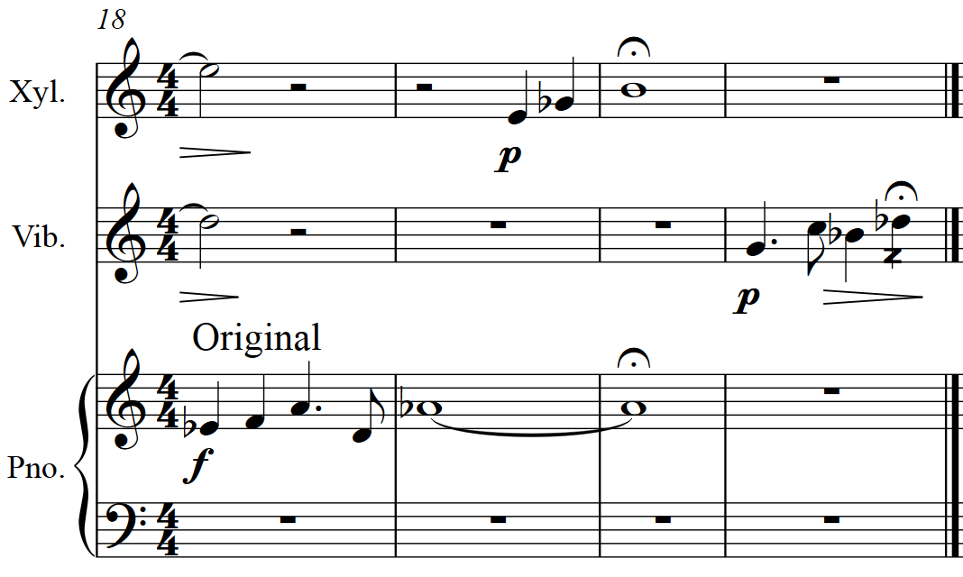
Bar 1
Bar 18

Slide 8
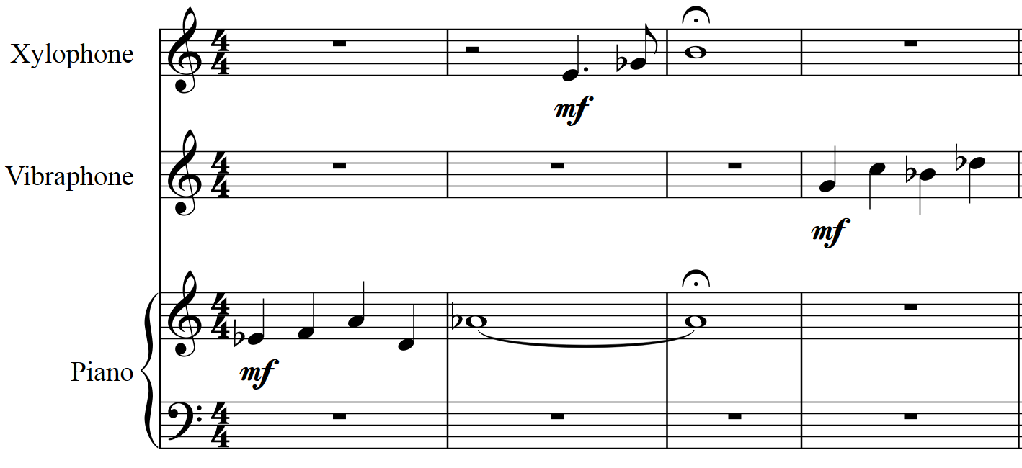
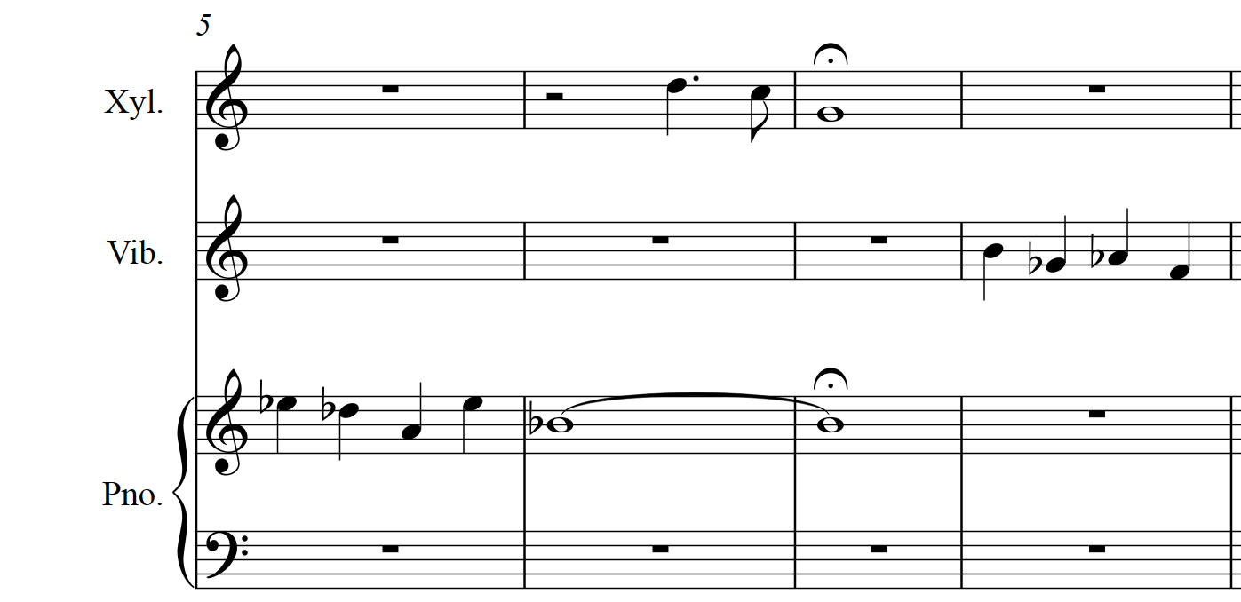
Original
Inversion

Slide 9
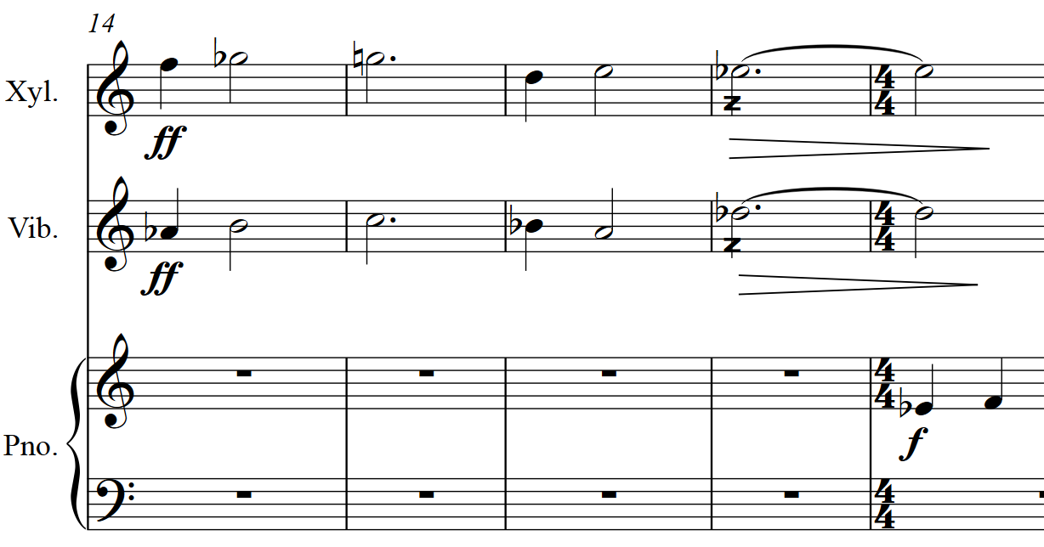

Slide 10
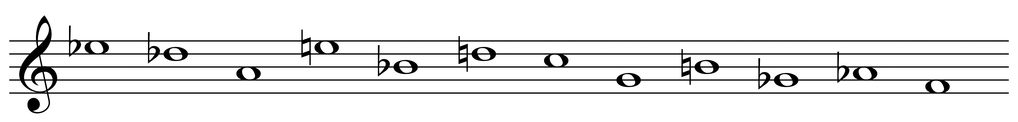
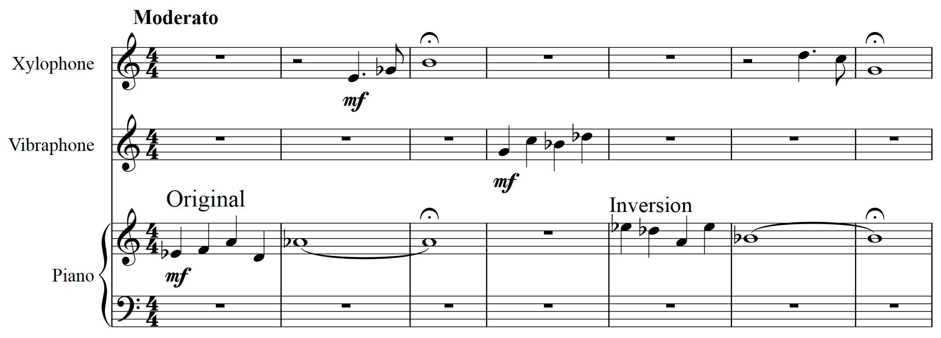
Twilight
Terror 2
Inversion

Slide 11
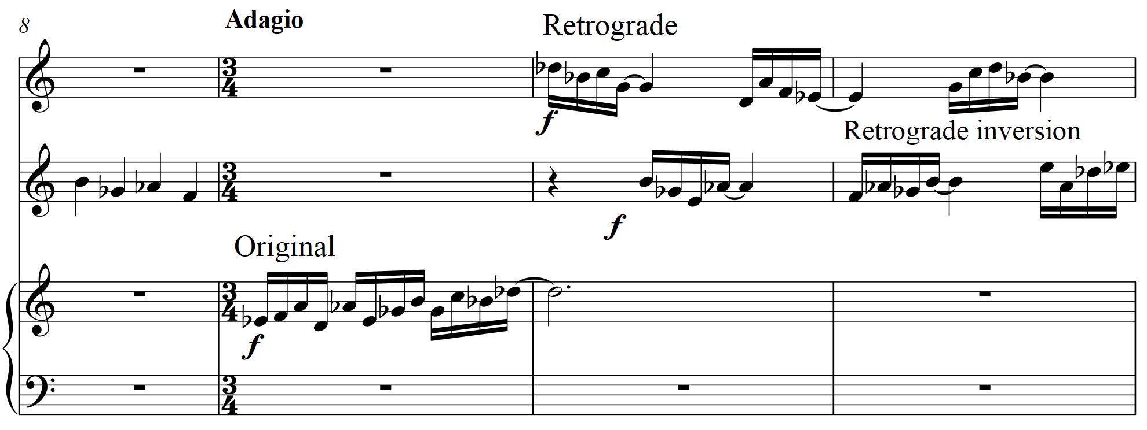
Twilight
Terror 2
Original

Slide 12
Twilight
Terror 2
Original

Slide 13
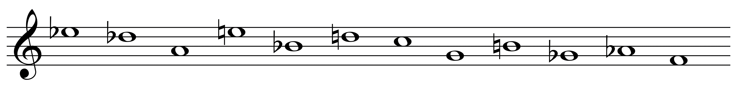
Twilight
Terror 2
Retrograde Inversion

Slide 14
Candidate 3 – Twilight Terror 2 – 2 marks
3-4 mark range
A composition demonstrating musical ideas that have been developed inconsistently within the candidate’s chosen style. The use of elements not always appropriate.
1-2 mark range
A composition demonstrating limited musical ideas with little or no development within the candidate’s chosen style. The use of elements is poor.

Slide 15
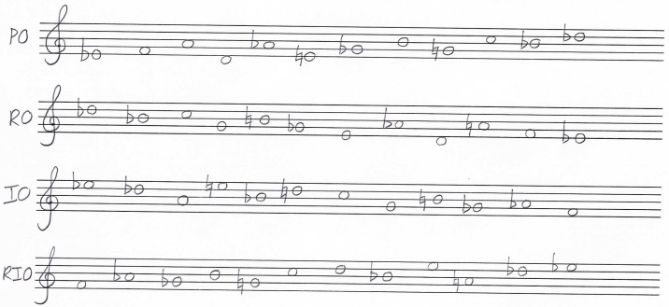
Twilight
Terror
version 1
Twilight
Terror
version 2
Original
Retrograde
Inversion
Retrograde Inversion

