Slide 1

Advanced Higher Candidate 2 – Twilight Terror 1 composition

Slide 2
Candidate 2 – Twilight Terror 1 – 10 marks
9-10 mark range
An excellent composition demonstrating a range of musical ideas that have been developed imaginatively and convincingly, appropriate to the candidate’s chosen style. The use of elements is highly creative and effective.
7-8 mark range
A good composition demonstrating a range of musical ideas that have been developed with some imagination, appropriate to the candidate’s chosen style. The use of elements shows creativity.

Slide 3
Questions to ask
Which musical ideas have been developed imaginatively and convincingly, appropriate to the candidate’s chosen style?
How has the candidate used elements in a highly creative and effective way?

Slide 4
Annotations for a composition or arrangement
Identification
Development
Inconsistencies

Slide 5
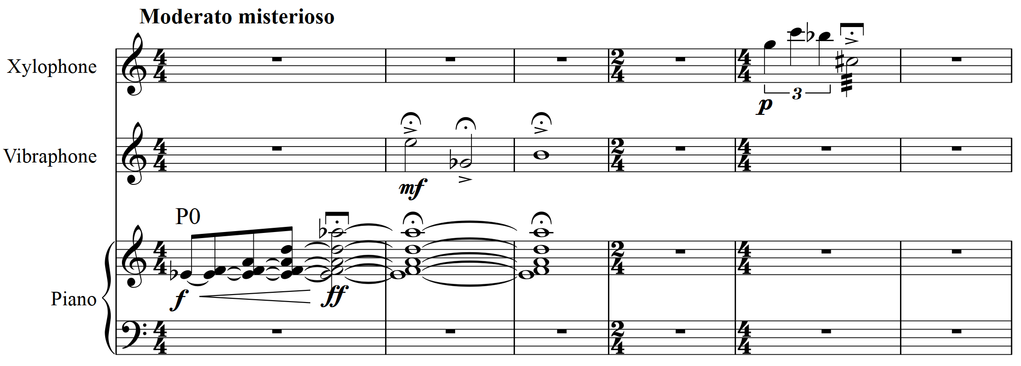

Slide 9
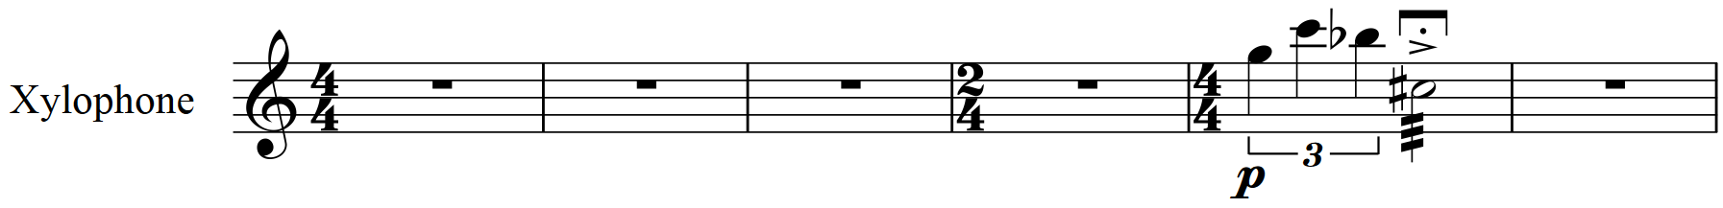
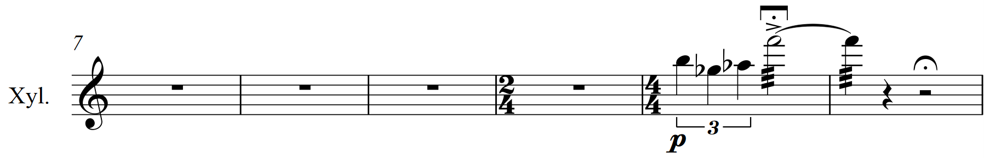
Prime note row
Inversion

Slide 10
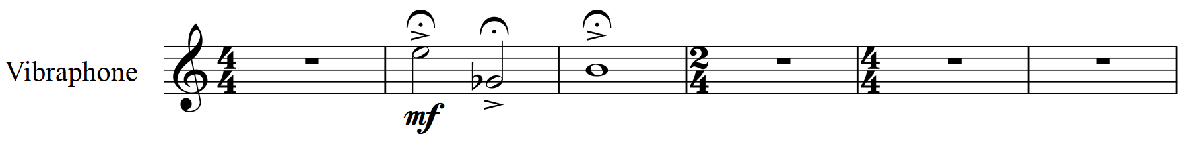
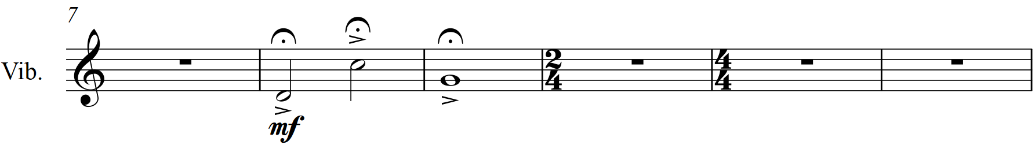
Prime note row
Inversion

Slide 11
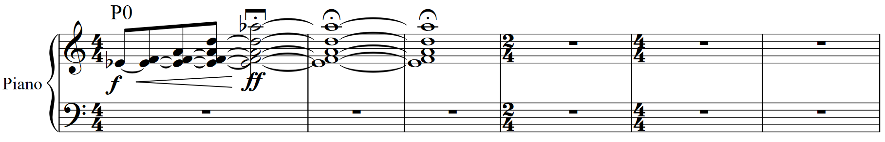
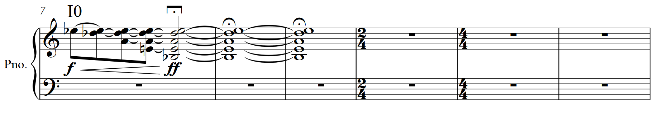
Prime note row
Inversion

Slide 12
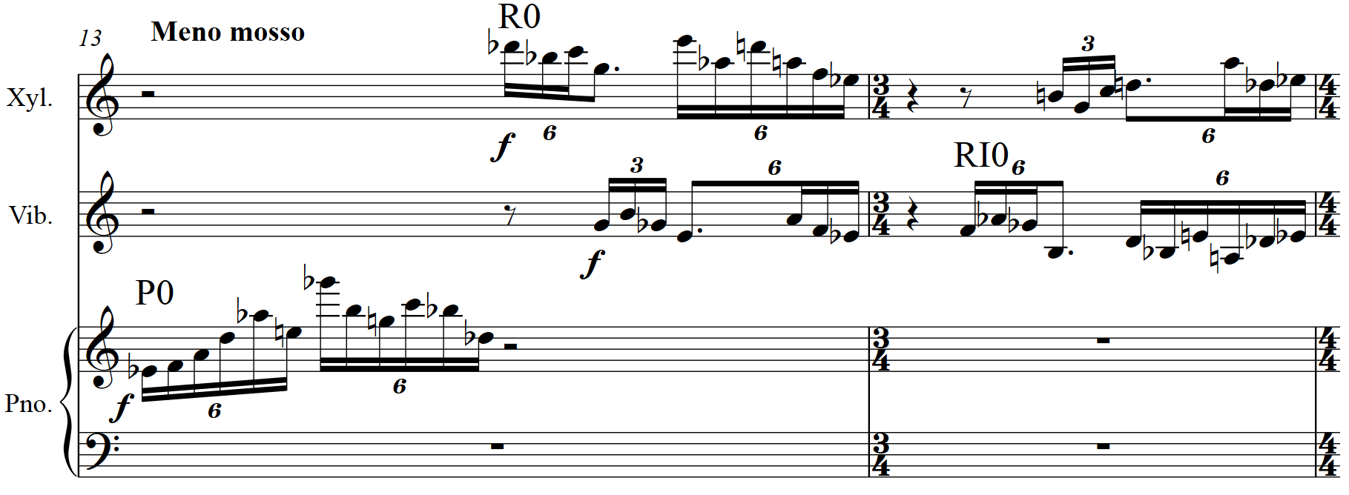

Slide 13
