Slide 1

Advanced Higher Candidate 1 – Lied composition

Slide 2
Candidate 1 – Lied – 5 marks
7-8 mark range
A good composition demonstrating a range of musical ideas that have been developed with some imagination, appropriate to the candidate’s chosen style. The use of elements shows creativity.
5-6 mark range
A composition demonstrating musical ideas which have been developed satisfactorily, appropriate to the candidate’s chosen style. The use of elements may be simplistic and straightforward.
3-4 mark range
A composition demonstrating musical ideas that have been developed inconsistently within the candidate’s chosen style. The use of elements is not always appropriate.

Slide 3
Annotations for a composition or arrangement
Identification
Development
Inconsistencies

Slide 4
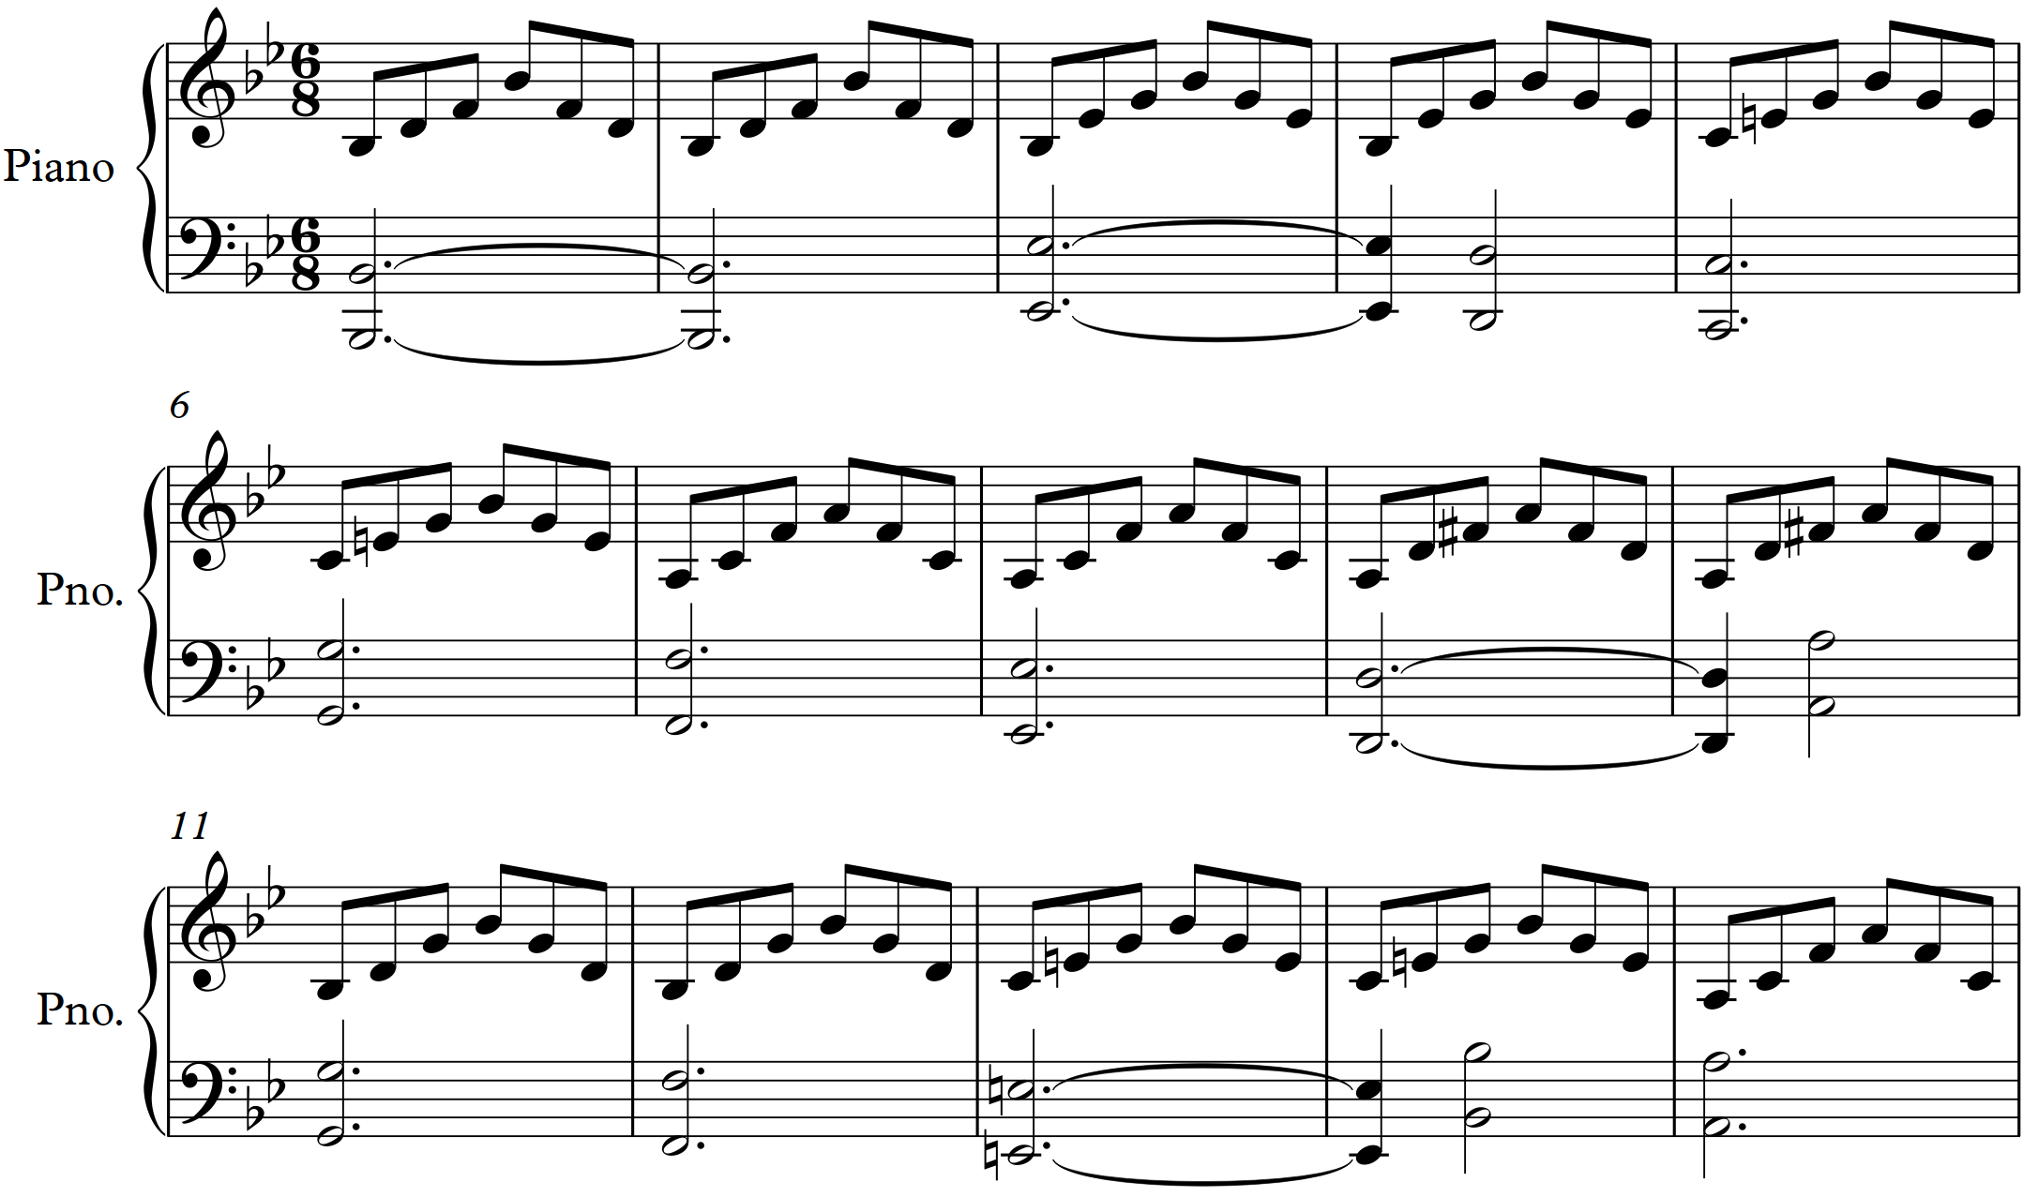
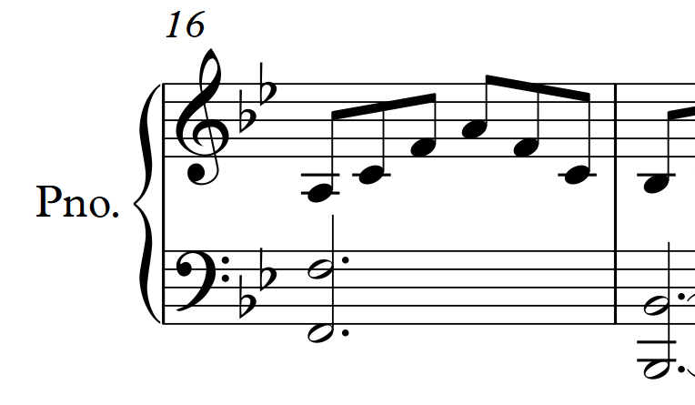

Slide 8
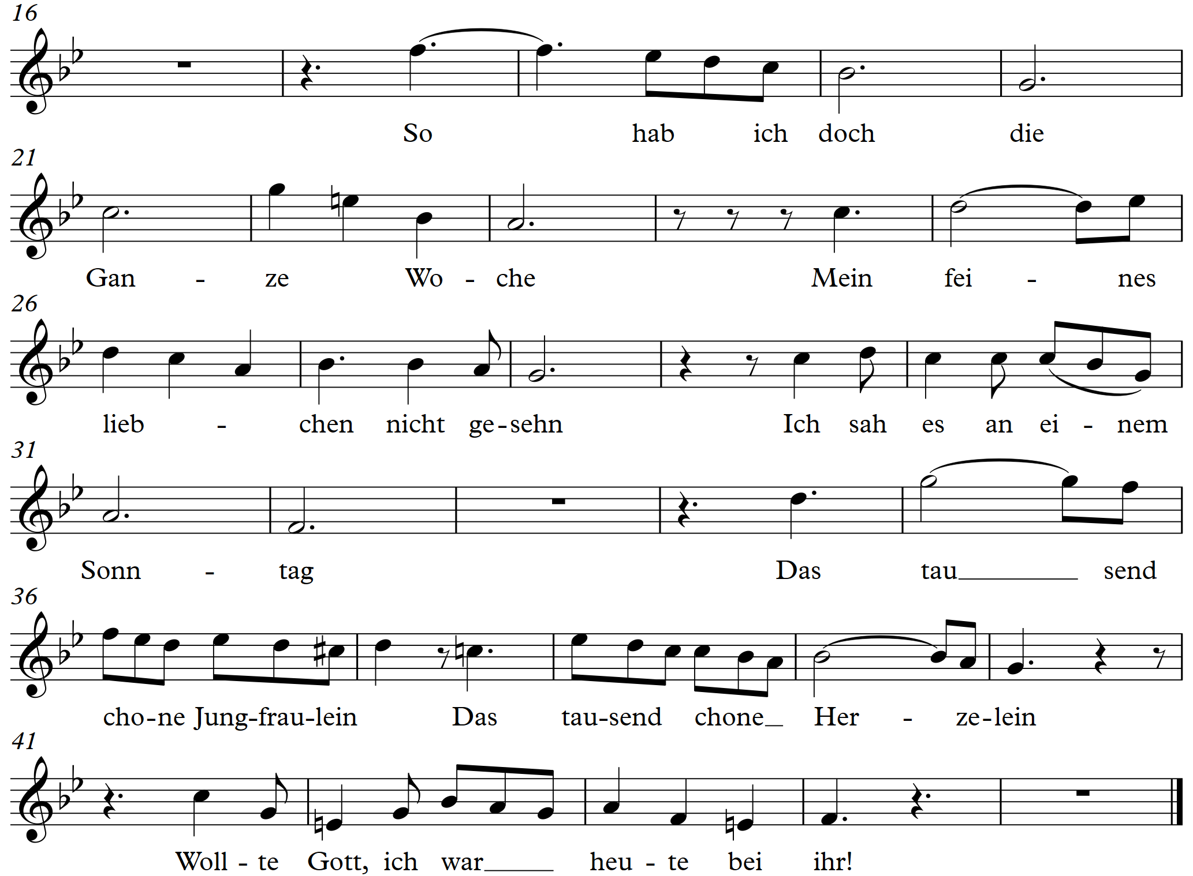

Slide 9
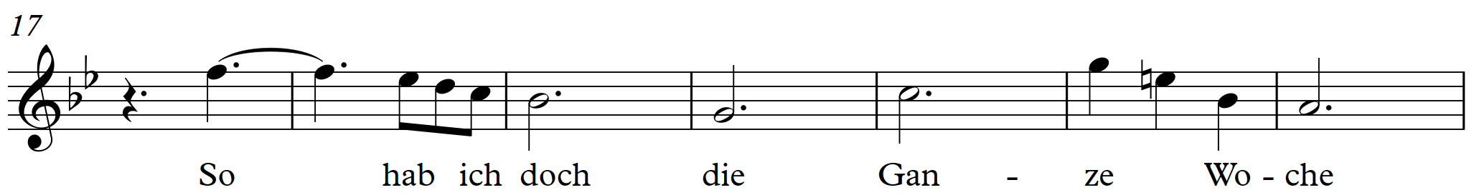
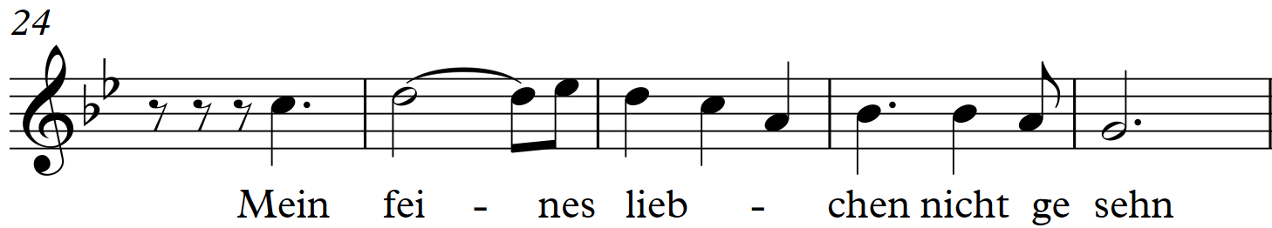
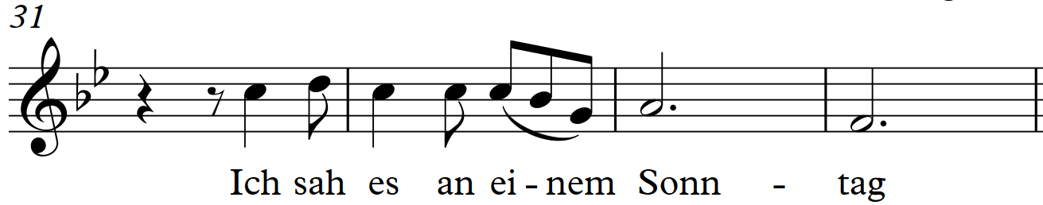

Slide 10
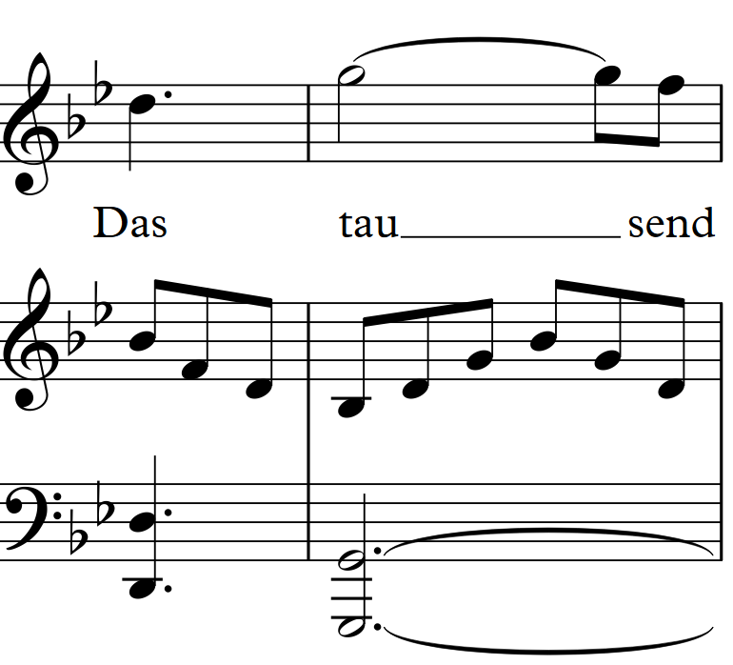
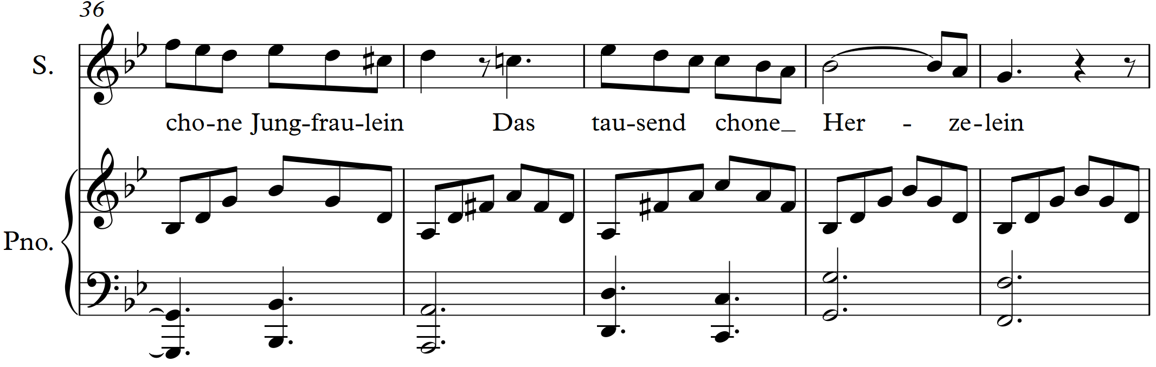

Slide 11
Further examples of compositions
The Gaitherin Reel (violins 1, 2, 3, piano and bass guitar) – 6 marks (AH Music Assignment, November 2019)
Vivo (violin, viola, cello, piano) – 4 marks (AH Music Assignment, November 2019)

