Slide 2
National 5
Design and Manufacture
Understanding Standards

Slide 3
Aims
To provide teachers, lecturers and assessors with:
an understanding of the key issues impacting on candidate performance in N5 Assignment: design
an opportunity to consider approaches to building candidate skill in key areas.

Slide 4
National 5 Assessment Overview
Three components
Question paper 80 marks
Assignment: design 55 marks
Assignment: practical 45 marks
180 marks

Slide 5
National 5 Assessment Overview
Question paper 80 marks
set and marked by SQA
team of markers, marking from image
quality assured by team leaders, PA and DPA
mean mark 37.8 (47%)

Slide 6
National 5 Assessment Overview
Assignment: practical 45 marks
marked by centres, verified by SQA
centres generally made reliable judgements
mean mark 30.5 (68%)

Slide 7
National 5 Assessment Overview
Assignment: design 55 marks
marked by SQA
central marking event
quality assured by team leaders, PA and DPA
standardisation using exemplars
mean mark 20.1 (37%)

Slide 8
National 5 Assessment Overview
Summary
Component | Mean
Question Paper | 37.8 (47%)
Assignment: practical | 30.5 (68%)
Assignment: design | 20.1 (37%)

Slide 9
National 5 Assessment Overview
Grade Boundary
SQA aims to set examinations which allow a competent candidate to score a minimum of 50% of the available marks (the notional C boundary) and a well prepared, very competent candidate to score at least 70% of the available marks (the notional A boundary)

Slide 10
National 5 Assessment Overview
Grade Boundary
Meeting with PAs, PV, QM, statistician and member of SQA management team.
Grade boundaries can go down if exam was more challenging than usual.
Grade boundaries can go up if exam was less challenging than usual.

Slide 11
National 5 Assessment Overview
Grade Boundary
National 5 Design and Manufacture 2018
BOUNDARY | MARK | %
A | 118 | 66%
B | 101 | 56%
C | 84 | 47%
D | 67 | 37%

Slide 12
Key Messages
Selection of the task
What went well
all tasks generated a wide range of responses
Reasons why candidates didn’t access marks
  information contained in the brief could have been used better
Advice for the preparation of future candidates :
selecting the correct task is key to success
ensure candidates don’t select a brief because they think its “easy”
ensure candidates can identify key statements in the brief to take into the specification, to explore and refine their proposal
familiarise candidates with exemplars
refer candidates to the brief and the candidate guide

Slide 13
Analysing the brief- Carrying out research:
What went well
pro formas performed well
Almost all candidates demonstrated some appropriate use of research techniques.
Reasons why candidates didn’t access marks
  Centre over direction – research was often invalid or superficial and limited candidates access to marks in other areas.
  Candidates using mind maps – these help analyse but do not generate marks for research
  Questionnaires- not always valid as response would not impact on their design decisions
  Use of images- didn’t allow generation of specification points
Advice for the preparation of future candidates :
Good research typically has:
  questionnaires on location, function, other requirements of target market
  conclusions about the theme/other restrictions in the brief
  record of measurements/sizes of relevant items

Slide 14
Example of effective research

Slide 15
Example of research
of limited effect

Slide 16
Analysing the brief- Specification:
What went well
pro formas performed well
almost all candidates demonstrated the ability to draw specification points from their research or the key information in the brief
Reasons why candidates didn’t access marks
Some specification points were:
    personal opinion/not drawn from research/contradicted research
    generic statements and omitted the detail from research
    not all candidates included the key information provided in the brief
Advice for the preparation of future candidates:
Good specification includes:
    3/4 pieces of key information taken from the brief (1 mark)
    additional specification points (detail) drawn from research such as: sizes of the items and/or details of location, aesthetic and functional requirements
  *The specification can improve marks gained in other sections

Slide 17
Example of a detailed specification

Slide 18
Example of a limited specification

Slide 19
Generating ideas:
What went well
most candidates generated ideas that addressed the brief
Reasons why candidates didn’t access marks
  limited use of idea generation techniques
  producing 2-5 ideas
  ideas lacked diversity or creativity
  ideas were simply shapes or drawings of structures- no function
  not N5 level
Advice for the preparation of future candidates:
Good idea generation:
  has ideas that addressed the brief
  has a wide range of ideas
  has creative and diverse ideas

Slide 20
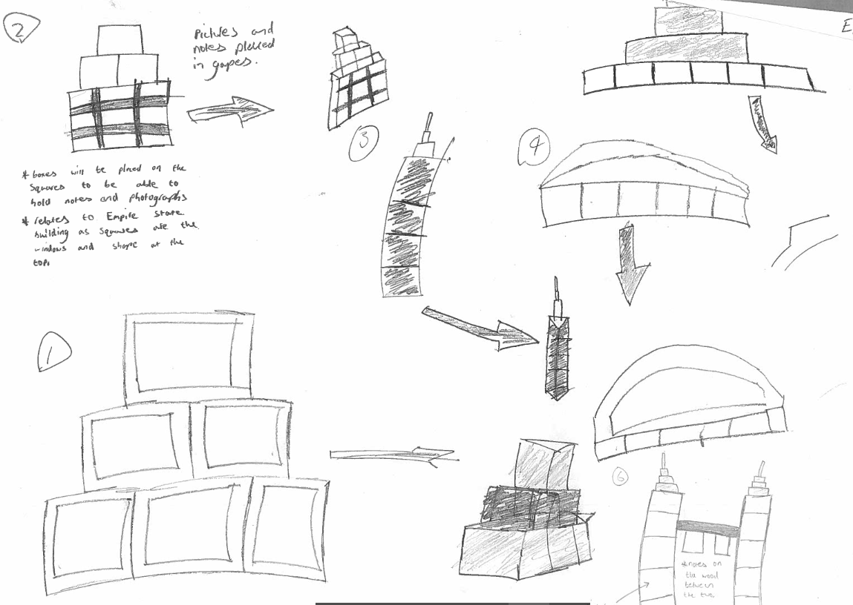
Example of limited
and effective
idea
generation

Slide 21
Exploring:
What went well
most candidates proposal evolved in some way from the initial idea
Reasons why candidates didn’t access marks
  exploration limited often to shape change
  lack of alternatives considered and not all proposals evolved
  limited/ no use of information in the specification and/or brief
Advice for the preparation of future candidates:
Good exploration:
  makes use of the brief/specification and has clear exploration of alternatives for these key points such as:
    incorporating the theme
    methods of holding, position of, arrangement and orientation of objects
    methods for manufacturing and assembling
    restrictions –element of movement, hanging, ease of use ..
  shows evolution from the initial idea
  *Effective exploration can improve marks gained in other sections

Slide 22
Example of limited exploration

Slide 23
Examples of effective exploration

Slide 24
Refining:
What went well
most candidates were able to generate some evidence for refinement
some candidates used modelling effectively to refine their proposal
Reasons why candidates didn’t access marks
  decisions were not recorded
  lack of refinement activity
  poor exploration left candidates with little opportunity to record decisions
Advice for the preparation of future candidates:
Good refinement will have:
  final decisions clearly recorded during the development section
  used the key points (facts) in the brief and specification such as function, aesthetics, sizes etc
  clear decisions for manufacturing, such as material, parts, and assembly detailed prior to the planning for manufacture pro forma
  used of modelling to allow informed understanding and allow meaningful decisions to be made

Slide 25
Example of effective refinement

Slide 26
Application of knowledge:
What went well
Design - Some candidates made good use of the theme and sizes of the items to explore and refine.
Materials and Manufacturing- Most candidates considered assembly
Reasons why candidates didn’t access marks
  limited use/reference to the brief/specification
  lack of meaningful exploration and refinement left candidates with little opportunity to apply knowledge
  superficial comments
Advice for the preparation of future candidates:
Good application of knowledge:
  communicates how well an idea meets the specification, improvements that have been made or are required, as it is explored and refined.
  uses information gained from the brief, specification and modelling
  has meaningful reference to theme function, sizes, aesthetics, ease of use
  justifies decisions relating to practical skills and manufacturing

Slide 27
Using models:
What went well
Evidence of more candidates using models in their work
Some candidates used CAD or physical models to work out difficult sizes
Reasons why candidates didn’t access marks
Limited/no use of modelling
Models didn’t add anything to graphics/ bolt on/ no clear findings
Advice for the preparation of future candidates:
Good use of models will be used intuitively for a range of purposes such as to:
  generate initial ideas or communicate something that’s difficult to sketch
  test sizes, access – test things fit/work
  test overall size, stability, work out sizes, proportion, scale
  test moving parts or assembly of parts
  evaluate alternatives
  *Using models can improve marks gained in other sections

Slide 28
Example of effective use of modelling

Slide 29
Example of modelling with adequate or limited effect

Slide 30
Using graphics:
What went well
Candidates generally used graphics to communicate well.
Almost all candidates communicated detail of sizes and parts in the plan for manufacture.
Reasons why candidates didn’t access marks
Not all graphics were appropriate for N5 level.
lack of exploration or refinement gave candidates little to use graphics
Advice for the preparation of future candidates:
2D and/or pictorial, CAD or manual graphic will be used effectively for a range of purposes such as to communicate:
  initial ideas and alternatives during exploration
  moving parts, position of items, functional aspects
  details of an idea such as material thickness, and simple exploded or detailed views to show assembly
  dimensions of the proposal or its parts

Slide 31
Limited use of graphics

Slide 32
Planning for manufacture:
What went well
pro forma performed well
Almost all candidates completed the pro forma with sufficient information and clarity.
Reasons why candidates didn’t access marks
Candidates did not always communicate how the parts would be assembled or what the final proposal should look like.
The proposal was not of a suitable complexity to allow access to full marks in planning at N5 level.
Advice for the preparation of future candidates:
A good plan for manufacture incudes:
  sufficient detail in the sequence with tools/equipment relevant to each stage
  a dimensioned graphic communicating the sizes of the proposal or its parts
  a graphic/model to communicate what the final assembled proposal should look like
  a completed cutting list

Slide 33
Effective plan for manufacture

Slide 34
Limited plan for manufacture

Slide 35
Workshop 1: Idea Generation
Task 1 & 2
Purpose:
As a teacher, use to:
encourage use of basic techniques to generate appropriate ideas
develop use of modelling in idea generation stage
Candidates will learn to:
use basic idea generation techniques to generate 3D ideas
use modelling during idea generation

Slide 36
Workshop 1: Idea Generation
Task 1
a) Take 5 of the pre-cut card shapes
create 5 structures which will support a pencil
b) Take 5 of the card strips
use pre-drawn line as profile for strip of card to generate structure to support pencil
draw another line and repeat (4 times)

Slide 37
Workshop 1: Idea Generation
Task 2
a) Take A5 Card
using 3 folds, create a structure which will support a plastic cup
repeat
b) Take A5 Card
draw 3 random lines across card
cut pieces
use pieces to create a structure which will support a plastic cup
repeat

Slide 38
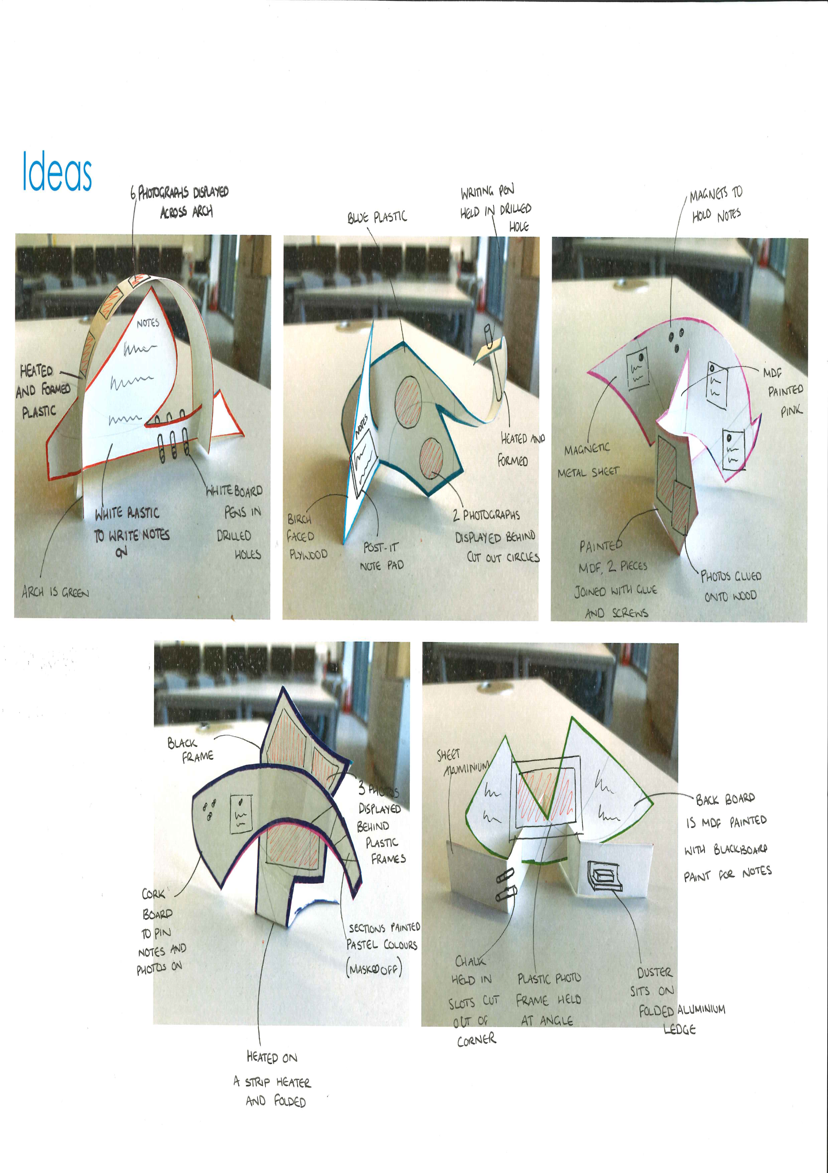
Good Example

Slide 39
Workshop 2: Exploration
Task 1
Purpose:
As a teacher use to:
develop intuitive exploration skills in candidates
link aesthetic changes to impact on other aspects of a design to tease out design knowledge in less able candidates
identify divergent and convergent thinkers
Candidates will learn to:
  visualise exploration pathways and recognise unrecorded decisions
  identify if their ideas have significant differences
  apply design knowledge (refer to spec) looking for strengths and weaknesses created by the changes

Slide 40
Workshop 2: Exploration
Fold your piece of paper into A4, then A5 then A6 then cut into 8 pieces.
Copy the sketch from the worksheet onto on of the small pieces of paper.
Now on a new piece of paper:
  apply a change that incorporates symmetry
  rotate something
  change the proportion
  incorporate a curve
  alter the shape
  add or remove material
  change the angle

Slide 41
Workshop 2: Exploration
Task 2
Purpose:
As a teacher use to:
develop meaningful exploration and application of knowledge
link changes to impact on other aspects of a design to tease out recording of design knowledge
encourage incorporation of aesthetic changes from Task 1
Candidates will learn to:
  link exploration to their specification
  apply design knowledge (refer to spec) looking for strengths and weaknesses created by the changes.
  recognise and record decisions due to chosen pathways
  ease of using the specification to explore aspects of the solution

Slide 42
Workshop 2: Exploration
Fold your piece of paper into A4, then A5 then A6 then cut into 8 pieces
Copy the sketch from the worksheet onto on of the small pieces of paper
Now on a new piece of paper:
  sketch 2 functional changes (position or method of holding items)
  quickly annotate to highlight impact on other aspects of the design
  sketch 2 changes incorporating the jungle theme
  quickly annotate to highlight impact on other aspects of the design
  sketch 2 changes to explore how the product could attract more marks for practical skills
  add final annotations and arrows to show pathways
  final piece of paper to sketch final idea

Slide 43
Workshop 3: Refinement
Task 1
Purpose:
As a teacher use to:
  give candidates an understanding of what should be included in a good refinement
  develop candidates skills in refining
Candidates will learn to:
  identify key areas to be refined
  apply design, materials and manufacturing knowledge when making decisions
  use data from research to justify refinement decisions
  fully refine a proposal in preparation for manufacture

Slide 44
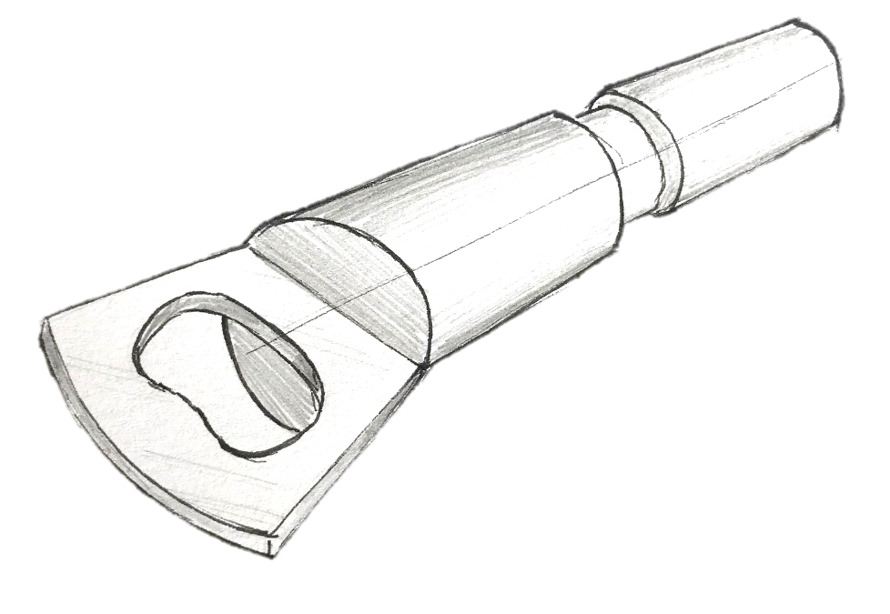
Task 1: Bottle Opener
Instructions:
Look at the bottle opener sketch below.
What do you need to know/ find out before you can manufacture this?
What do you need to know to ensure it functions and performs well?

Slide 45
Task 1: Bottle Opener
Things that you should have considered:
Material?
Consider options and choose based on the requirements of this product.
Dimensions?
Length of handle, look at anthropometric data or make a scale model.
Joining method?
Consider options for joining the parts and choose the most suitable for this product.
Manufacturing?
Are any specific process needed; turning.
Finishes?
Do the materials require a protective finish to suit the use of this product.
Shape?
Shape/size needed to function correctly, test with scale model.

Slide 46
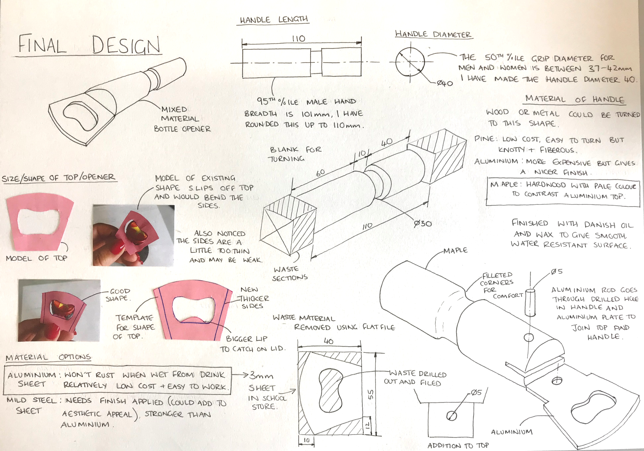
Good Example

Slide 47
Workshop 3: Refinement
Task 2
Purpose:
As a teacher use to:
  give candidates an understanding of what should be included in a good refinement
  develop candidates skills in refining through modelling.
  develop candidates modelling skills
Candidates will learn to:
  identify key areas to be refined
  use modelling to test and make decisions
  apply design, materials and manufacturing knowledge when making decisions
  fully refine a proposal in preparation for manufacture

Slide 48
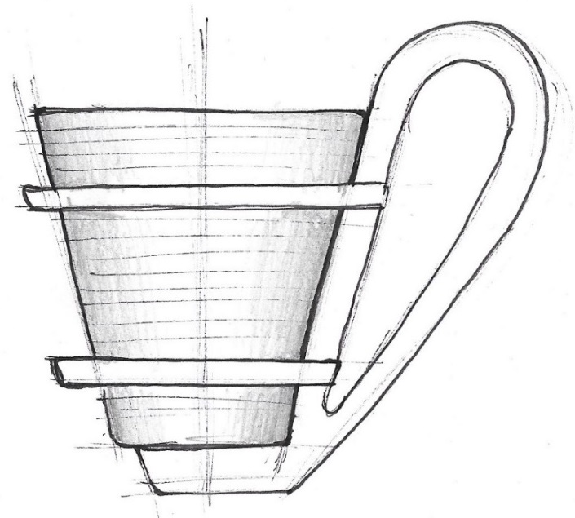
Task 2: Cup Holder
Instructions:
Look at the cup holder sketch below, you have a copy at your table. You are going to refine this proposal through modelling.
NOTE: The cup being held is your plastic cup from earlier.

Slide 49
Task 2: Cup Holder
Instructions:
Using the card that has been provided, make an initial model of the cup holder.
Your model/ models should be used to refine the assembly of the components and dimensions of each component part.
Photograph each model and record decisions being made as a result of findings, i.e. hand too big/too small, rings too small, holder unstable, etc.
Use additional sketches and annotation to communicate refinement decisions.

