Slide 2

Art and Design
National 5 and Higher
Guidance for the
Expressive portfolio

Slide 3
Aims of this audio-visual presentation
to provide visual exemplification of the guidance on the expressive portfolio which is published on the SQA website
to support teachers and lecturers in creating more time for learning and teaching by suggesting ways to make expressive portfolios more concise

Slide 4
National 5
Expressive portfolio

Slide 5
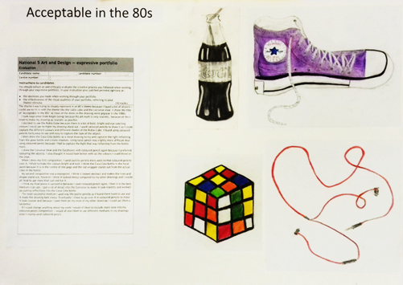
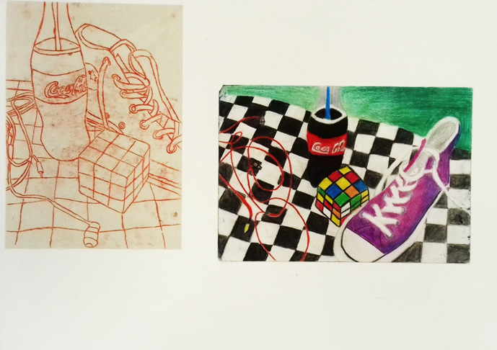
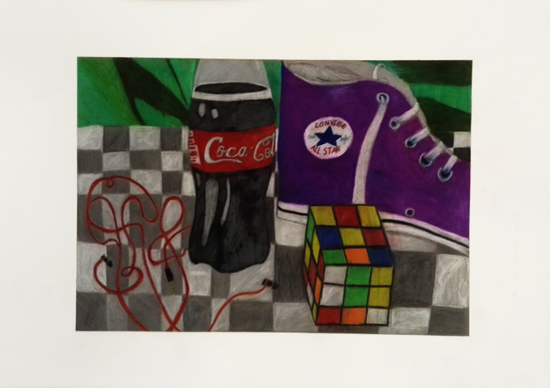


Acceptable in the 80s
Process | 10/10
 | 18/30
Skills | 12/25
 | 10/25
Sub-total | 50/90

Slide 6
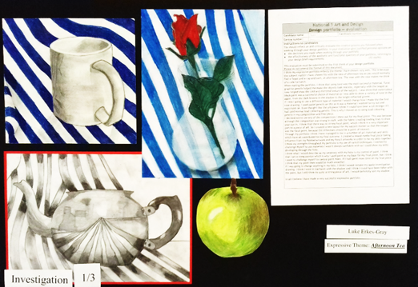
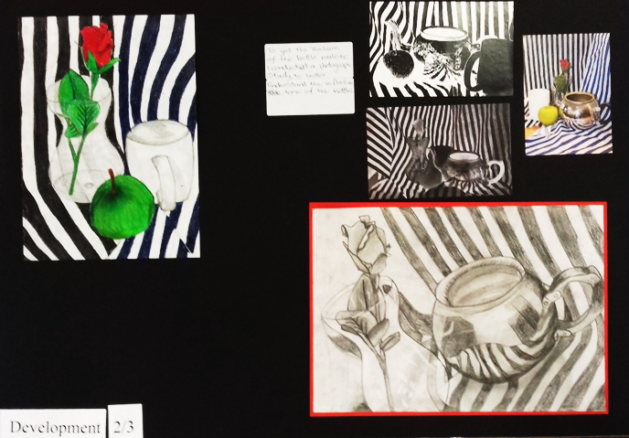
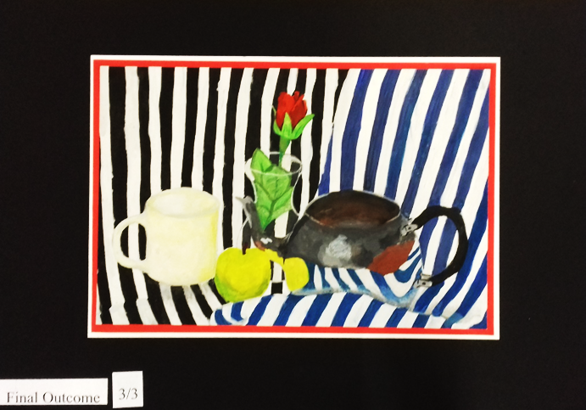

Afternoon Tea
Process | 10/10
 | 23/30
Skills | 16/25
 | 16/25
Sub-total | 65/90

Slide 7
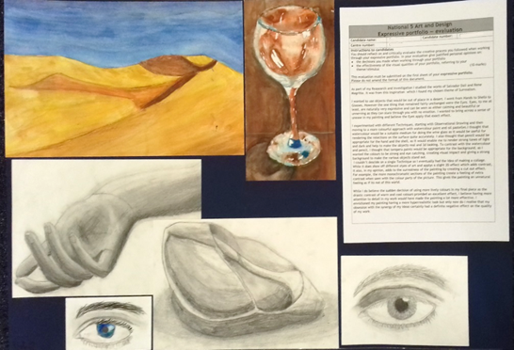
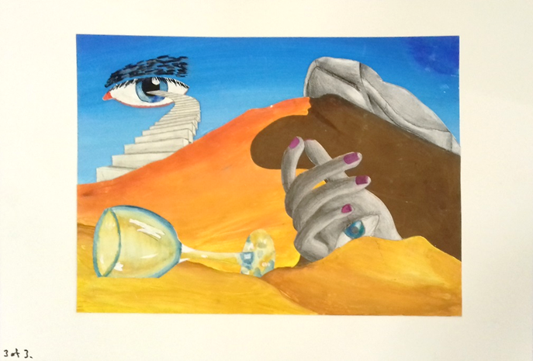
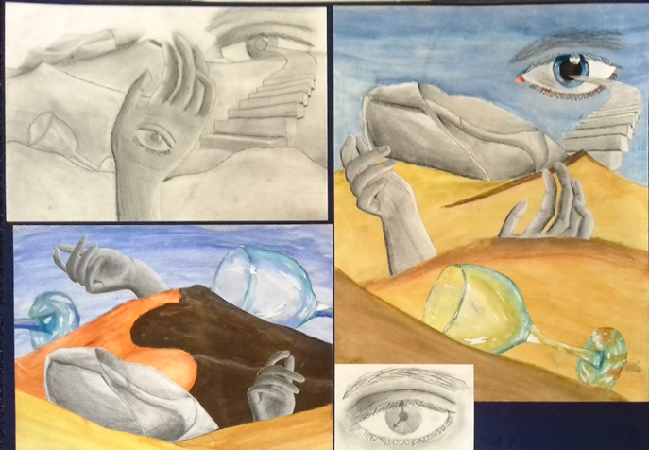
Surreal Dreams
Process | 10/10
 | 30/30
Skills | 17/25
 | 17/25
Sub-total | 74/90

Slide 8
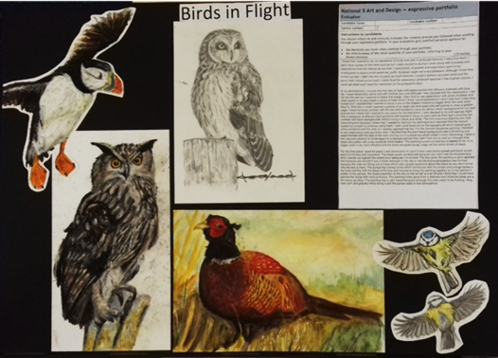
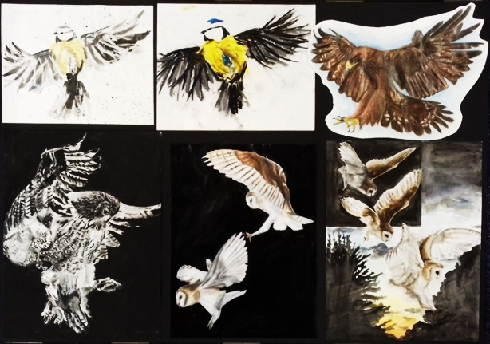
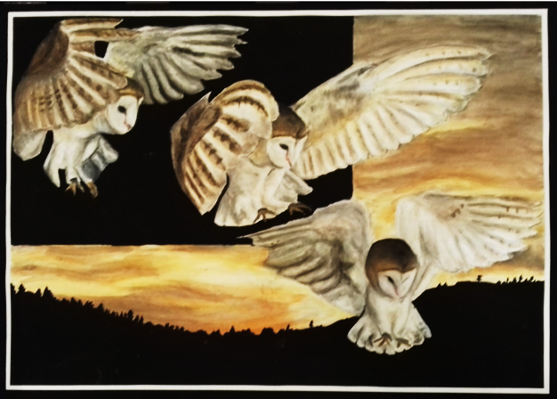
Birds in Flight
Process | 10/10
 | 23/30
Skills | 25/25
 | 23/25
Sub-total | 81/90

Slide 9
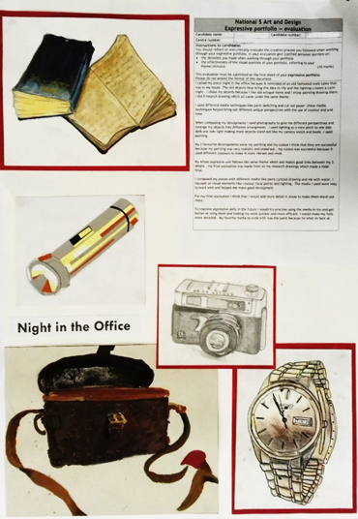
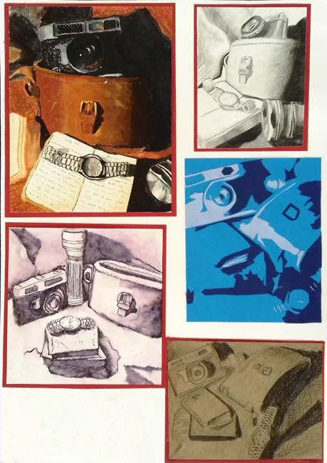
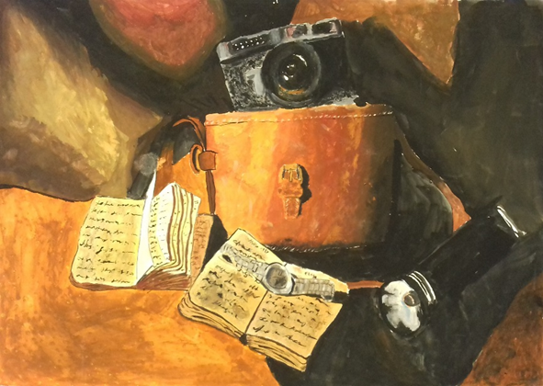
A Night in the Office
Process | 10/10
 | 30/30
Skills | 21/25
 | 23/25
Sub-total | 84/90

Slide 10
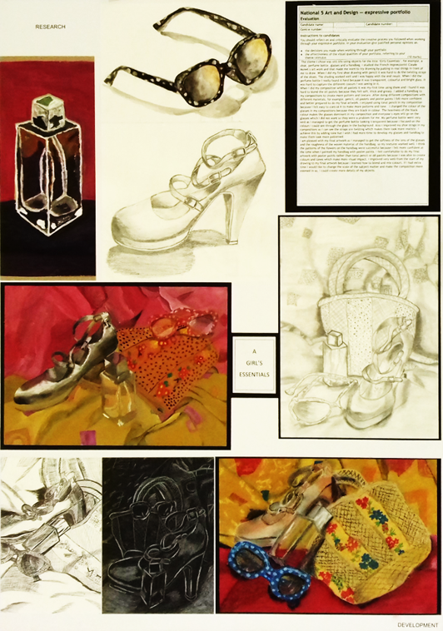
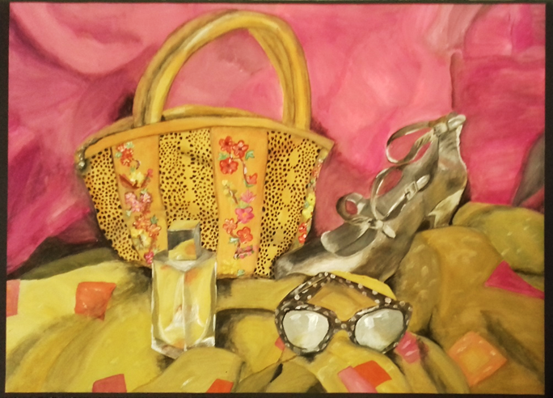

A Girl’s Essentials
Process | 10/10
 | 30/30
Skills | 25/25
 | 25/25
Sub-total | 90/90

Slide 11
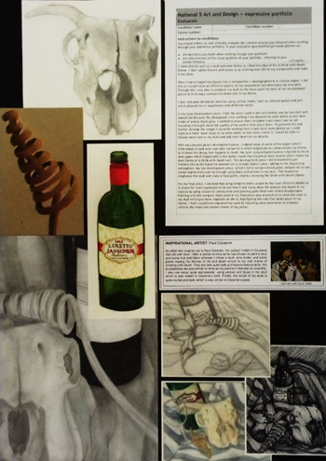
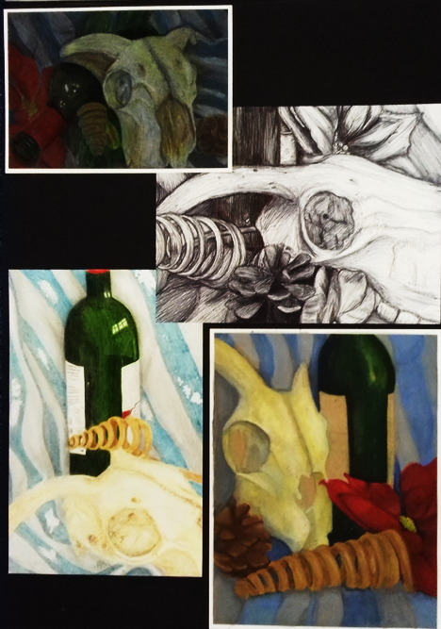
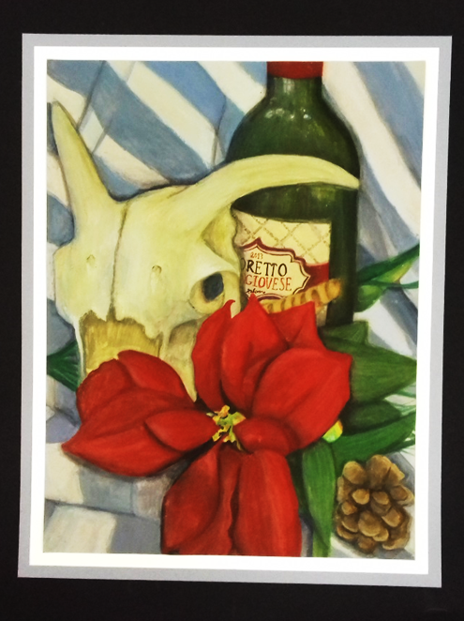
A Drink with Death
Process | 10/10
 | 30/30
Skills | 25/25
 | 25/25
Sub-total | 90/90

Slide 12
Higher
Expressive portfolio exemplars

Slide 13
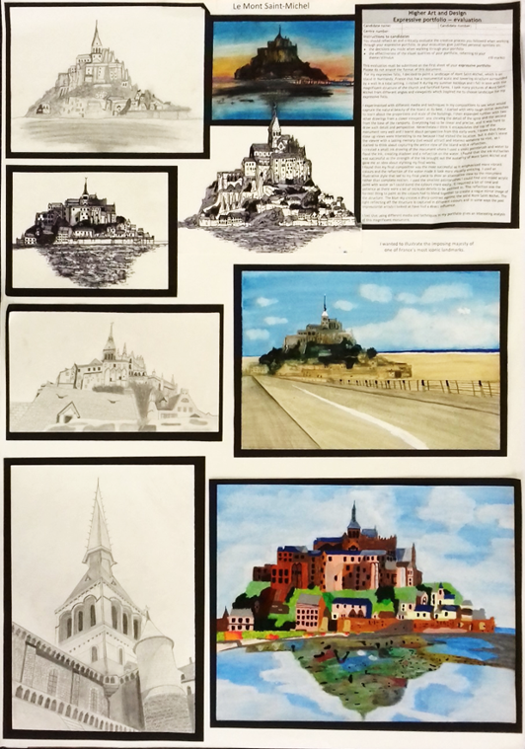
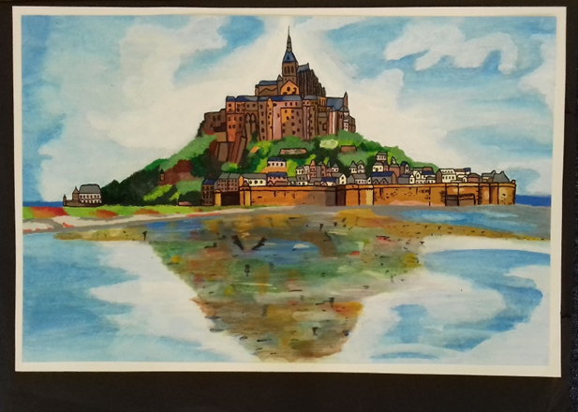

Le Mont St Michel
Process | 10/10
 | 16/30
Skills | 12/25
 | 10/25
Sub-total | 48/90

Slide 14
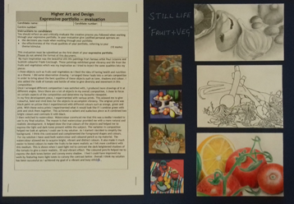
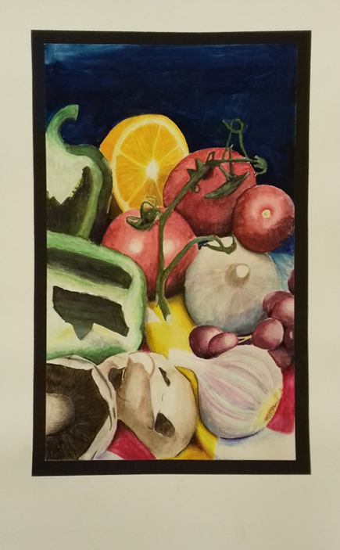
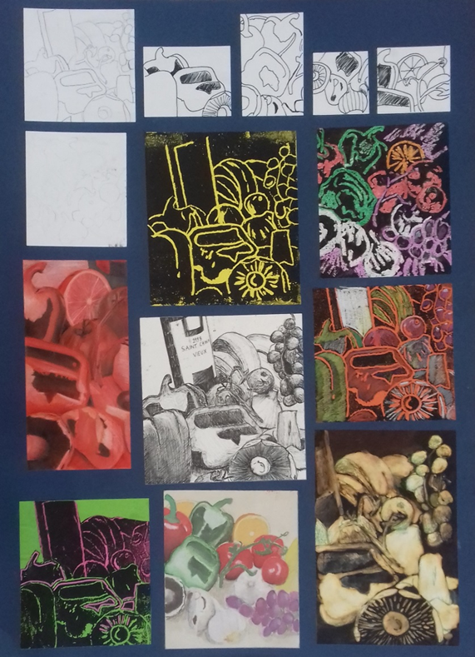
Fruit and Veg
Process | 7/10
 | 18/30
Skills | 16/25
 | 17/25
Sub-total | 58/90

Slide 15
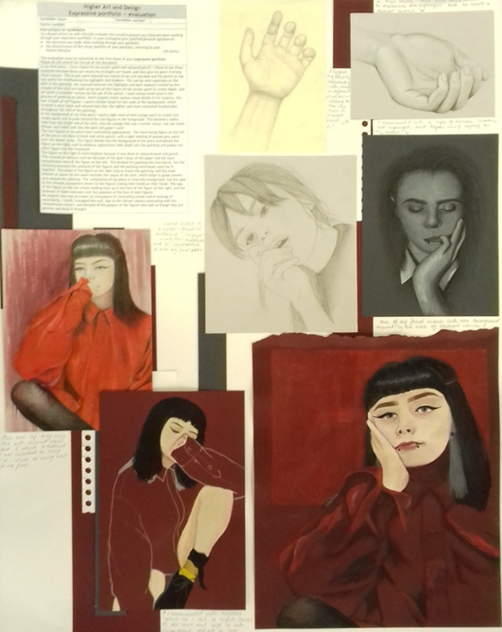
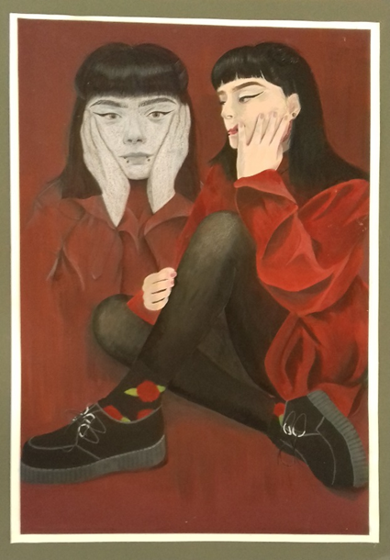
Deep in Thought
Process | 10/10
 | 24/30
Skills | 20/25
 | 20/25
Sub-total | 74/90

Slide 16
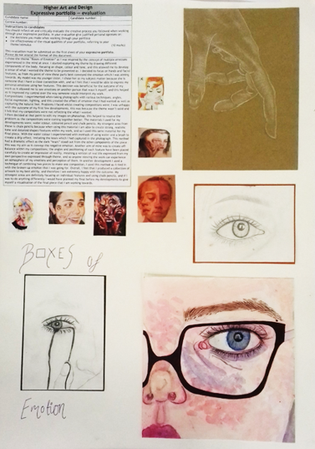
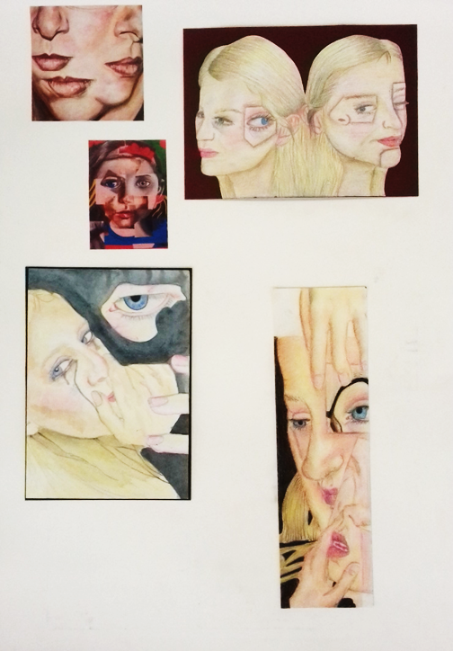
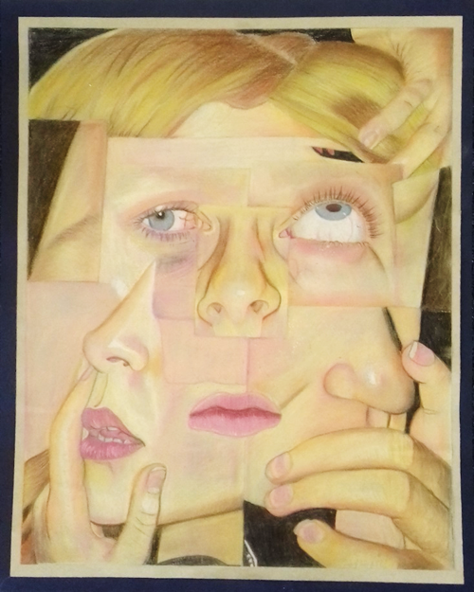
Boxes of Emotion
Process | 10/10
 | 28/30
Skills | 22/25
 | 25/25
Sub-total | 85/90

Slide 17
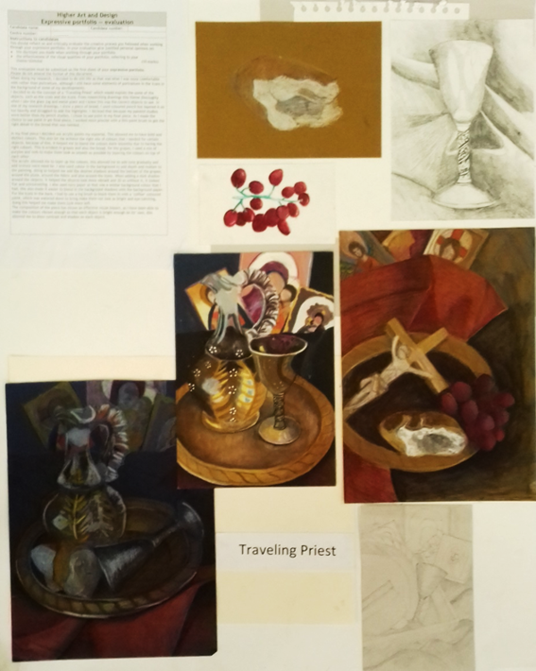
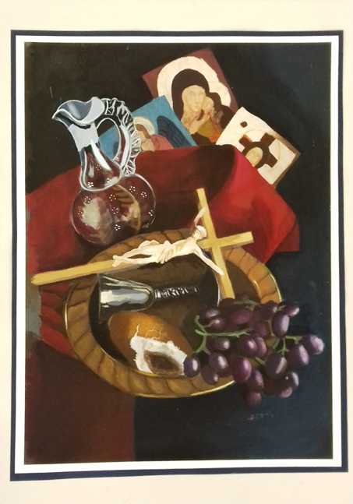

Travelling Priest
Process | 6/10
 | 23/30
Skills | 20/25
 | 20/25
Sub-total | 69/90

Slide 18
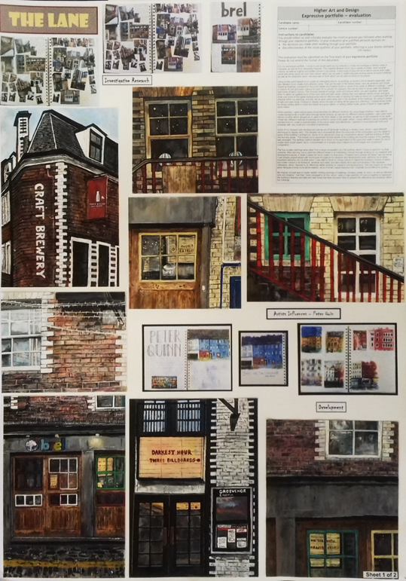

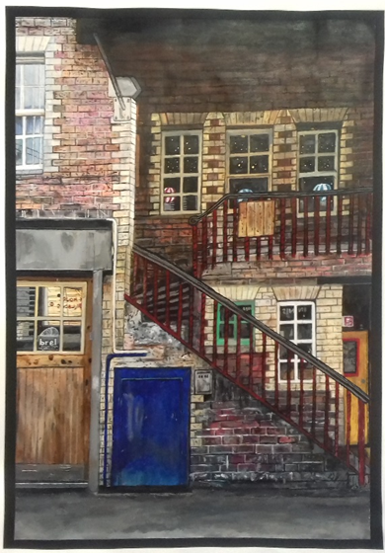
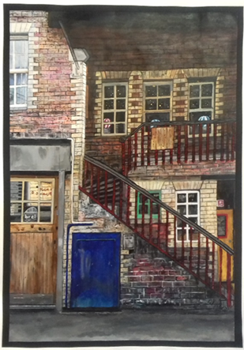
The Lane
Process | 10/10
 | 30/30
Skills | 25/25
 | 25/25
Sub-total | 90/90

Slide 19
Key messages
Many portfolios could be reduced to two A2 sheets or equivalent without impacting negatively on marks.
Before starting their portfolio, candidates should have made decisions about their approach.
A concise process will allow candidates to focus on quality rather than quantity.
Candidates are not required to work with multiple different types of materials – a focused approach is often more effective.

Slide 20
Contact information
If you have any queries about expressive portfolio assessment, please contact:
customer@sqa.org.uk

