Slide 2

Art and Design
National 5 and Higher
Guidance for the
Design portfolio

Slide 3
Aims of this audio-visual presentation
to provide visual exemplification of the guidance on the design portfolio which is published on the SQA website
to support teachers and lecturers in creating more time for learning and teaching by suggesting ways to make design portfolios more concise

Slide 4
Example portfolios
The following examples have been adapted from benchmark portfolios that were used to exemplify standards during central marking. The changes made to these portfolios show how:
the advice given in the guidance document might be applied
more concise portfolios can reduce workload for candidates without impacting negatively on the marks awarded

Slide 5
National 5
Design portfolios

Slide 6
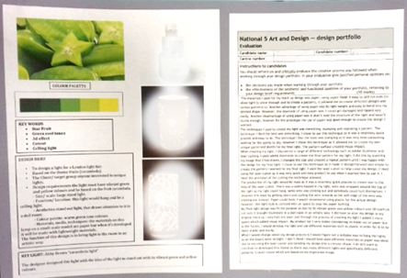
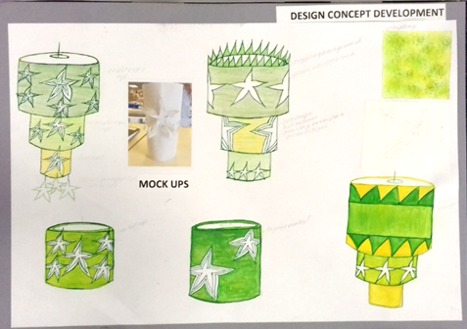
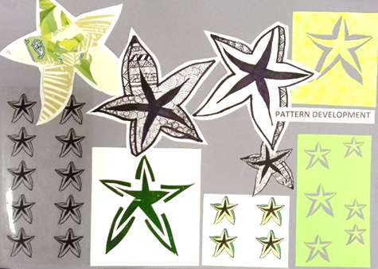
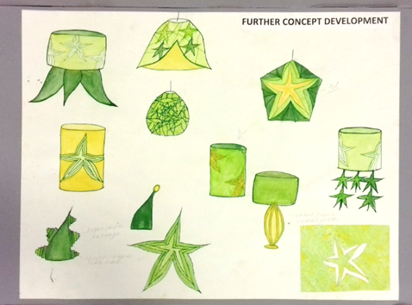
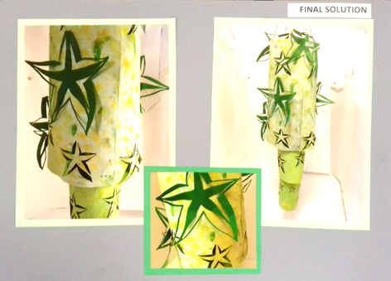

Starfruit Lamp
Process | 10/10
 | 16/30
Skills | 13/25
 | 13/25
Subtotal | 52/90

Slide 7
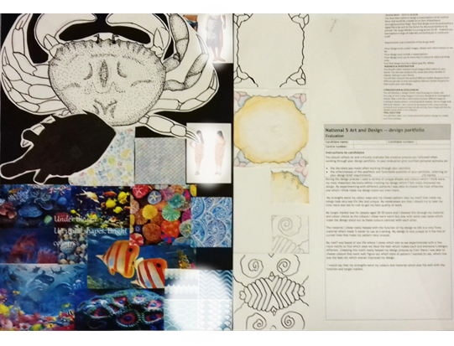
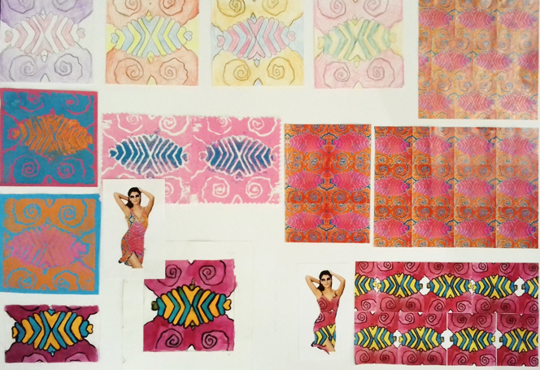
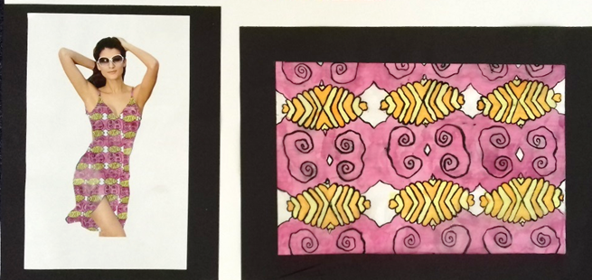
Sealife Print
Process | 10/10
 | 18/30
Skills | 13/25
 | 12/25
Sub-total | 53/90

Slide 8
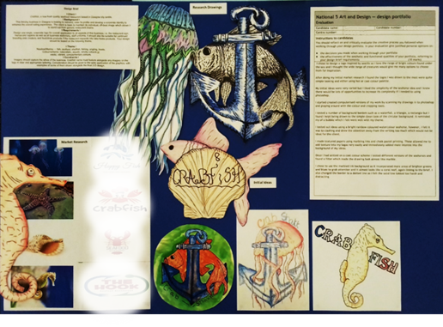
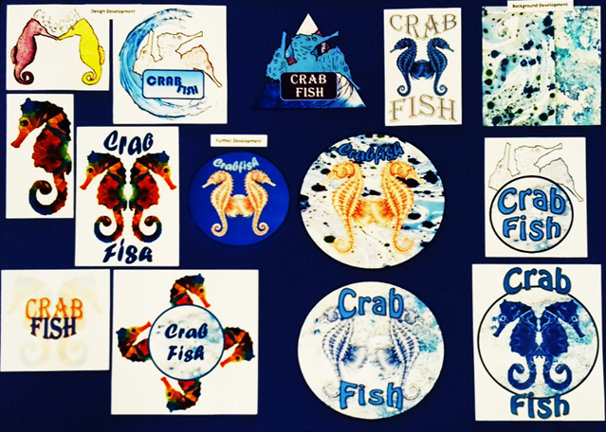
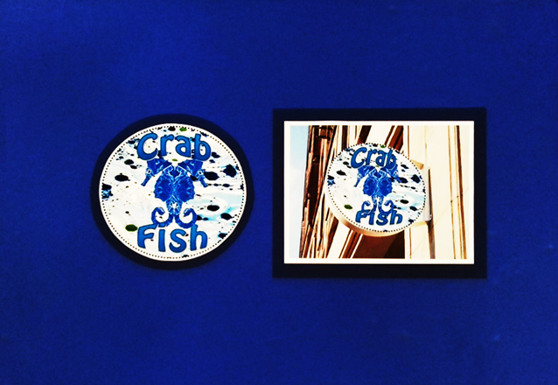
Crab Fish Logo
Process | 10/10
 | 15/30
Skills | 18/25
 | 18/25
Sub-total | 61/90

Slide 9
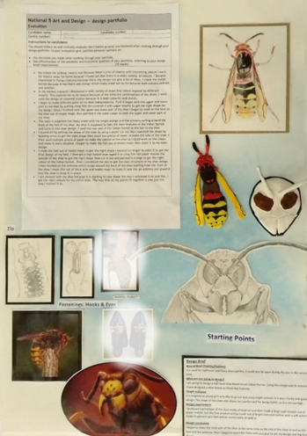
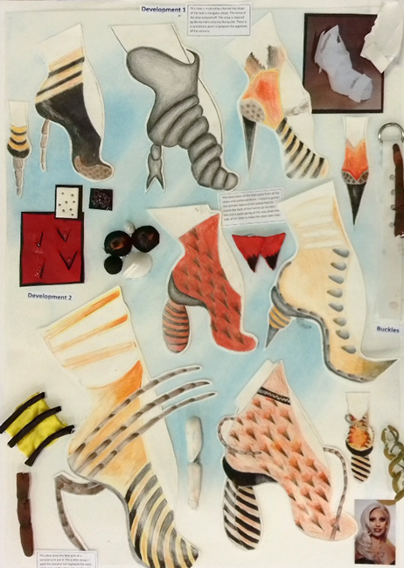
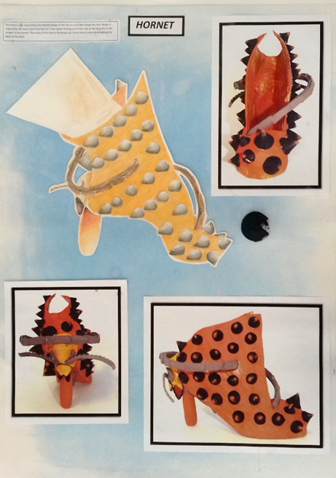
Hornet Shoe
Process | 10/10
 | 27/30
Skills | 22/25
 | 24/25
Sub-total | 83/90

Slide 10
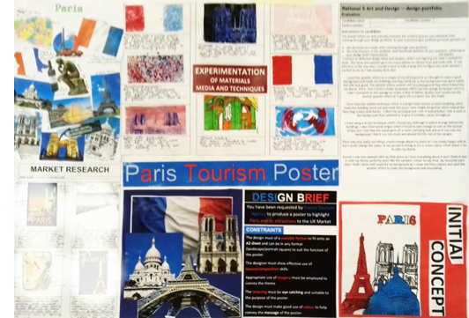
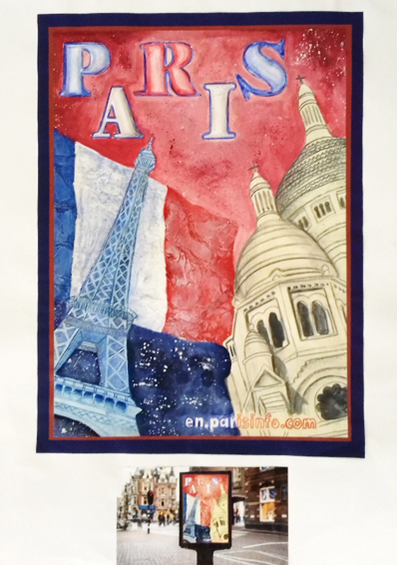
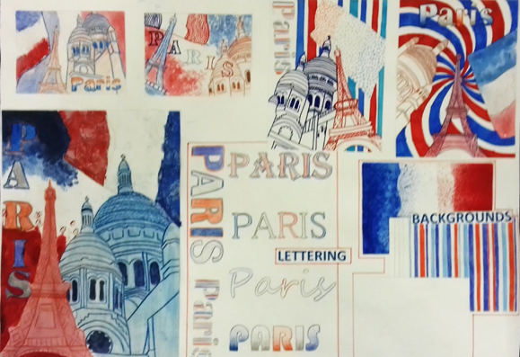
Paris Poster
Process | 10/10
 | 27/30
Skills | 23/25
 | 23/25
Sub-total | 83/90

Slide 11
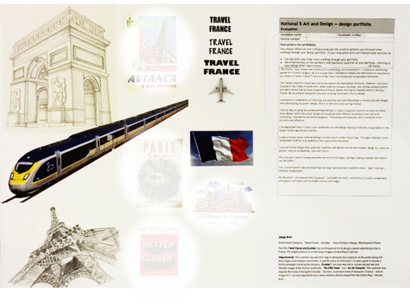
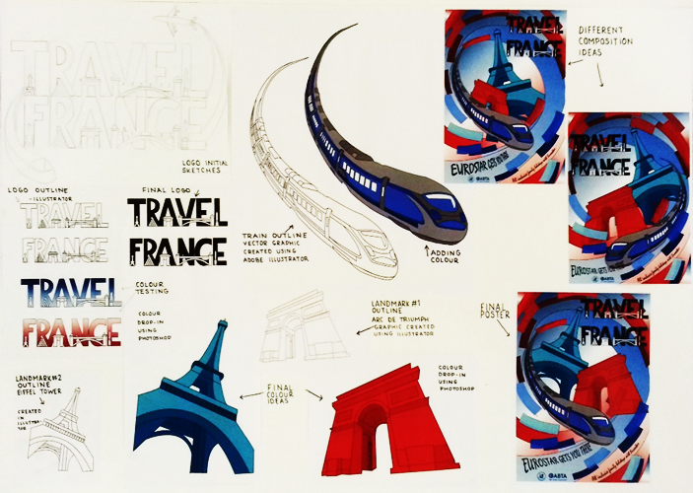
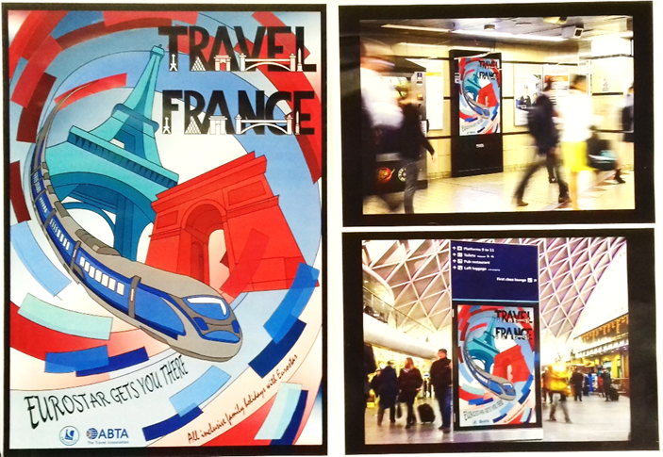
Travel France Poster
Process | 10/10
 | 30/30
Skills | 25/25
 | 25/25
Sub-total | 90/90

Slide 12
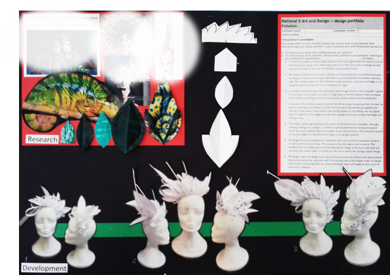
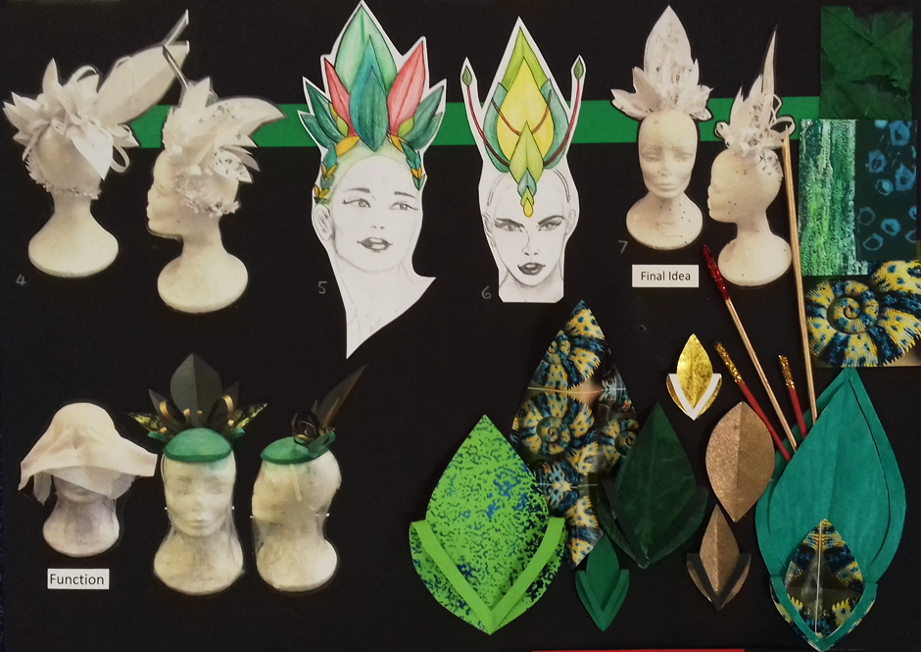
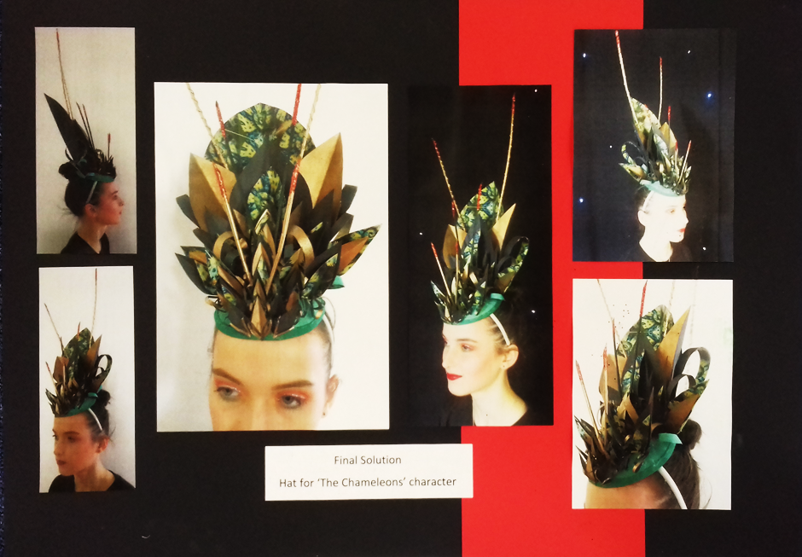
Chameleon Headpiece
Process | 10/10
 | 30/30
Skills | 25/25
 | 25/25
Sub-total | 90/90

Slide 13
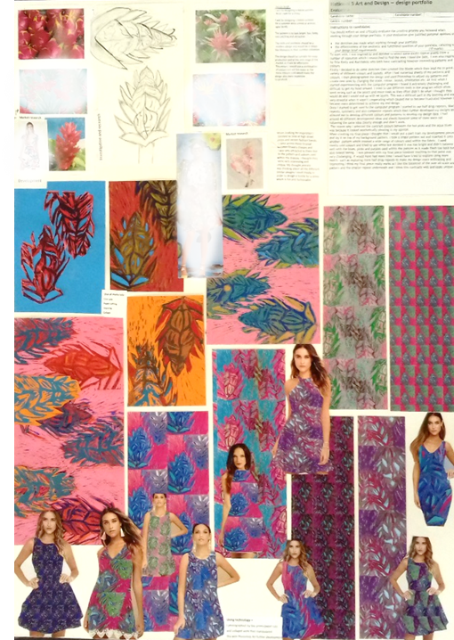
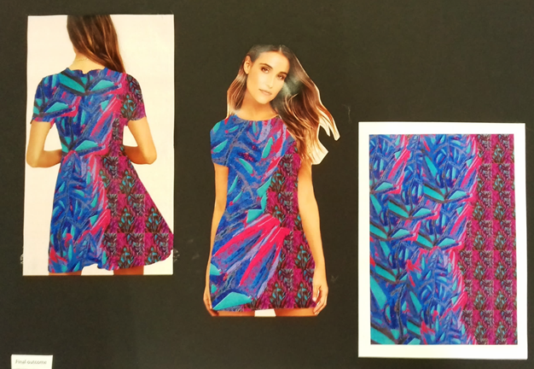
Tropical Storm Print
Process | 10/10
 | 30/30
Skills | 25/25
 | 25/25
Sub-total | 90/90

Slide 14
Higher
Design portfolios

Slide 15
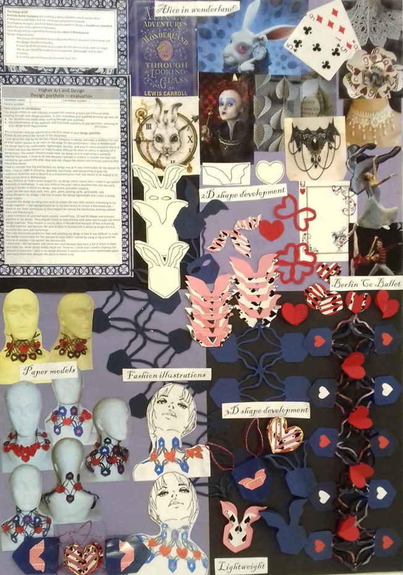
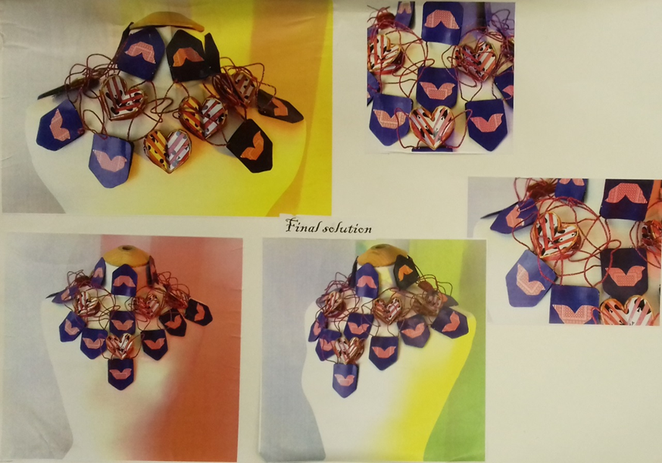
Alice in Wonderland Neckpiece
Process | 10/10
 | 22/30
Skills | 13/25
 | 13/25
Sub-total | 58/90

Slide 16
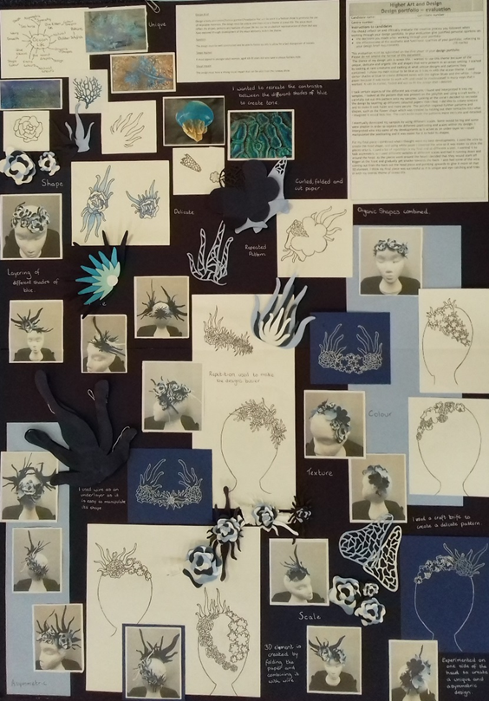
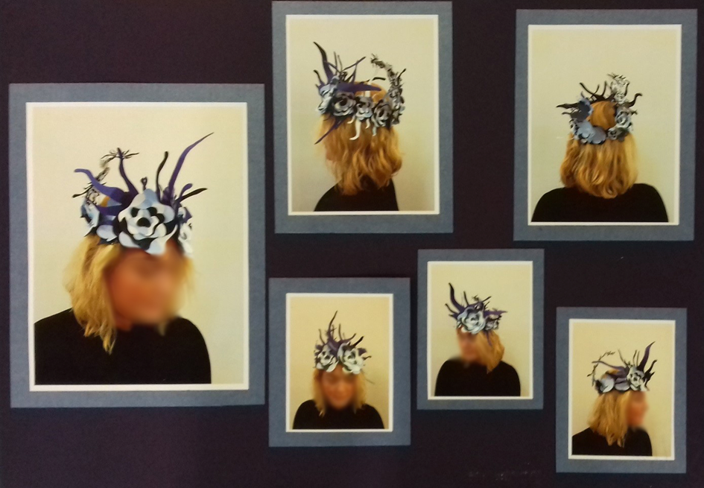
Coral Headpiece
Process | 6/10
 | 28/30
Skills | 22/25
 | 22/25
Sub-total | 78/90

Slide 17
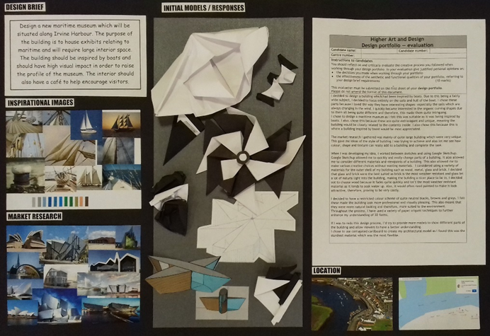
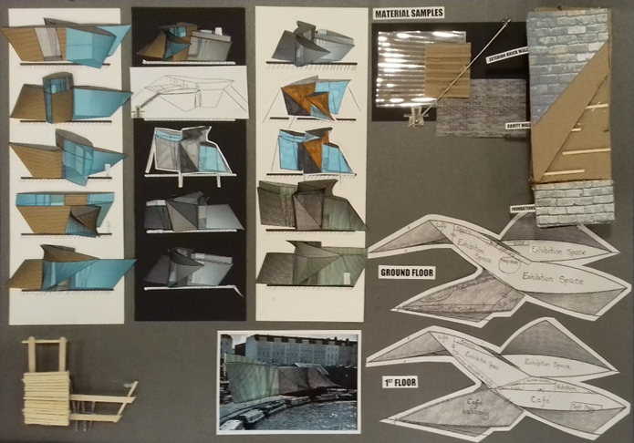
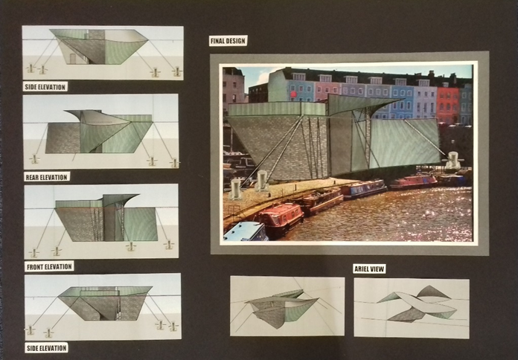
Maritime Museum
Process | 10/10
 | 30/30
Skills | 18/25
 | 22/25
Sub-total | 80/90

Slide 18
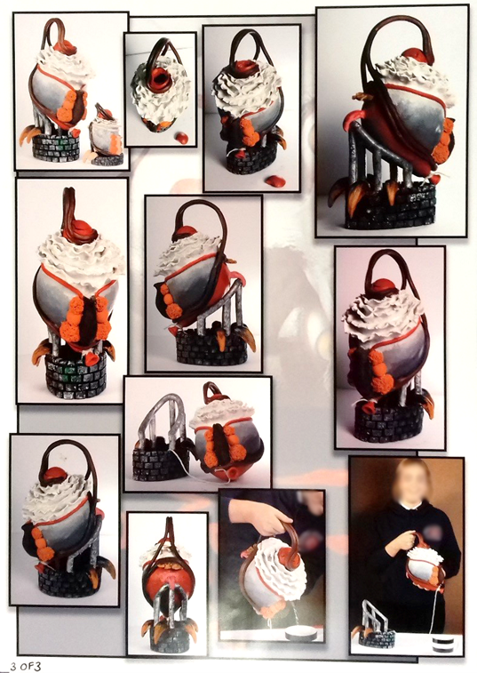
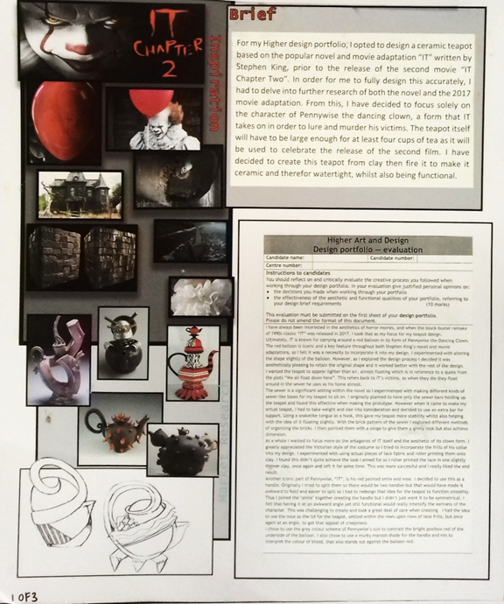
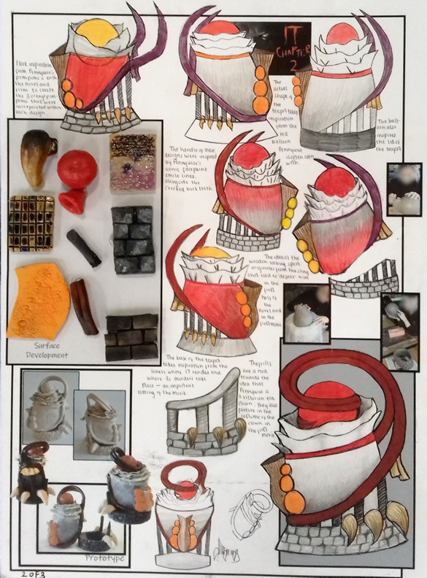
Pennywise Teapot
Process | 10/10
 | 30/30
Skills | 25/25
 | 25/25
Sub-total | 90/90

Slide 19
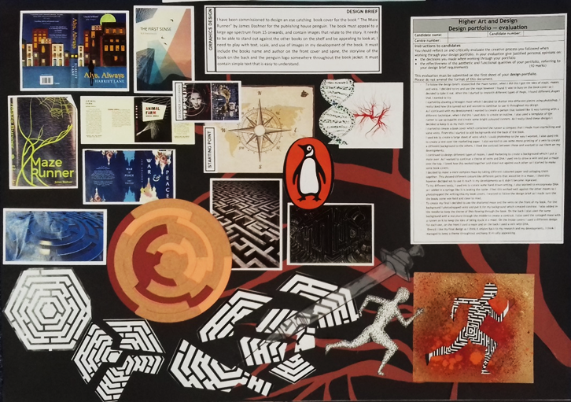
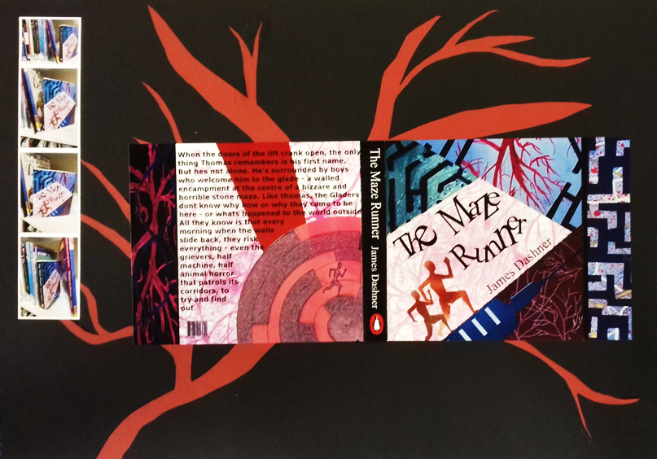
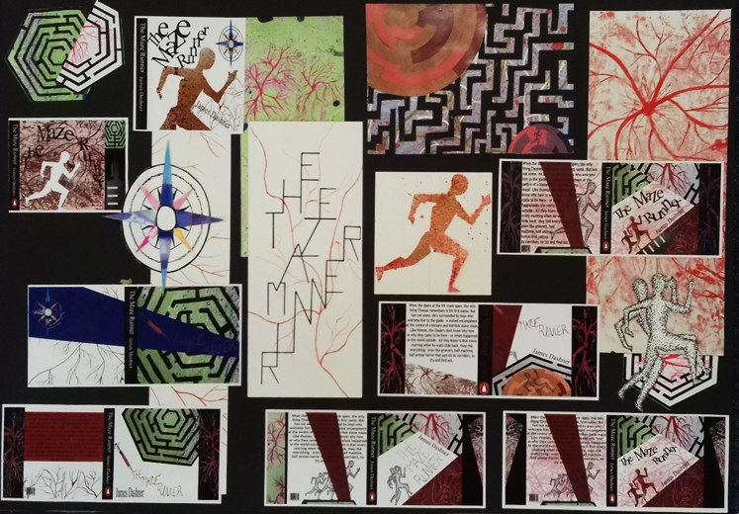
Maze Runner Book Cover
Process | 10/10
 | 30/30
Skills | 25/25
 | 25/25
Sub-total | 90/90

Slide 20
Key messages
Many portfolios could be reduced to two A2 sheets or equivalent without impacting negatively on marks.
Before starting their portfolio, candidates should have carried out some initial thinking about their brief so that they can focus on one line of development.
Observational drawing is not required for investigation.
A development may consist of more than one piece of work.
Candidates are not required to work with multiple different types of materials – a focused approach is often more effective.

Slide 21
Contact information
If you have any queries about design portfolio assessment, please contact:
customer@sqa.org.uk

