Slide 2
Revised National 5 Course Assessment
Applications of Mathematics

Slide 3
Aims of the day
To support teachers, lecturers and assessors in their understanding of the requirements of the revised course assessment for Applications of Mathematics.
To provide opportunities for delegates to:
ask questions and seek clarification.
discuss the revised requirements with colleagues.

Slide 4
2017
Paper 1

Slide 5
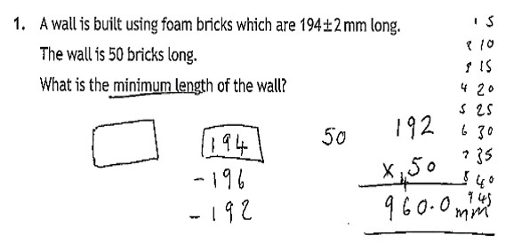
Question 1
Candidate 1

Slide 6
Q1 Award 1/2
Candidate 1
Valid strategy
Incorrect answer

Slide 7
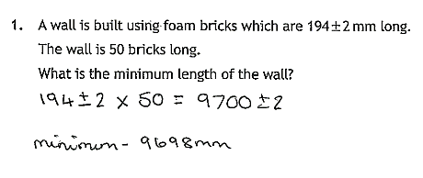
Question 1
Candidate 2

Slide 8
Q1 Award 1/2
Candidate 2
See commonly observed response 1 in the marking instructions

Slide 9
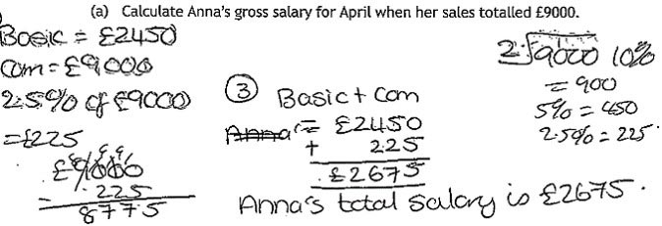
Question 2(a)
Candidate 3

Slide 10
Q2(a) Award 2/3
Candidate 3
See commonly observed response 1 in the marking instructions

Slide 11
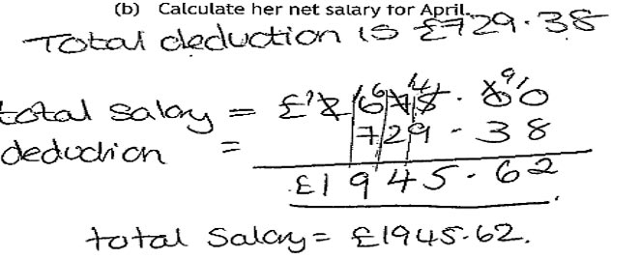
Question 2(b)
Candidate 3

Slide 12
Q2(b) Award 1/2
Candidate 3
Correct strategy
Net pay calculated incorrectly

Slide 13
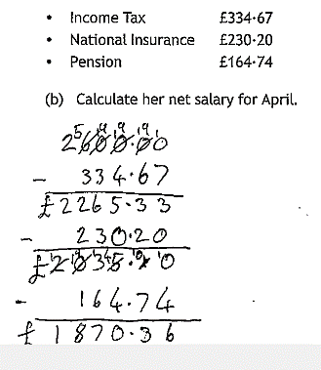
Question 2(b)
Candidate 4

Slide 14
Q2(b) Award 1/2
Candidate 4
Valid strategy
Incorrect calculation

Slide 15
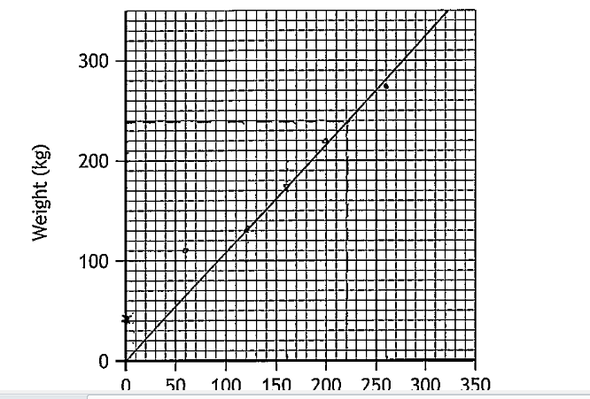
Question 3(a)(b)
Candidate 5

Slide 16
Q3(a) Award 2/2
Candidate 5
All points plotted correctly
Q3(b) Award 0/1
Invalid line of best fit

Slide 17
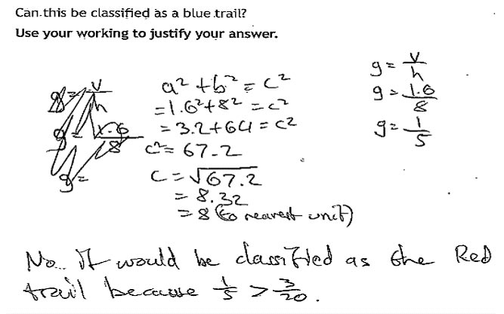
Question 4
Candidate 6

Slide 18
Q4 Award 1/3
Candidate 6
Correct strategy
See note 3 of the marking instructions
See note 4 of the marking instructions
Note: 2 different strategies attempted here. Mark both and give the higher mark.

Slide 19
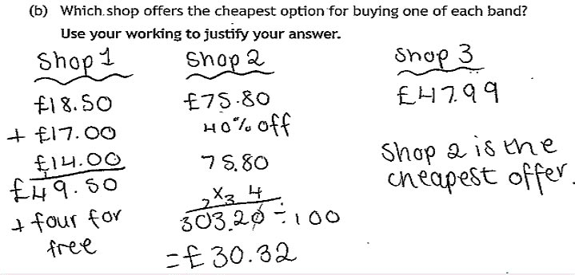
Question 5(b)
Candidate 7

Slide 20
Q5(b) Award 1/3
Candidate 7
Cost for shop 1 correct
Cost for shop 2 not calculated
See note 1 of the marking instructions Attempt to compare a cost to a discount
Alternative strategy: mark 1 awarded. Marks 2 and 3 not awarded.

Slide 21
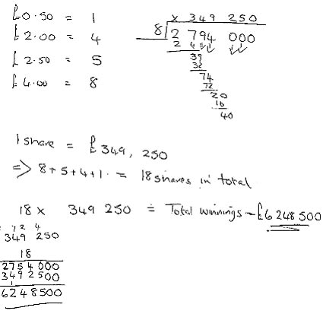
Question 6
Candidate 8

Slide 22
Q6 Award 2/3
Candidate 8
Alternative Strategy 1:
Calculates value of one share
Calculates number of shares
Incorrect calculation

Slide 23
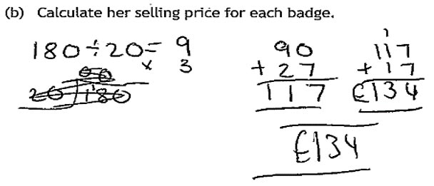
Question 7(b)
Candidate 9

Slide 24
Q7(b) Award 1/3
Candidate 9
Alternative strategy:
Correct number of badges
Incorrect total cost
No attempt to divide by 9

Slide 25
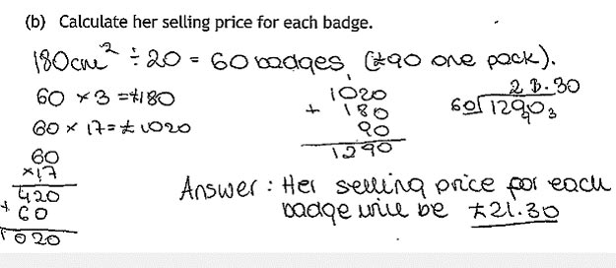
Question 7(b)
Candidate 10

Slide 26
Q7(b) Award 1/3
Candidate 10
Incorrect number of badges
Consistent total cost
Inconsistent cost per badge

Slide 27
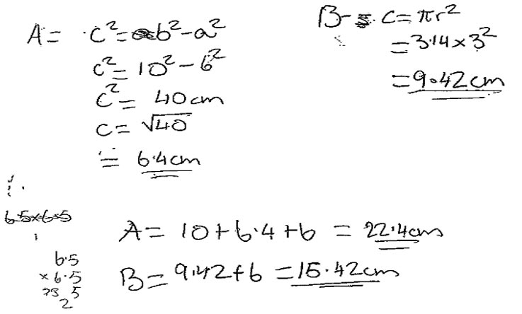
Question 9(a)
Candidate 11

Slide 28
Q9(a) Award 1/4
Candidate 11
Correct substitution into Pythagoras
Missing side incorrect
Invalid method
Perimeter of whole shape not found

Slide 29
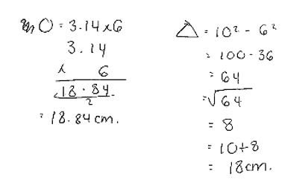
Question 9(a)
Candidate 12

Slide 30
Q9(a) Award 3/4
Candidate 12
Correct substitution into Pythagoras
Missing side correct
Semi circle incorrect
Perimeter of whole shape consistent with
working (in part b)

Slide 31
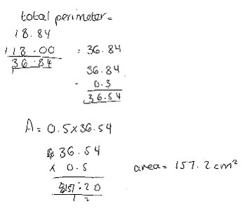
Question 9(b)
Candidate 12

Slide 32
Q9(b) Award 1/2
Candidate 12
Valid strategy
Area calculated incorrectly

Slide 33
2017
Paper 2

Slide 34
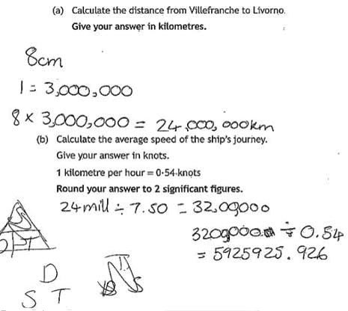
Question 5(a)(b)
Candidate 13

Slide 35
Q5(a) Award 1/2
Candidate 13
See commonly observed response 1 in the marking instructions.
Q5(b) Award 1/3
Speed calculated correctly consistent with answer to (a)
Incorrect conversion to knots
Final answer not rounded to two significant figures

Slide 36
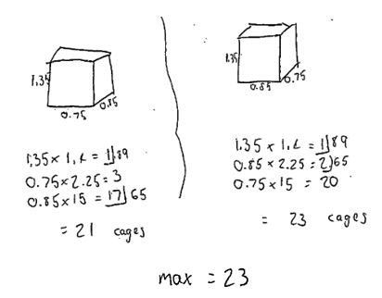
Question 6(a)
Candidate 14

Slide 37
Q6(a) Award 1/3
Candidate 14
Knows to check 2 arrangements
First arrangement incorrect
Calculations are incorrect, neither considered 2 layers

Slide 38
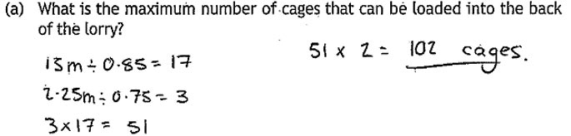
Question 6(a)
Candidate 15

Slide 39
Q6(a) Award 1/3
Candidate 15
Only one arrangement tried
One arrangement calculated correctly
No second arrangement

Slide 40
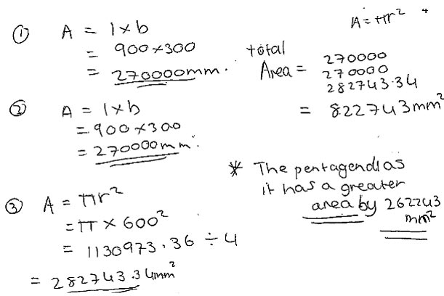
Question 8(c)
Candidate 16

Slide 41
Q8(c) Award 2/4
Candidate 16
Valid strategy (quarter circle plus rectangles)
Area of quarter circle correct
See note 3 of the marking instructions
Inconsistent conclusion

Slide 42
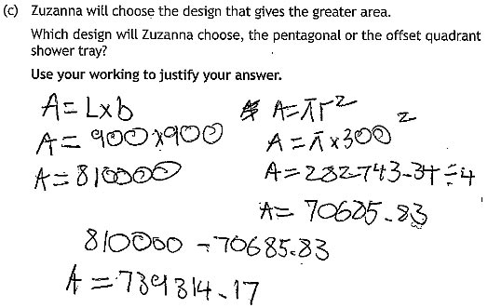
Question 8(c)
Candidate 17

Slide 43
8(c) Award 1/4
Candidate 17
Alternative strategy:
Invalid strategy (wrong area taken away)
Quarter circle incorrect (wrong radius)
Area consistent with previous working (see commonly observed response 3 in the marking instructions)
No conclusion

Slide 44
WWW.sqa.org.uk│0303 333 0330

