Slide 2
Revised Higher
Course Assessment
- Art and Design
Introduction

Slide 3
Aims of the day
To support teachers, lecturers and assessors in their understanding of the requirements of the revised course assessment for Higher Art & Design
To provide opportunities for delegates to:
ask questions and seek clarification
discuss the revised requirements with colleagues

Slide 4
Overview
The removal of mandatory units has required revisions to the course assessment to maintain:
      breadth
      depth
      challenge
      integrity

Slide 5
Overview (cont.)
The content of the course has not changed
Content previously only assessed in the units is now included in the course assessment
There is a change to the weighting of the question paper and the practical assessment: it is now 23%:77%

Slide 6
Course Structure
The course structure comprises of three components marked out of 260
Component 1: question paper – 60 marks (23%)
Component 2: expressive portfolio – 100 marks (38.5%)
Component 3: design portfolio – 100 marks (38.5%)

Slide 7
Portfolios
The removal of unit assessment has led to amendments to the portfolio assessment tasks
Investigation and initial development previously assessed in the units is now included in the portfolio
Marking instructions have been restructured

Slide 8
Portfolios: Preparing candidates
The expressive and design portfolio assessment tasks are published on the SQA website. These contain:
instructions for teachers
marking instructions
instructions for candidates

Slide 9
Portfolio presentation
The portfolio format continues to offer centres flexibility. However, portfolios must:
not be any bigger than three A2 size, single-sided sheets or equivalent
fold to a size not exceeding A1

Slide 10
Portfolio presentation
Themes/title should be included on the first sheet of the expressive portfolio
Design briefs should be included on the first sheet of the design portfolio
Evaluations must:
  be completed on the mandatory SQA template
  be attached to the first sheet
  not overlap any other work or extend beyond the three A2 sheets or equivalent

Slide 11
Portfolio: Submission for marking
Expressive and design are now two separate components. This means that:
  expressive and design portfolios must now be packaged separately
  separate attendance registers will be provided
  the components will be marked separately by two different teams
  SQA will be able to collect more detailed data on candidate performance

Slide 12
Revised Higher
Course Assessment
- Art and Design
Question Paper Workshop

Slide 13
Overview
The content of the course has not changed
The question paper has been restructured
Consultation with teachers was carried out through focus groups and NQST (National Qualifications Support Team)

Slide 14
What has changed?
 | Up to 2018 | 2019
Total marks | 60 marks | 60 marks
Time | 2 hours | 2 hours
Weighting | 27% | 23%
Structure | Two sections – Expressive Art Studies and Design Studies Candidates attempt two questions from four in each section, a total of four question | Two sections – Expressive Art Studies and Design Studies Candidates attempt one mandatory question and two optional questions from a choice of five in each section, a total of six questions
Command words | Select Describe Explain Discuss | Select Explain Analyse

Slide 15
 | Up to 2018 | 2019
Expressive Art Studies Images | Two works representing different genres, styles and processes | Five artworks featuring: people places objects or a combination of these a range of different processes
Design Studies Images | Two designs from different design areas | Five designs from: graphics product design interior/environmental/ architectural design jewellery fashion/textiles
Prompts | Similar selection of prompts used in both types of questions to test understanding of concepts | Different selection of prompts used in mandatory and optional questions to test understanding of concepts

Slide 16
 | Up to 2018 | 2019
Testing the knowledge and understanding of artists and designers studied on the course | Candidates selected one from questions 3 and 4 and one from questions 7 and 8 | Questions 1 and 7 are mandatory
 | 2 x 20 marks each Total 40 marks | 2 x 10 marks each Total 20 marks
 | Questions split into part (a) and part (b) | No part (a) or (b)
 | Command words: Select Discuss Explain | Command words: Select Explain
 | Sampled from candidates’ learning on the course Candidates selected artworks/designs from the range they had studied | Samples from candidates’ learning on the course Candidates select one artwork and one design from the range they have studied

Slide 17
 | Up to 2018 | 2019
Testing the knowledge and understanding of artists and designers studied on the course (cont.) | Optionality within the question – candidates could answer on one or more artworks and designs | Candidates must answer on one selected artwork and one selected design
 | Prompts selected from subject specific terms Candidates could respond to one or both prompts in part (a) | Prompts allow candidates to demonstrate their accumulated knowledge and understanding of a selected artwork/design Candidates must respond to all prompts
 | 10 marks were available within each 20 mark question for explaining the impact of social cultural and/or other factors on the selected artwork(s)/design(s) | 4 marks are available within each 10 mark question for explaining the impact of social cultural and/or other factors on the selected artwork/design

Slide 18
Mandatory questions – prompts
Expressive Art Studies Question 1 | Design Studies Question 7
One from: use of materials and/or technology use of scale use of techniques working methods | One from: consideration of function use of materials and/or technology use of techniques working methods
and one from: choice of subject matter consideration of mood and atmosphere consideration of style use of one visual element from line, tone, colour, texture, shape, form, pattern (selected by the candidate) | and one from: consideration of aesthetics consideration of style consideration of target market/audience use of one visual element from line, tone, colour, texture, shape, form, pattern (selected by the candidate)
and: impact of social, cultural, and/or other influences | and: impact of social, cultural, and/or other influences

Slide 19
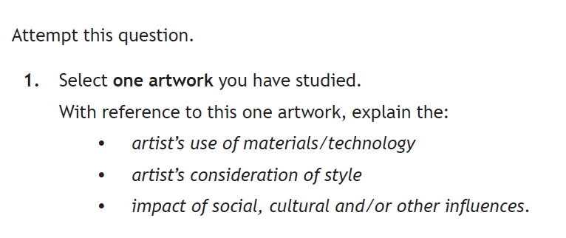
Mandatory question 1: Example

Slide 20
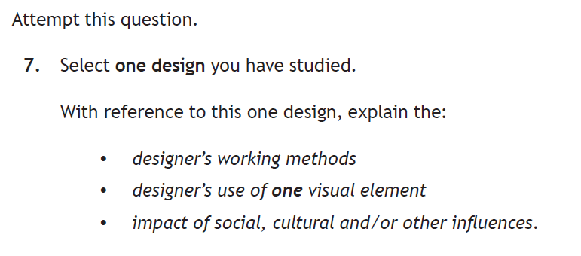
Mandatory question 7: Example

Slide 21
 | Up to 2018 | 2019
Applying skills, knowledge and understanding in an unfamiliar context (unseen images) | Candidates select one from questions 1 and 2 and one from questions 5 and 6 | Candidates select two from questions 2-6 and one from questions 8-12
 | 2 x 10 marks each Total 20 marks | 4 x 10 marks each Total 40 marks
 | Questions split into part (a) and part (b) Part (a) two prompts (6 marks) Part (b) combined point leading to third prompt (4 marks) | No part (a) or (b) Three prompts Maximum 4 marks available for each prompt up to total of 10
 | Command words: Describe Explain | Command word: Analyse

Slide 22
Optional questions – examples of prompts
Expressive Art Studies |  | Design Studies
colour composition focal point form imagery lighting line location materials mood and atmosphere pattern perspective | pose scale setting shape style subject matter symbolism techniques technology texture tone use of space viewpoint | aesthetics colour construction decoration ergonomics fitness for purpose form function imagery layout line location manufacturing process materials | pattern scale shape sources of inspiration style target audience target market techniques technology texture tone typography use of space wearability

Slide 23
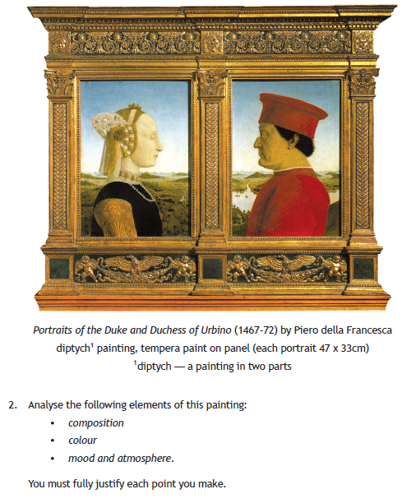
Optional image question: Example

Slide 24
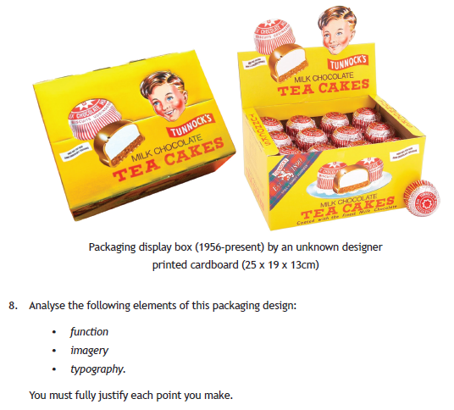
Optional image question: Example

Slide 25
What is the difference between mandatory and optional questions?
Mandatory questions | Optional questions
Responses should be based on the candidate’s knowledge and understanding of their prior learning about selected works | No prior knowledge of the artwork/design is necessary Responses are be based on the candidate’s applied knowledge and understanding of art/design practice
Responses should contain factually correct information showing that the candidate has studied the work and the context in which it was produced Factually inaccurate and speculative responses cannot be awarded marks | Responses can be speculative – there are no right or wrong answers As long as the response is fully justified and demonstrates an understanding of art/design concepts, the candidate can gain marks
Candidates will benefit from teaching which focuses on key art/design concepts and the social and cultural context relating to particular artworks/designs works | Candidates will benefit from introduction to a diverse range of different artworks/designs and the opportunity to analyse these though discussion and writing

Slide 26
N5 – Higher comparison: breadth, depth and challenge
N5 | Higher
50 marks | 60 marks
12 questions, 6 in each section | 12 questions, 6 in each section
Command words: Select Comment on Explain | Command words: Select Explain Analyse
Questions 1 and 7 are mandatory 15 marks each – total 30 marks | Questions 1 and 7 are mandatory 10 marks each – total 20 marks
The impact of social and cultural influences can be related to any of the work or practice of the selected artist/designer Breadth or depth can be demonstrated | The impact of social and cultural influences must be explained in relation to their one selected artwork/design More depth of knowledge required

Slide 27
N5 – Higher comparison: breadth, depth and challenge
N5 | Higher
Questions have 3 prompts (8 marks) and an opinion (2 marks) All aspects of the question must be addressed to gain full marks | Questions have 3 prompts A balanced response must be given to all aspects of the question (max 4 marks available for each prompt) More depth and challenge
In the optional questions, candidates must demonstrate knowledge and understanding in response to one selected artwork and one design from a specific design area | In the optional questions, candidates respond to two selected artworks representing different processes and styles, and designs form two different areas More breadth of knowledge required More higher order thinking required
Comments must be justified | Explanations and analysis must be fully justified

Slide 28
Recommendations to centres:
Consider how you will make use of the time that would have been spent generating, assessing and re-assessing unit evidence
Consider the effectiveness of your approach
Ensure candidates are introduced to a variety of expressive art genres and styles and at least two design areas
Teach candidates the meaning of the art and design terminology likely to be encountered in the exam

Slide 29
Ensure candidates are familiar with the format of the question paper and have opportunities to practice their exam technique
Teach candidates how to develop and justify their points and how to connect their responses to the question asked
Mark homework and practice exams in line with the national standard and ensure consistency across your department
Provide feedback to candidates on how they can improve in this component

Slide 30
Resources
The following documents are available on the SQA website:
The course specification document, which contains:
  – question paper prompts
  – social, cultural and other influences which impact on artists’ and designers’ work and practice
  – appendix 1: course support notes
  – appendix 2: definitions of art and design terms
Specimen question paper and marking instructions

Slide 31
Revised Higher
Course Assessment
- Art and Design
Expressive Portfolio Workshop

Slide 32
Expressive portfolio assessment task
The expressive portfolio assessment task requires candidates to provide evidence of their ability to:
respond to their theme by producing relevant and focused 2D/3D analytical drawings, studies and investigative research
creatively and skilfully use appropriate materials, techniques and/or technology for visual effect in response to their theme or stimulus
demonstrate a single line of focused development, showing visual continuity, the refinement of one idea and the production of a final piece
reflect on and critically evaluate their creative process

Slide 33
Portfolios: Marking instructions
The marking instructions for the expressive portfolio have been restructured to reflect the intentions of the revised assessment task
The marking instructions contain three sections:
Section 1 – Process (40 marks)
Section 2 – Skills (50 marks)
Section 3 – Evaluation (10 marks)

Slide 34
Expressive portfolio: Process
Candidates will be assessed on:
producing relevant and focused 2D/3D analytical drawings, studies and investigative research appropriate to the selected theme/stimulus and their line of development (10 marks)
demonstrating a single line of focused development, showing visual continuity and the refinement of one idea, and producing a final piece
(30 marks)

Slide 35
Expressive portfolio: Skills
Candidates will be assessed on:
creatively and skilfully using a selection of materials, techniques and/or technology for visual effect in response to the theme/stimulus (25 marks)
creatively and skilfully using appropriate visual elements and expressive effects (e.g. composition, focal point, perspective, viewpoint, lighting, mood and atmosphere, symbolism) in response to the theme/stimulus (25 marks)

Slide 36
Expressive portfolio: Evaluation
Candidates will be assessed on:
giving a justified critical evaluation of the effectiveness of their decisions and the visual qualities of their expressive portfolio with reference to their theme/stimulus
(10 marks)

Slide 37
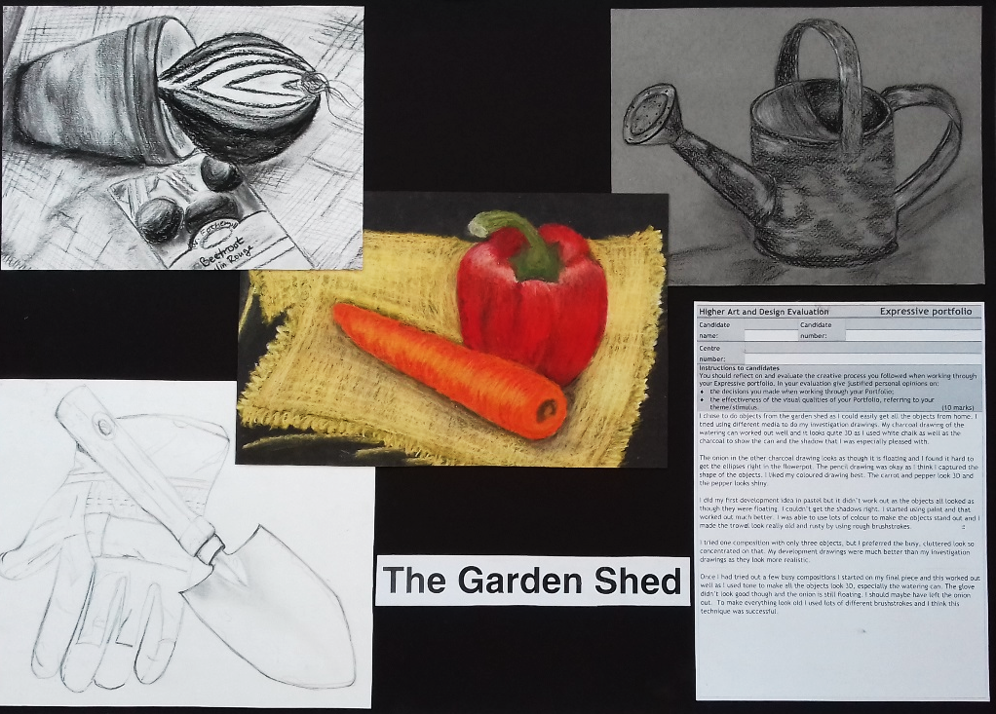
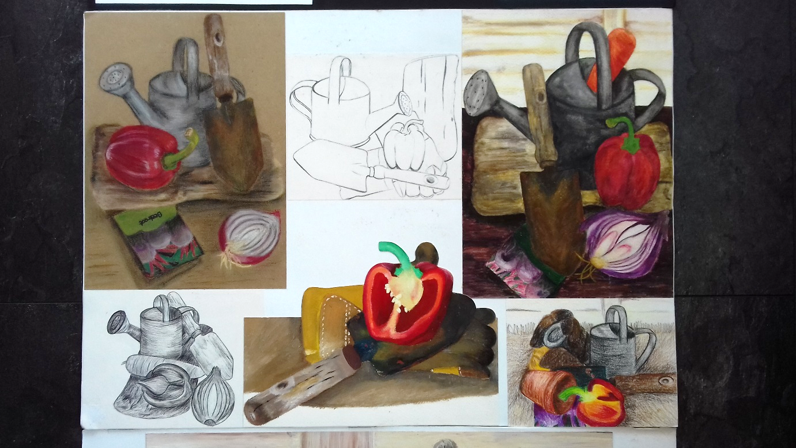
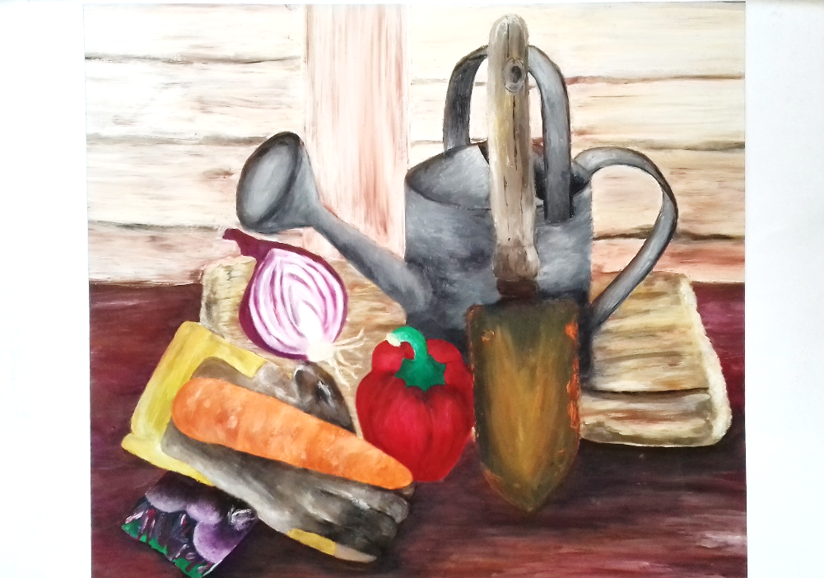
Applying the marking instructions to an exemplar portfolio

Slide 38
Process
Candidates are assessed on producing relevant and focused 2D/3D analytical drawings, studies and investigative research appropriate to the selected theme or stimulus and their line of development
All the analytical drawings are highly relevant to the theme and clearly link to the subsequent development and final piece.
Highly relevant

Slide 39
Process
Candidates are assessed on demonstrating a single line of focused development, showing visual continuity and the refinement of one idea and producing a final piece
The candidate has clearly enjoyed developing a single line of enquiry based on their theme, experimenting with composition and media, allowing a clear link through to the final piece. The final piece, however, shows little further refinement of either the composition or the use of media.
Effective

Slide 40
Skills Candidates will be assessed on creatively and skilfully using appropriate materials, techniques and/or technology in response to their theme or stimulus
Appropriate media and techniques have been effectively selected by the candidate to develop a creative response to the theme ‘The Garden Shed’. The skills evident are not as refined in terms of media handling on different objects in the compositions. Some of the objects appear flat and float, lacking in accuracy particularly in the final piece.
Effective

Slide 41
Skills Candidates will be assessed on creatively and skilfully using appropriate visual elements and expressive effects (e.g. composition, focal point, perspective, viewpoint, lighting, mood and atmosphere, symbolism) in response to their theme or stimulus
The range of development studies are more convincing in terms of effective composition and viewpoint. The candidate explores the visual elements, using linear, tonal and colour studies to develop the theme. The final solution is less effective as it lacks further refinement of the skill shown earlier in the portfolio. The scaling up of the final outcome proved to be more challenging for the candidate as the use of materials on the larger scale has led to some of the refinement being lost.
Effective

Slide 42
Evaluation
Candidates are assessed on giving a justified critical evaluation of the effectiveness of their decisions made when working through their and the visual qualities of their expressive portfolio with reference to their theme or stimulus
The candidate explains their creative decisions in a straightforward manner with reference to their theme. Most of the comments are descriptive with little justified critical points being made. Partially justified critical evaluation

Slide 43
Performance in the
expressive portfolio

Slide 44
Markers reported that:
the quality of work produced by candidates showed increasing confidence and creativity in the choice of contexts as well as the experimental use of media and techniques
that presentations were generally easy to ‘read’ with good visual continuity and a clear line of development
use of the mandatory evaluation form resulted in more focused and effective evaluative responses

Slide 45
Recommendations to centres:
Build on existing good practice
Candidates should be supported in their choice of a personalised theme/stimulus and to edit and present portfolio work effectively
Final pieces don’t need to be A2 in size if a candidate is better suited to working on a smaller scale
Adapt successful approaches from the previous version of the qualification to include investigation studies

Slide 46
Revised Higher
Course Assessment
- Art and Design
Design Portfolio Workshop

Slide 47
Design portfolio assessment task
The design portfolio assessment task requires candidates to provide evidence of their ability to:
respond to their design brief by producing and compiling relevant and focused 2D/3D investigative material and market research
use appropriate materials, techniques an/or technology for aesthetic and functional effect
demonstrate their understanding of appropriate design elements
demonstrate a single line of development leading to the production of a design solution
reflect on and critically evaluate their creative process

Slide 48
Portfolios: Marking instructions
The marking instructions for the design portfolio have been restructured to reflect the intentions of the revised assessment task.
The marking instructions contain three sections:
Section 1 – Process (40 marks)
Section 2 – Skills (50 marks)
Section 3 – Evaluation (10 marks)

Slide 49
Design portfolio: Process
Candidates will be assessed on:
compiling and producing relevant and focused 2D/3D investigative material and market research appropriate to the design brief and their line of development (10 marks)
demonstrating a single line of focused development, showing visual continuity and the refinement of one idea and producing a design solution
  (30 marks)

Slide 50
Design portfolio: Skills
Candidates will be assessed on:
creatively and skilfully using appropriate materials, techniques and/or technology for aesthetic and functional effect in response to their design brief/design area (25 marks)
creatively and skilfully demonstrating understanding of appropriate design elements (e.g. aesthetics, style, layout, function, safety, balance, ergonomics, wearability, target market, impact, visual elements) in response to their design brief requirements (25 marks)

Slide 51
Design portfolio: Evaluation
Candidates will be assessed on:
giving a justified critical evaluation of the effectiveness of the aesthetic and functional qualities of their design portfolio with reference to their design brief/design area
  (10 marks)

Slide 52
Applying the marking instructions
to an exemplar portfolio
Design Brief
Design a book cover for ‘Life of Pi’ by Yann Martel. This is a book about a boy who gets stranded on a boat with only a tiger. As the book progresses it shows how the magical relationship is between the boy and the tiger and how they need to work as a team to survive.
Produce a modern inspirational and eye-catching design
The imagery should relate to the plot and content of the book
The design should include the front, back and spine of the book
Ensure that the text, including the name of the book and the author is easy to read
Include a short summary of the book on the back cover
There should be a bar code on the back cover
It should appeal to a target audience of 21+

Slide 53
Applying the marking instructions to an exemplar portfolio
Life of Pi folio can be viewed on the SQA Secure website

Slide 54
Process producing and compiling relevant and focused 2D/3D investigative material and market research appropriate to the design brief and their line of development
The candidate has collected thematic images which are relevant to the brief. The market research images presented are relevant but only the front cover of the selected books is shown. There are no images of the spine or back or book jacket layouts, as required by the brief.
Relevant

Slide 55
Process Candidates are assessed on demonstrating a single line of focused development, showing visual continuity and the refinement of one idea and producing a design solution
The single line of development shows visual continuity with the investigation, as these images are used as a starting point. The initial development ideas show some refinement, however, the process is not fully explored or resolved. The development of the imagery lacks sophistication and refinement as it moves from the latter stages of the development and into the design solution. Effective

Slide 56
Skills Candidates will be assessed on creatively and skilfully using appropriate materials, techniques and/or technology for aesthetic and functional effect in response to their design brief
The choice of materials is focused and used with some control. The candidate has effectively used a restricted colour palette, using watercolour and black pen. Technology is predominantly used to change the text and gradient in the design in a straightforward manner. The repetition in the latter stages of the development, with the simple changes of lettering and layout, indicate that the candidate’s level of skill in response to their graphic design brief is effective, rather than highly effective. Effective

Slide 57
Skills
Candidates will be assessed on creatively demonstrating understanding of appropriate design elements (eg aesthetics, style, layout, visual elements, function, safety balance) in response to the design brief
The candidate has shown some skilful use of aesthetics and layout, as well as a creative understanding of visual impact and function at the start of the development process. These skills become less resolved as the development progresses; it becomes more repetitive and loses some of the effectiveness of earlier development ideas.
Effective

Slide 58
Evaluation Candidates are assessed on giving a justified critical evaluation of the effectiveness of the aesthetic and functional qualities of their design portfolio with reference to their design brief
The candidate has made some justified evaluative comments about the aesthetic and functional qualities of their portfolio. There are areas of description and general information which stops it reaching ‘fully justified’. Justified critical evaluation

Slide 59
Performance in the
design portfolio

Slide 60
Markers reported that:
candidates who worked from an achievable and personalised design brief generally showed a more individual and creative response to the opportunities and requirements offered by the brief
candidates who carefully considered both the aesthetic and functional aspects of their further development ideas and final solution were in general more successful
use of the mandatory evaluation form resulted in more focused and effective responses

Slide 61
Recommendations to centres:
Candidates should select design briefs which are realistic in terms of their existing skills
Avoid overcrowding portfolios with unnecessary, repetitive images and also avoid layering of work. Aim for clarity of presentation – avoid cluttered and confusing layouts
Development work should show both aesthetic and functional refinement of the candidate’s idea leading to the final solution
Use clear well-lit photographs to show a variety of viewpoints in lieu of 3D work, if 3D work is not submitted

Slide 62
WWW.sqa.org.uk│0303 333 0330

