Slide 2

Understanding Standards Advanced Higher Geography
project-folio assessment

Slide 3
What this presentation covers
Helpful hints and guidance relating to the assessment of the Advanced Higher Geography project-folio.
Component 1: Geographical Study (60 marks)
Component 2: Geographical Issue (40 marks)

Slide 4
Introduction
Preparedness and organisation
SQA course specification (page 4 and pages 10-11)
SQA course assessment task document (includes general marking principles as well as the project-folio marking instructions)
marking grid

Slide 5
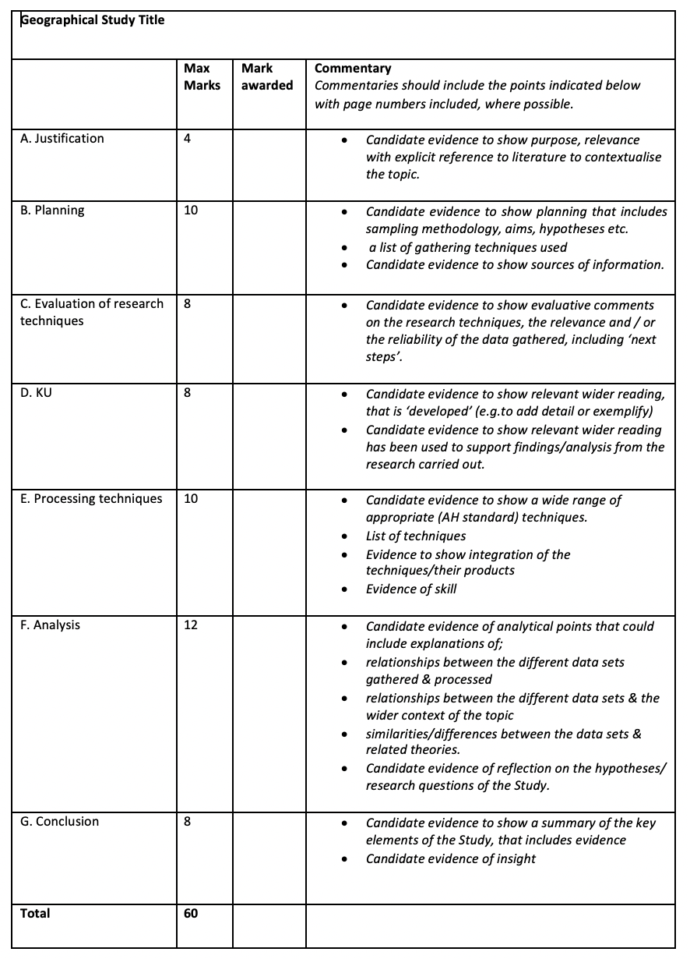
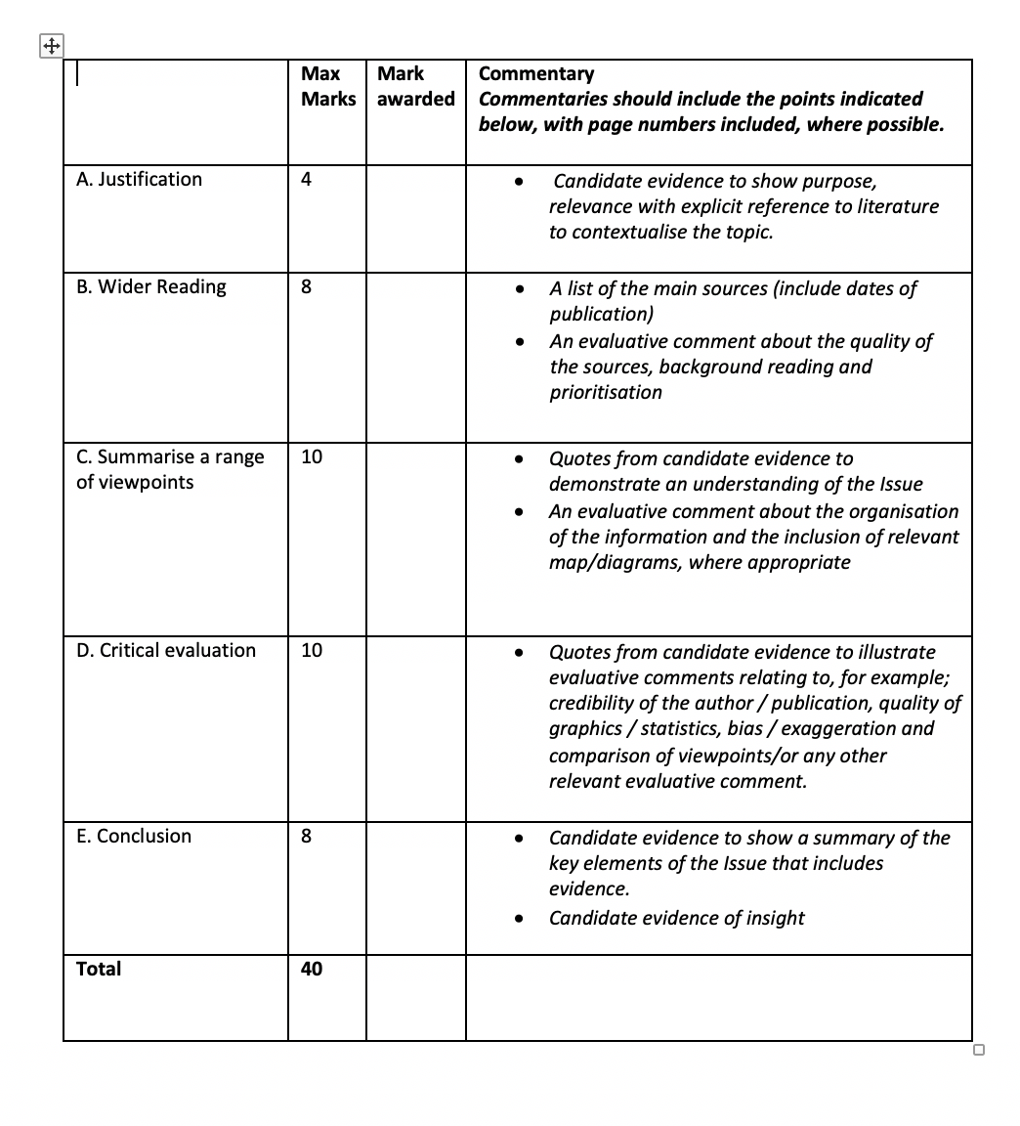


Slide 6
Introduction (continued)
Read the Study/Issue. Ask yourself questions that relate to:
knowledge and understanding and skills – are these appropriate at Advanced Higher standard?
the bibliography – is it valid, relevant and used appropriately?
the written and graphic quality of the Issue/Study in relation to word count, coherence, integration, reflectiveness and insight.

Slide 7
Step 1 – evidence
Use the marking grid, candidate study/issue and marking instructions.
Re-read the Study/Issue to identify/gather evidence (using page numbers/highlighted quotes/notes) relating to each of the general marking principles (A-G for the Study and A-E for the Issue).

Slide 8
Step 2 – applying marking instructions
Use the supported commentary for each general marking principle (GMP) to:
decide the range of marks available
decide which mark within the range most accurately reflects the candidate’s work, using the descriptors within the supported commentary to help you.

Slide 9
General Marking Principle (GMP) | Max Mark | Supported commentary
B: Plan and carry out detailed research, which could include field work | 10 | Candidates can be credited up to a maximum of 10 marks for which they should show evidence that they have planned in detail and used a wide range of techniques and sources on information. Research can, but does not have to, include fieldwork. Candidates can gain full marks without carrying out fieldwork

Slide 10
General Marking Principle (GMP) | Max Mark | Supported commentary
B: Plan and carry out detailed research, which could include field work | 10 | 8-10 marks There is clear & explicit evidence of detailed planning for research that allows for the generation of relevant & detailed hypotheses/sub-aims/research questions The evidence is supported by relevant sources of information to produce sufficient data to support good analysis The research techniques are appropriate & have been used with skill to gather data that allow relationships to be identified.

Slide 11
Candidate/commentary evidence (Study)
‘Determining whether Stirling fits a specific urban model could help to determine the most efficient way to ‘grow’ a city via adding more residential land use and/or improving the infrastructure in key areas where most needed’ (GMP A: Justification)
‘an interrupted transect with 10 selected sample sites (Fig 2) was selected to best capture the variety of land use sectors from the city centre toward the greenbelt. A larger settlement, such as Stirling, with a population of 45,750 (www. stirling.gov.uk), will allow for analytical comparisons with urban models’ (GMP B: Planning)

Slide 12
Candidate/commentary evidence (Study)
‘it was decided to use this data gathering method to simplify the process and make scoring the individual location sites more efficient, and therefore as accurate as possible’. (GMP C: Evaluation)
‘it could have been beneficial to record traffic types within categories for the traffic surveys as this would have allowed for further analysis via a Chi²’, for example. (GMP C: Evaluation)

Slide 13
Candidate/commentary evidence (Study)
‘With 1 in 6 EU citizens exposed to noise pollution and a therefore degraded quality of life in 2018’ (ec.europa.eu), exploring this was relevant to my Study in order to gain an understanding of how noise can impact on the quality of life of an environment’ (GMP D: KU)

Slide 14
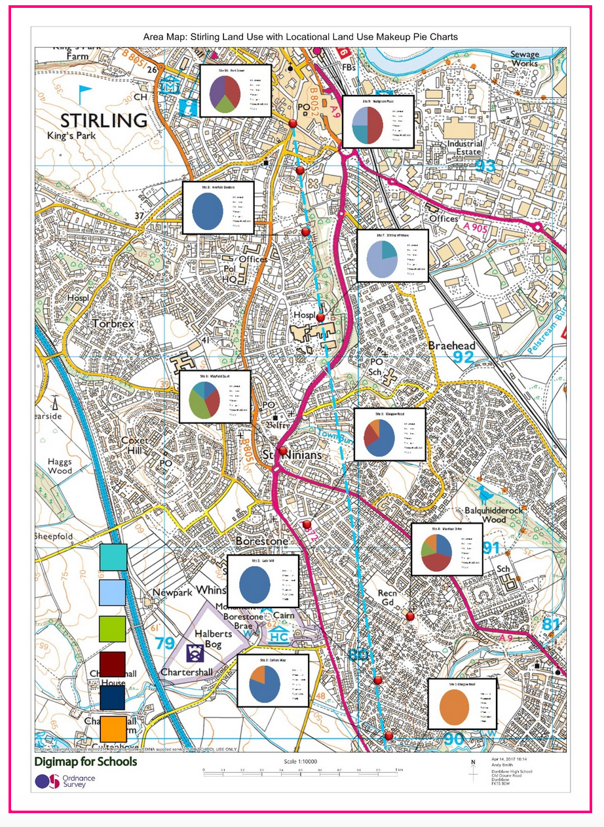
MAP-BASED DIAGRAM
Exemplification of effective integration of techniques (GMP E)

Slide 15
Candidate/commentary evidence (Study)
‘However there is an outlier/anomaly at site 8, 700 metres from the CBD but with a low level of noise (40 decibels recorded), that contributed to an overall higher than expected environmental quality. This may be the result of old Victorian style houses (Fig 10) being renovated into ‘high end’ expensive flats, with an average valuation of £469.061 (zoopla.co.uk). (GMP F: Analysis)

Slide 16
Candidate/commentary evidence (Study)
‘The overall representation of the data in this Study (land use, environmental quality, population data) shows that as distance to the city centre decreases, so too does quality of life, thus following Waugh’s model of the rural-urban continuum. The data gathered and processed also shows traits of the Burgess Concentric Zone model in that Stirling shows specific zones of land use that differ significantly across the urban transect with each showing its own resulting quality of life’ (GMP G: Conclusion)

Slide 17
Candidate/commentary evidence (Issue)
The reintroduction of beavers, whether legal or not, has stirred much controversy. The beaver’s significant effect on the surrounding environment has many positive and negative impacts and the government, environmentalists, farmers, anglers and landowners all have their share of opinions on whether the species should be allowed to stay. The following articles explore these opinions and present the many viewpoints of this controversial issue. (GMP A)

Slide 18
Candidate/commentary evidence (Issue)
Source 1: Warwick, Hugh ‘Should we cull grey squirrels so save the native red?’ 28th November 2016 [online] available: http://www.theguardian.com/commentisfree/2016/nov/28/cull-grey-squirrels-save-native-red
Source 2: Flanagan, Padriac ‘Prince Charles backs plan for grey squirrel cull.’ 9th May 2016 [online] available: http://www.telegraph.co.uk/news/earth/environment/conservation/10818545/Prince-Charles-backs-plan-for-grey-squirrel-cull.html
Source 3: Stephen Harris, Carl D. Soulsbury, Graziella Iossa ‘Is culling of grey squirrels a viable tactic to conserve red squirrel populations?’21st June 2016 [online] available: http://www.onekind.org/uploads/publications/0811_grey_squirrel-populations.pdf
(GMP B)

Slide 19
.ac.uk/biology/people/stephen-harris/index.html
Figures:
Figure 1: www.naturalforestpractice.com
Figure 2: http://rsst.org.uk/about-us/faqs/
Figure 3: http://animals.pawnation.com/DM-Resize/photos.demandstudios.com/getty/article/144/190/stk105937cor.jpg?w=600&h=600&keep_rati=1&webp=1
Figure 4: http://www.telegraph.co.uk/news/uknews/theroyalfamily/8331024/Prince-of-Wales-in-bid-to-save-red-squirrel.html
Candidate/commentary evidence (Issue)
Footnotes 1,2,3,4,5,11 and 12: Red Squirrel Survival Trust website [online] available: http://rsst.org.uk/
Footnote 7: Brenda Mayle, Mark Ferryman, Harry Pepper ‘Controlling Grey Squirrel Damage to Woodlands’ August 2007 [online] available: http://www.forestry.gov.uk/pdf/fcpn004.pdf/$file/fcpn004.pdf
Footnote 10: ‘Grey Squirrels and England’s Woodlands: Policy and Action’ PDF file [online] available: http://www.forestry.gov.uk/pdf/greysquirrel-policy.pdf/$file/greysquirrel-policy.pdf
Figure 1: www.naturalforestpractice.com
Figure 2: http://rsst.org.uk/about-us/faqs/
Figure 3: http://www.telegraph.co.uk/news/uknews/theroyalfamily/8331024/Prince-of-Wales-in-bid-to-save-red-squirrel.html

Slide 20
Candidate/commentary evidence (Issue)
Firstly the opinion of the British government is presented …..
beavers represented a health hazard because of the risk of “tapeworms sometimes found in beavers in continental Europe”.
The article includes the opinion of Derek Gow, an ecologist, who also is in favour of beaver reintroduction and believes the beaver is “an essential keystone species that is vital for creating the kind of complex wetlands that support a greater biodiversity”. Werth also explores arguments against beaver reintroduction in the article…
The article concludes with a viewpoint presented by A. L Jones from the Welsh Beaver Project ….. (GMP C)
.

Slide 21
Candidate/commentary evidence (Issue)
Throughout the articles there is a highly noticeable lack of statistical evidence. The writer uses very few figures to back up their arguments which somewhat weakens the credibility of the articles, but compensates by using some anecdotal evidence and quotes from experts in their field, such as ……..
The source is presented to the reader by way of a neutral perspective which in turn removes any bias and adds weight to the writer’s line of argument. Furthermore the writer does not exaggerate points but presents facts and opinions in a rational way that does not include any personal opinions or emotions.
The writer uses statements from scientists working on research projects, relating to the reintroduction of beavers to reinforce his viewpoint that beavers cause disruption to the upstream and downstream migration of fish.
For example……. (GMP D)

Slide 22
Candidate/commentary evidence (Issue)
In conclusion, the reintroduction of beavers to the UK is a highly controversial topic on which there are many differing views and opinions. Sources one, two and three present some of these views and opinions and do so with very different styles and degrees of success
In comparison to source one, source two……..
S&TA have come to the conclusion that beaver reintroduction would indeed be beneficial but would need “specific management.” This is an opinion I personally agree with. Reintroduction should take place due to the significant monetary benefits to the local economy and the positive impacts it has on biodiversity. However reintroduction needs to be managed as we must accommodate the needs of anglers and farmers who rely upon the surrounding landscape for their livelihoods.
(GMP E)

Slide 23
Other additional sources of support for project-folio
There are examples of candidate responses for the project–folio, along with associated commentaries, on SQA’s Understanding Standards website.
There is a project–folio webinar (five files) which can be accessed from the Advanced Higher Geography subject page, under the ‘Understanding Standards’ tab.
Any questions may be sent to Joan Highton (Subject Implementation Manager) - joan.highton@sqa.org.uk

